Slide 1
Incorporating Anti-Racism into Curricula
July 2023

Slide 2
Logistics
Up to 1.0 CPH recertification credit
Slides & recording on website within 24 hours

Slide 3
Access this and past presentations

Slide 4
Questions? Comments?

Slide 5
What’s on the agenda?
Panelists
Q&A session

Slide 6
Up Next: Panelists

Slide 7
Public Health is Social Justice
Stephanie Miles-Richardson, DVM, PhD
Professor and Chair, Department of Public Health Education
Associate Dean, Graduate Education in Public Health
Director, Master of Public Health Program
Morehouse School of Medicine, Atlanta, GA

Slide 8
Public Health at Morehouse School of Medicine (MSM)
First accredited public health program at an Historically Black College and University (HBCU) – 1999
Community-focused generalist curriculum
Average 23-25 students per cohort
Primary Faculty – 6
Administrative Support Staff – 6

Slide 9
What is Public Health?
Assuring conditions in which people can be healthy.
Organized community efforts aimed at the prevention of disease and the promotion of health.
Preventing disease, promoting life and promoting health through organized community effort.

Slide 10
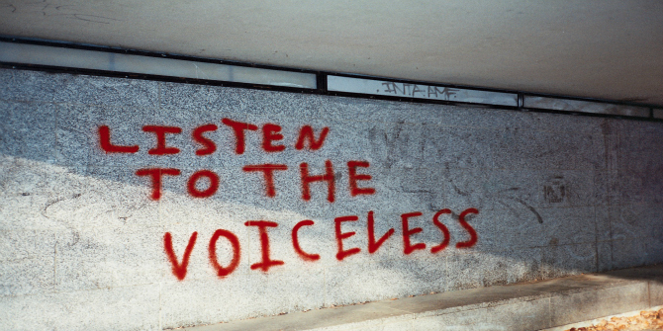
Operationalizing Public Health– Social Justice
Social justice seeks to address social determinants: i.e., social, economic, biological, genetic, behavioral, physical, healthcare, culture, and political.
Social justice encompasses issues beyond health, such as poverty, discrimination, human rights, and access to resources and opportunities—which contribute to positive or negative health outcomes.
The ultimate goal of public health is to ensure that all individuals have the opportunity to lead healthy lives.

Slide 11
MSM’s mission makes it easy!
We are an MPH program in a private institution.
Our vision is to lead the creation and advancement of health equity.

Slide 12
It all starts with Community…
Community health course is required for all.
Community-based windshield surveys assure an accurate understanding of community assets and deficits.
Public health interventions must be aligned with findings from the windshield survey.
Master’s research must be aligned with data from the community.

Slide 13
Developing a health equity lens through the socio-ecological model of health
https://apps.carleton.edu/ccce/issue/health/public-health-in-practice/?module_api=image_detail&module_identifier=module_identifier-mcla-ImageSidebarModule-mloc-sidebar-mpar-da9af63edc444779df2c954dfc8d4d40&image_id=1286677

Slide 14
Course/Language Examples
From Site Visit Report (D2): Competency 14 is mapped to an infographic assignment in MPH 508. During the site visit, the faculty member who teaches the course explained that in the first semester of their first year, students conduct a windshield survey of a local community. Students determine the specific needs of that community, including political, economic, or demographic issues, and focus on that community throughout their time in the program. Based on the community’s specific need, students create an infographic advocating for a solution to an identified need. The infographic is targeted at community partners. For example, in certain neighborhoods around Atlanta there is limited access to the public transportation system, Marta, because stations are distant or trains run infrequently. In this example, the student created an infographic on the need for Marta to run more frequently.

Slide 15
Windshield Survey
A windshield survey is a method of collecting data by simply observing the community while driving a car or riding public transportation.
Common characteristics of the community that might be observed are: people on the street, neighborhood gathering places, and the rhythm of community’s life, housing quality, and geographic boundaries.
Directions: Based on your visual observation as you walk or drive through your community, complete as many of the following questions as possible.

Slide 16
Environment
Physical environment
Community location (boundaries, urban/rural):
Prominent topographical features (green space/parks):
Housing (type, condition, adequacy, number of persons per dwelling, sanitation):
Businesses (nonprofit and for profit):
Safety hazards present in the environment (lack of speed bumps):
Day care facilities:
Sewage and waste disposal:
Nuisance factors (loud music, airports, wastewater plant):
Potential for disaster:

Slide 17
Psychological environment
Prospects for the community:
Significant events in community history (e.g. dismantling of public housing):
Interaction of groups within the community (racial tension, etc):
Protective services (adequacy, local crime rates, insurance rates):
Communication network (media, informal channels, and links to outside world):
Sources of stress in the community:
Extent of mental illness in the community:

Slide 18
Social environment
Race and Ethnicity:
Education (prevailing levels, attitudes, facilities):
Government (type, effectiveness, and community officials):
Unofficial leaders (significant informants):
Political affiliations of community members:
Status of minority groups (influence, length of residence):
Language spoken by community members:
Community income levels (poverty, coverage by assistance programs):
Religion (major affiliations, programs and services, influence on health):
Culture (affiliation, influence on health):
Employment level:
Transportation (type, availability, cost, use):
Social service (type, availability, adequacy, use):

Slide 19
Lifestyle
Consumption patterns
Nutrition (general levels, preference, special needs, prevalence of obesity):
Alcohol (consumption patterns, extent of abuse, advertisement):
Drug use (legal and illegal):
Smoking (consumption patterns, advertisements):
Exercise (extent, type):
Occupational
Primary occupations of community members
Major employers:
Occupational hazards:

Slide 20
Health and Safety/ Health System
Safety (use of cross walks, jaywalking)
Use of safety devices (seat belts, car seats, helmets):
Community attitudes towards health (definitions, support of services):
Health services and resources (type, availability, cost, adequacy, utilization):
Personal care (availability: clinic, WIC, Planned Parenthood offices):
Emergency services (availability, adequacy):
Health education services (availability, adequacy):
Health-care financing (extent of insurance coverage, Medicaid, Medicare,etc)

Slide 21
Key Takeaways
Focus on community assets and deficits
Determinants drive health outcomes, thus interventions
Remember, public health is social justice

Slide 22
Incorporating Anti-Racism into Curricula
Council on Education for Public Health
Brenikki R. Floyd, PhD, MPH
Associate Dean for Community Engagement
Director, Collaboratory for Health Justice
July 19, 2023

Slide 23
Overview
UIC-SPH Academic Profile
School-wide Assessments
CEnT at UIC-SPH: Epidemics of Injustice

Slide 24
UIC - SPH Academic Profile

Slide 25
UIC - SPH Academic Profile: Degrees + Concentrations
Undergraduate
BA = 50
EOHS = 42
MS
EOHS = 4
MHA
HA = 73
EHA = 27
PhD
Epidemiology = 7
CHS = 31
EOHS = 8
Epidemiology = 29
Epidemiology
= 102
HPA = 98
HPA = 7
HPA = 13
DrPH
CHS = 125
MPH
BS = 36
PH Leadership = 115
Biostatistics = 24
Biostatistics = 13
Biostatistics = 12
Global Health* = 20

Slide 26
SPH Divisions
Community Health Sciences
Epidemiology/Biostatistics
Environmental and Occupational Health Sciences
Health Policy and Administration

Slide 27
School-wide Assessments

Slide 28
Incorporating Culturally Responsive Themes in UIC SPH Classes
SPH Strategic Plan Goal 2: Prioritize and cultivate a commitment to health equity, social justice and diversity and inclusion
Objective 2.1: Increase/enhance curricular content related to cultural competence/humility and the advancement of health equity, social justice and diversity and inclusion
Metric: # and % of courses that include cultural competency/humility, health equity and/or social justice as reflected in the syllabus (including community members)
Data sources: 1) Faculty Alignment Survey (self-reported annually)
2) UIC SPH Committee on Education Programs review syllabi

Slide 29
UIC-SPH Faculty Alignment Survey
Administered to all faculty with an appointment in SPH
Key Question:
“Did you integrate any of the topics listed below in your course(s) this year? If yes, please enter the course(s) in the space provided (e.g., HPA 593) and briefly describe how this was done. Select all topics that apply [cultural competence/humility, health equity, social justice, and/or diversity and inclusion.”

Slide 30
Alumni & Stakeholder Data Collection Process
1 FTE Academic Affairs with communication support of academic coordinators + division directors + 1 IT
staff person
Alumni
Stakeholder
Job Placement Survey (annual)
Exit Survey (annual)
Alumni Competency Survey (once every 3-5 yrs)
1 FTE Executive Affairs
Partner Advisory Board qualitative feedback

Slide 31
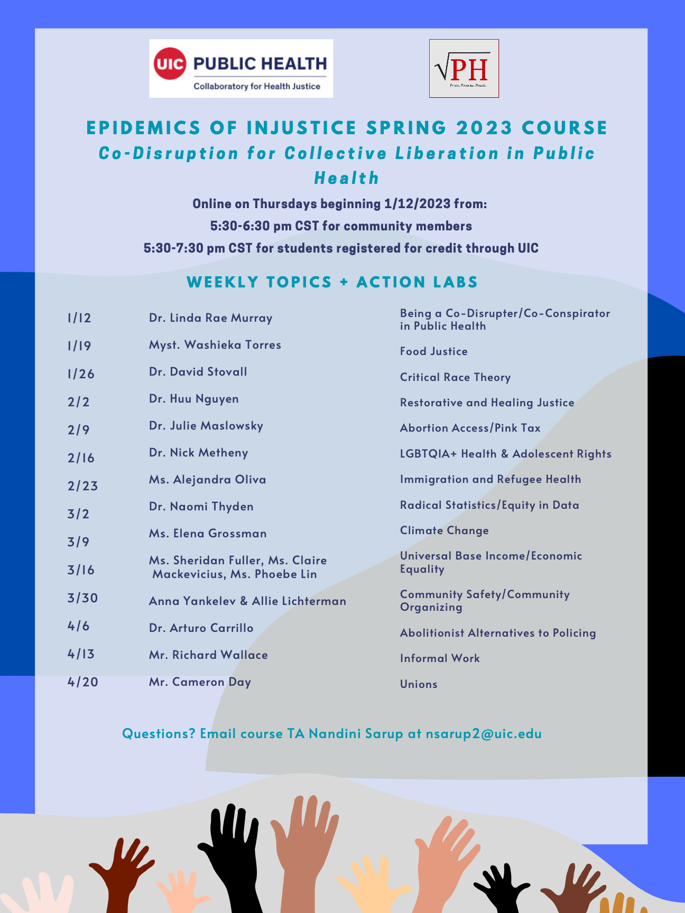
Community-engaged Teaching: Epidemics of Injustice

Slide 32
Epidemics of Injustice
Co-created by members of Radical Public Health and SPH graduate students and faculty who were brought together in 2018 by a sense of urgency to address ongoing threats to democracy, social justice, and the public’s health.
This course focuses on the historical, social, cultural, and political factors related to the historical and contemporary health, and the historical and contemporary resistance and rebellion through public health, as seen through interdisciplinary and cross-movement work.
This course provides a historical understanding of structural and socioeconomic determinants of health and points to both modern and historical examples of how we can leverage our work for advocacy.
Through guest lecturers and action labs, students learn from others’ experiences and workshop tangible skills that will prepare them to engage in action and advocacy with others across disciplines and sectors.
Supported by the Collaboratory for Health Justice (CHJ)

Slide 33
Class Format
Two credit-hour course taught during the spring semester
Initially taught in-person but transitioned to virtual due to the pandemic
Course length: 2 hours (5:30 PM – 7:30 PM CST)
Guest Speaker Session: first hour we host guest speakers to present to the class and community members are invited to join.
Discussion Session/Action Lab: second hour UIC enrolled in the course engage in planned discussions or action labs.
Guest speakers: community members, UIC faculty
Course materials accessed using Blackboard for UIC students and Google Classroom for community members
Action lab: For the action labs, the instruction team worked with the guest speaker or with another individual or organization who does work on the same topic to plan an engaging activity.
Examples include creating infographics for #DeeperThanWater to use on their social media for the purpose of educating individuals about inequities related to prison health. Action labs can also include art, meditation, and interacting with case studies.

Slide 34
E of I Course Assignments
Reflections
Midterm Book Report
Final Assignment
Engagement Activity
Write short reflections bi-weekly on readings, speaker and/or action labs; different formats encouraged (e.g., written, short video, audio note)
Attend an event or engage in an activity outside of class where they can learn about advocacy or engage in direct action at least once over the course of the semester
Conduct a critical analysis of a book that explores topics related to systems of oppression and power structure dynamics including any social and structural determinants of health; purpose is to examine the historical context and the extent to which these social and structural drivers impact health inequities and social injustices
Create and share a piece of work that integrates a specific topic or strategy from the course with a specific advocacy tool

Slide 35
E of I Implementation Cycle
End of semester course reflections
Identify course instructor(s) + Instructor of Record if needed
Identify course theme
Identify course speakers
Guest speaker outreach
Identify TAs
Plan Action Labs
Finalize course materials
Promote course
Launch Course

Slide 36
Spring 2023 Instruction Team Disruption for Collective Liberation in Public Health
Washieka Torres (she/her), Doctoral Instructor
Nandini Sarup (she/her), Teaching Assistant
Katie O’Connell (she/her), Teaching Assistant
Washieka Torres is a disability rights scholar, activist, and documentarian. She is from the South Bronx in New York City and is currently a third-year Ph.D. student in the Disability Studies Program at UIC. She is a documentarian, researcher, and public speaker. Her work explores the intersections of poverty, disability, food insecurity, and food justice. Her current projects focus on disabled cooking methods, meaning, and knowledge translation.
Nandini Sarup (she/her) is a second year MPH student in the Health Policy and Administration division with a concentraton in Global Health. Her work is focused on research-based bladder health and HIV prevention and care for underserved communities and priority jurisdictions. Nandini's research interests include HIV policymaking, health equity, and climate change.
Katie O'Connell (she/her) is a first year MPH student in the Community Health Sciences division. She has experience working in the mental health field and her interests include queer public health, medication and drug use, health insurance, and the social determinants of health.

Slide 37
Google Classroom

Slide 38
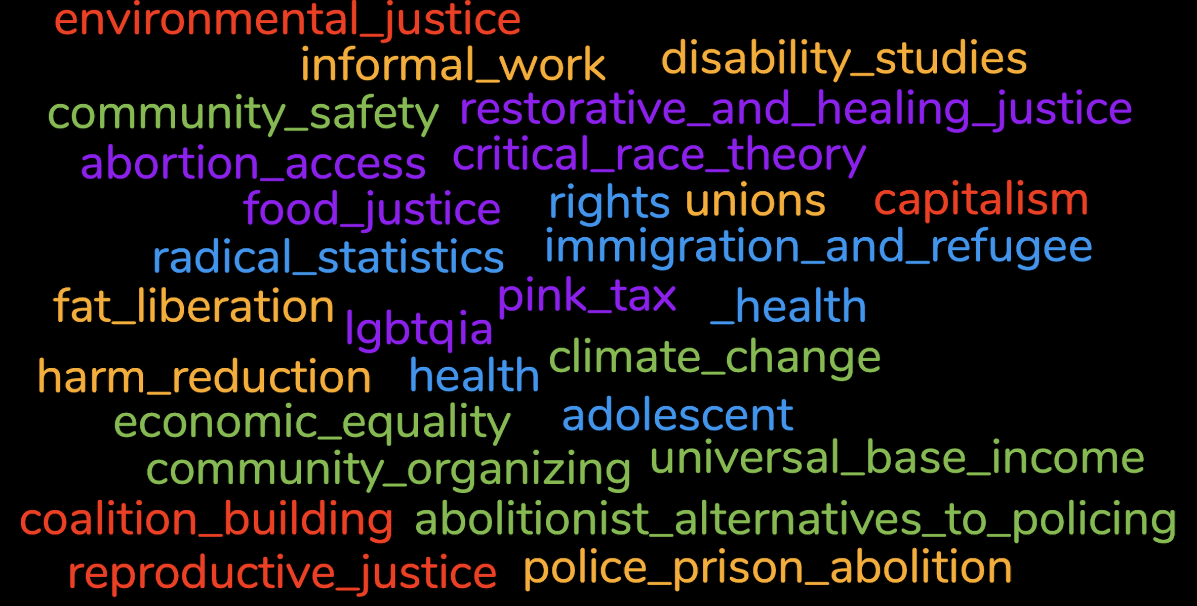
Past Guest Speaker Topics

Slide 39
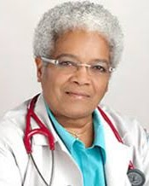
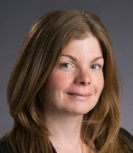
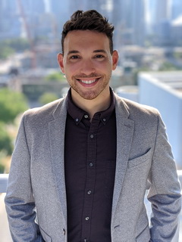
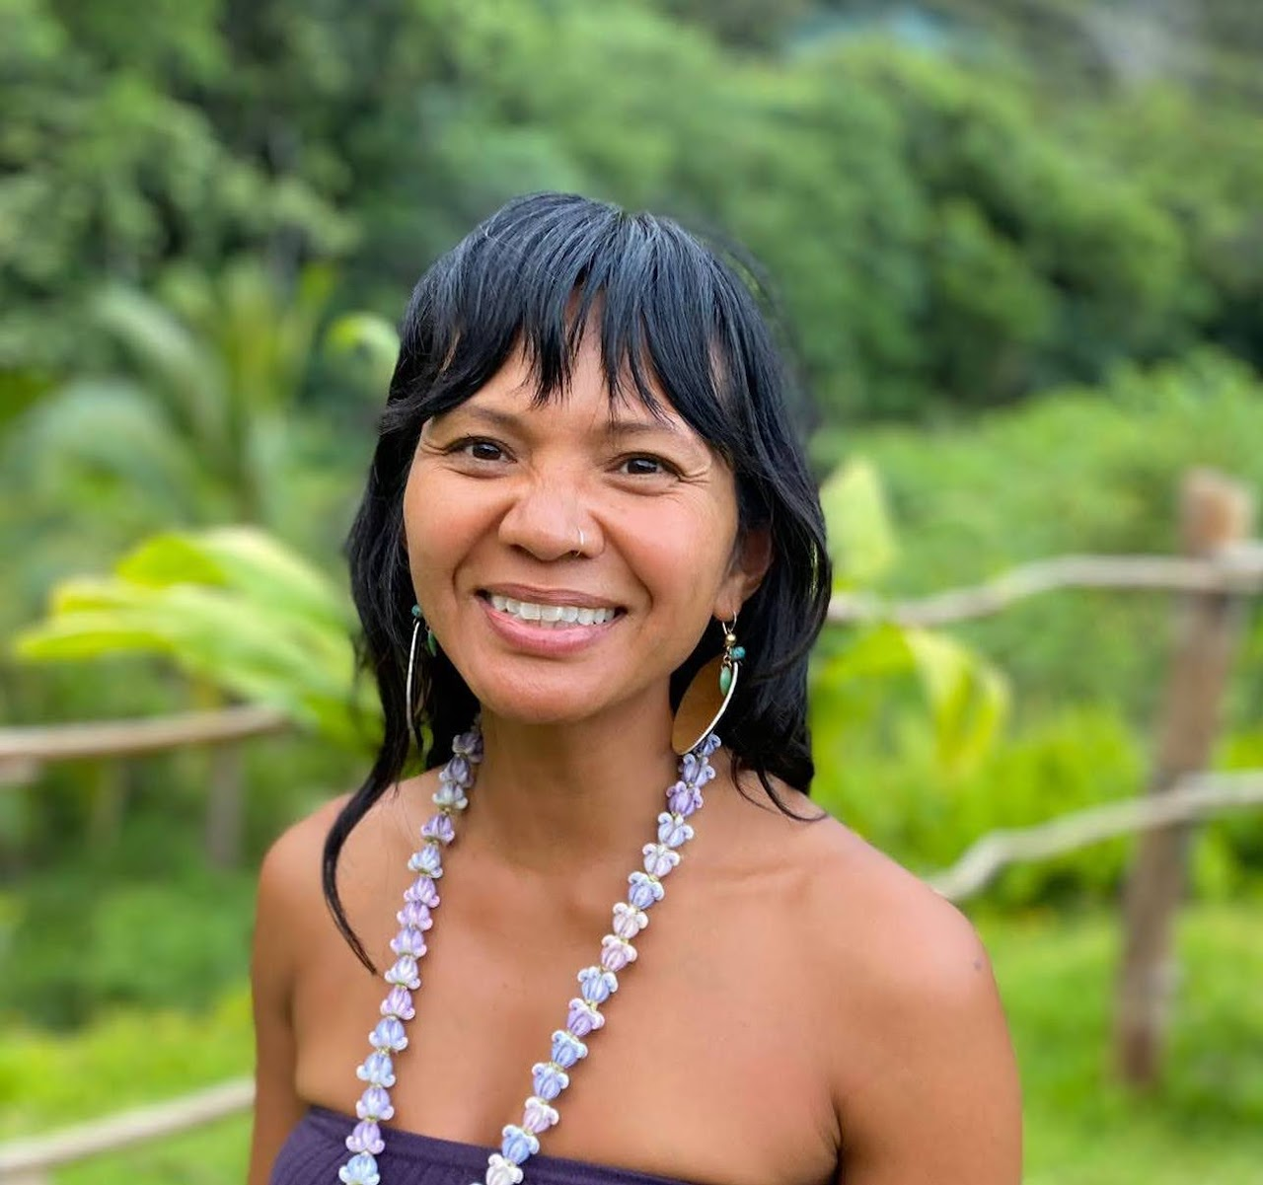
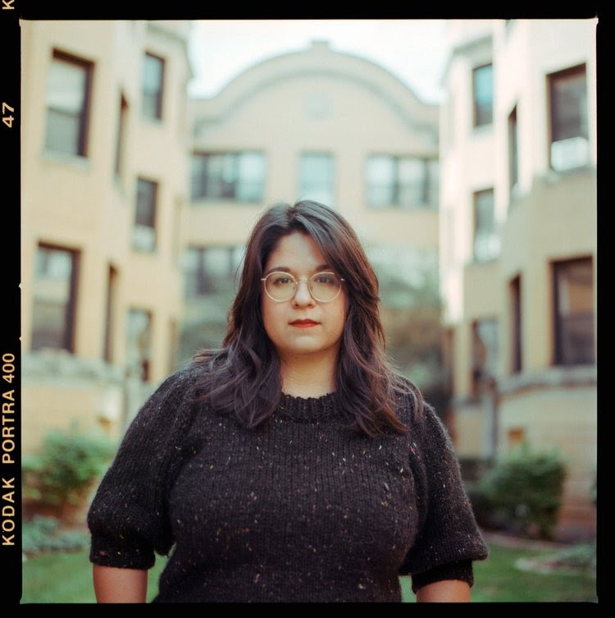
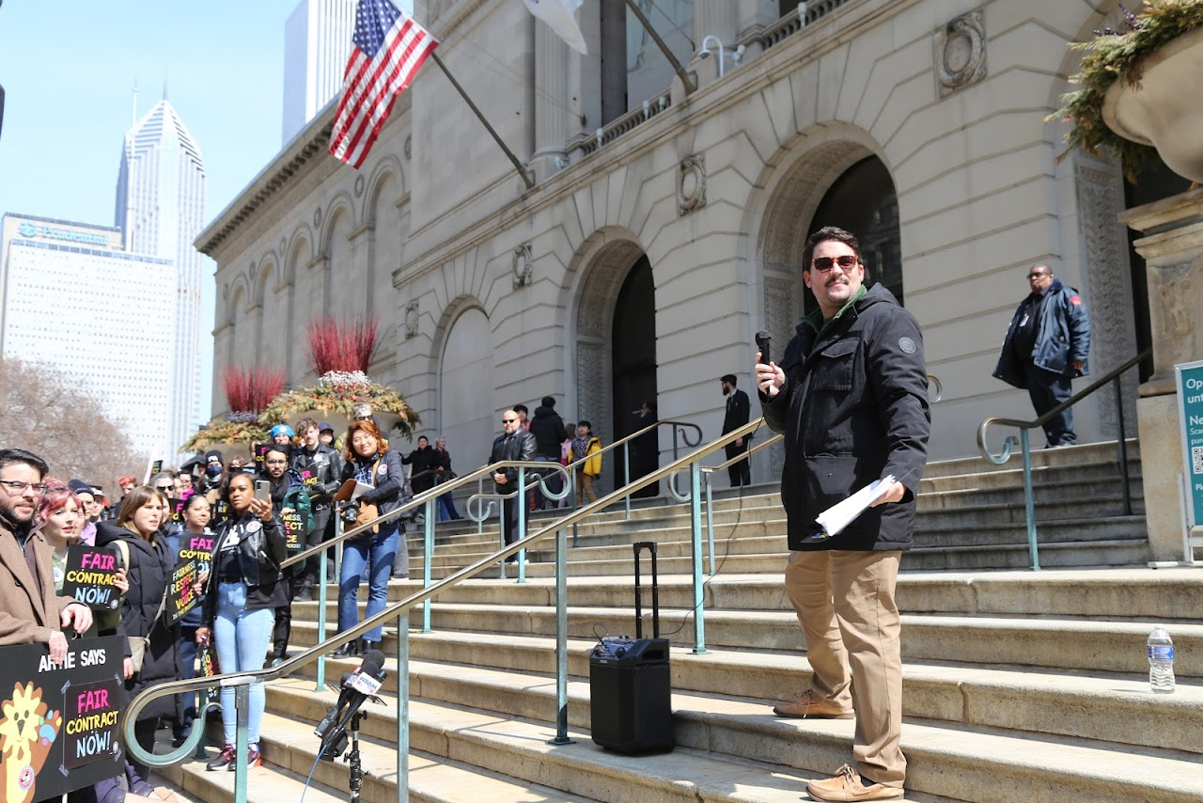
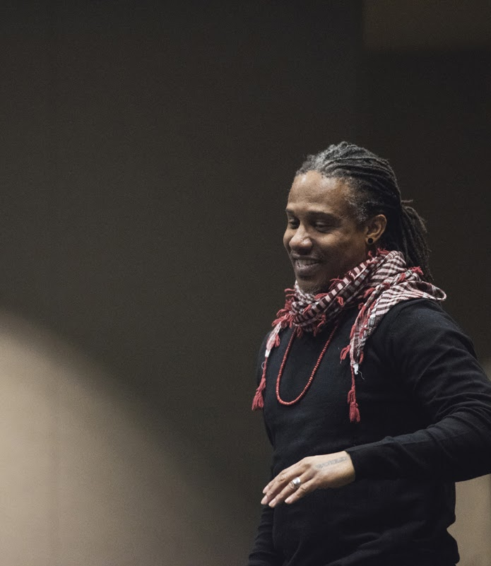
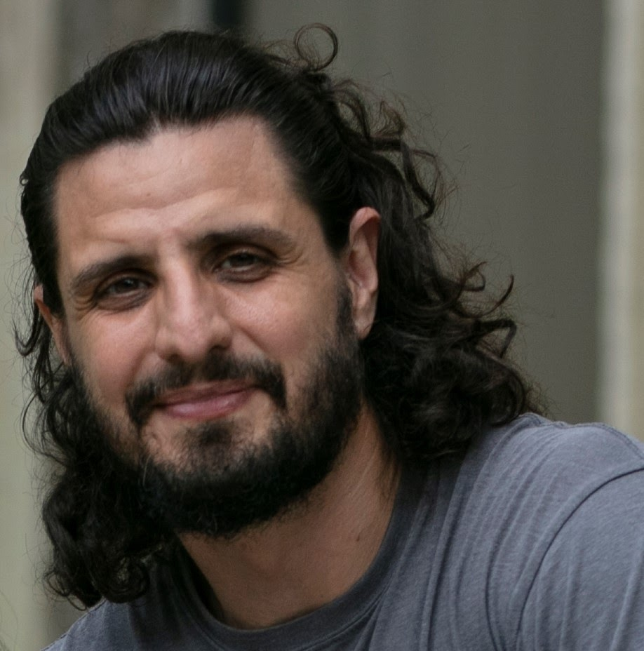
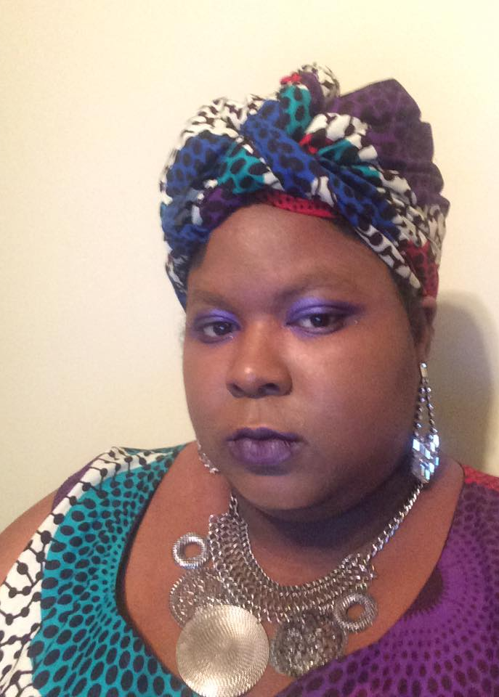
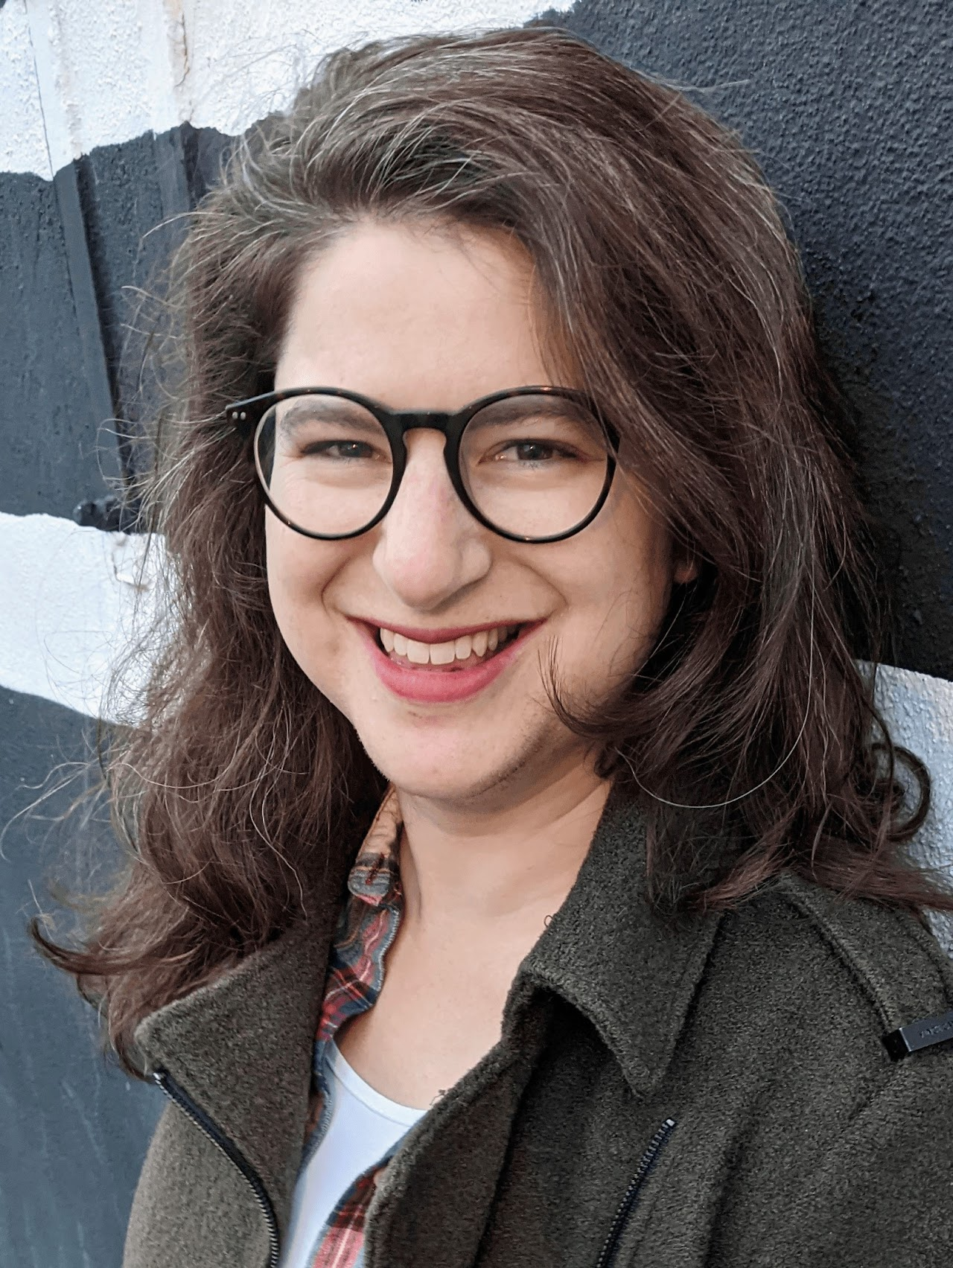
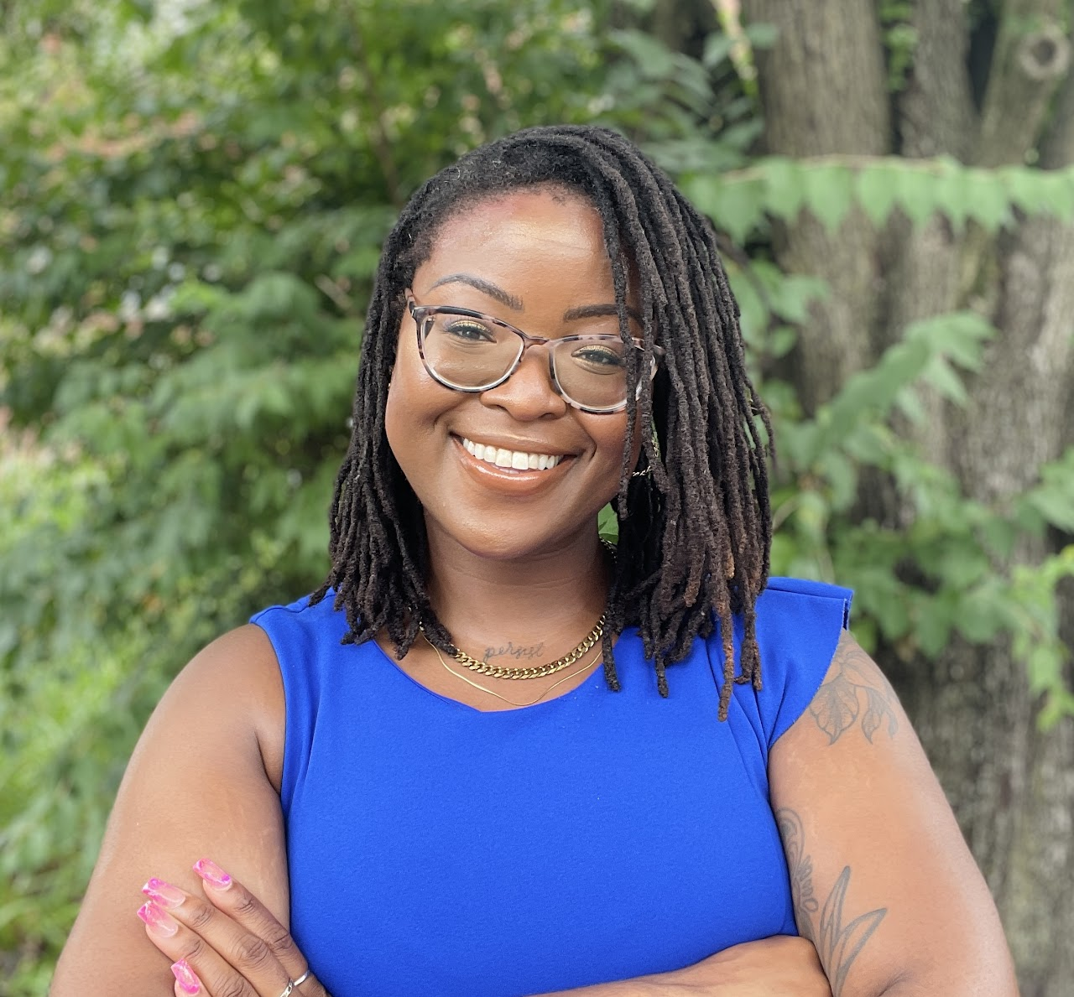
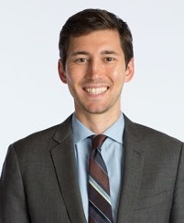
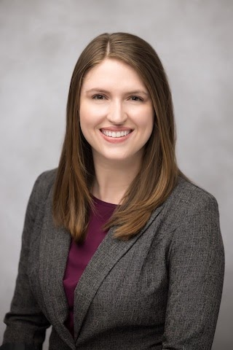
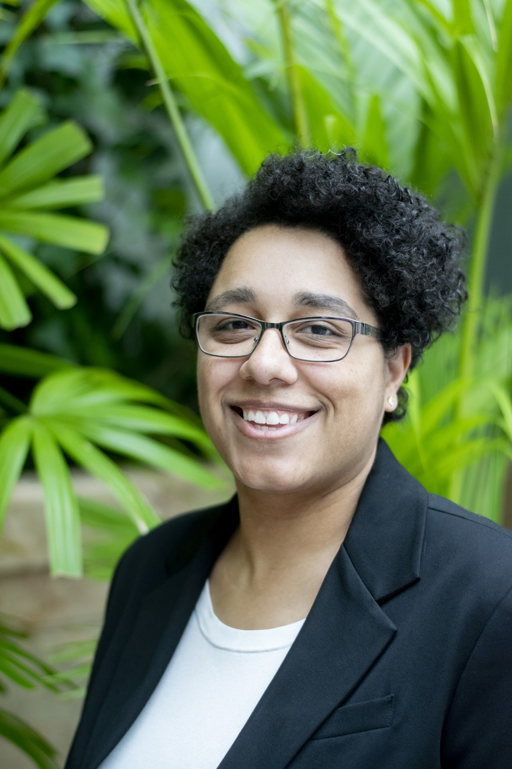
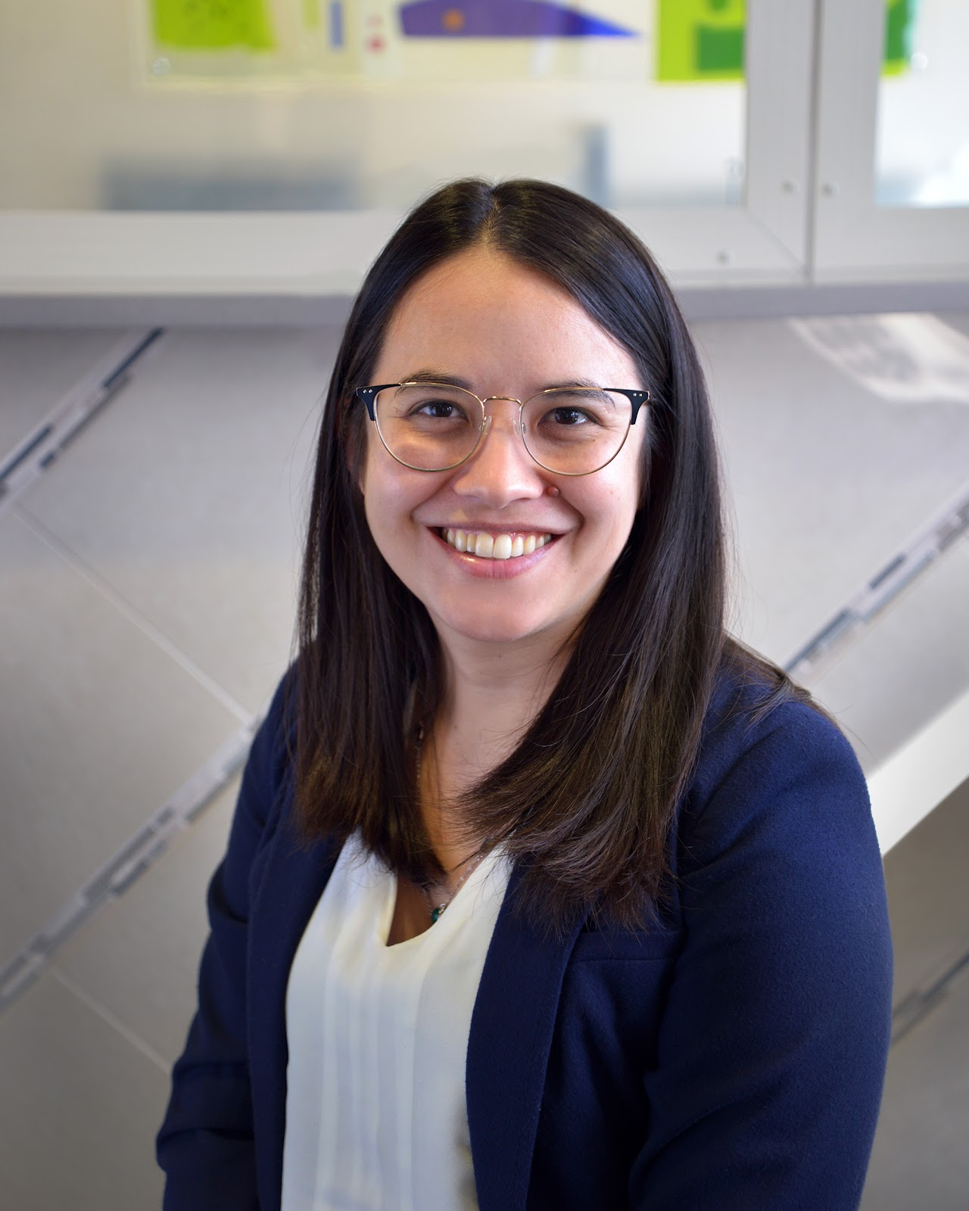
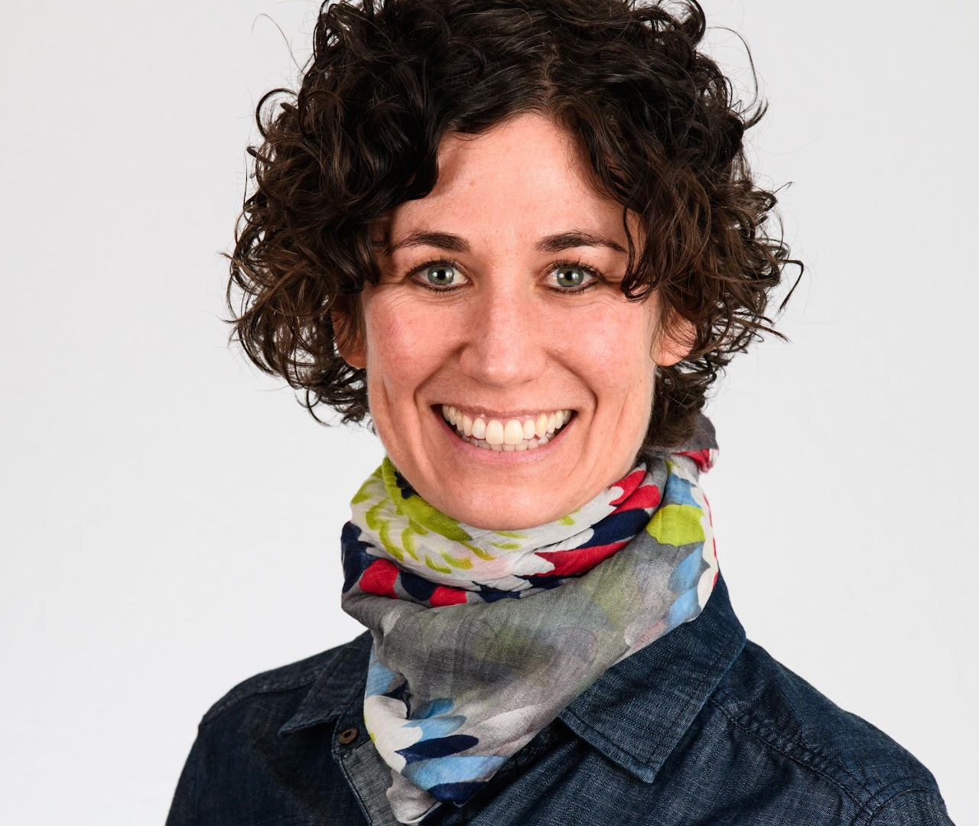
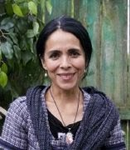
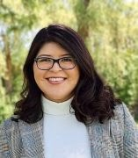
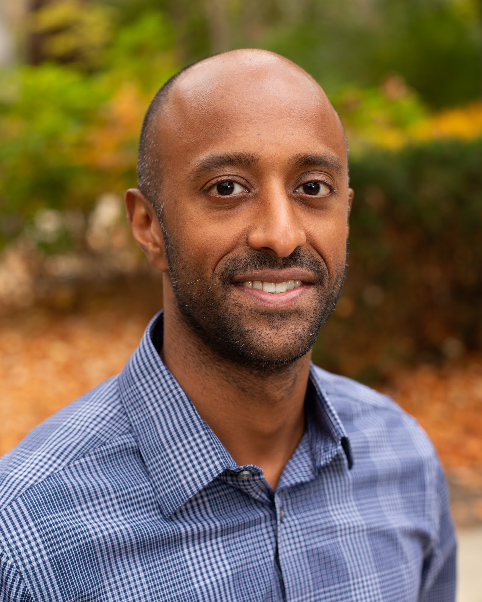
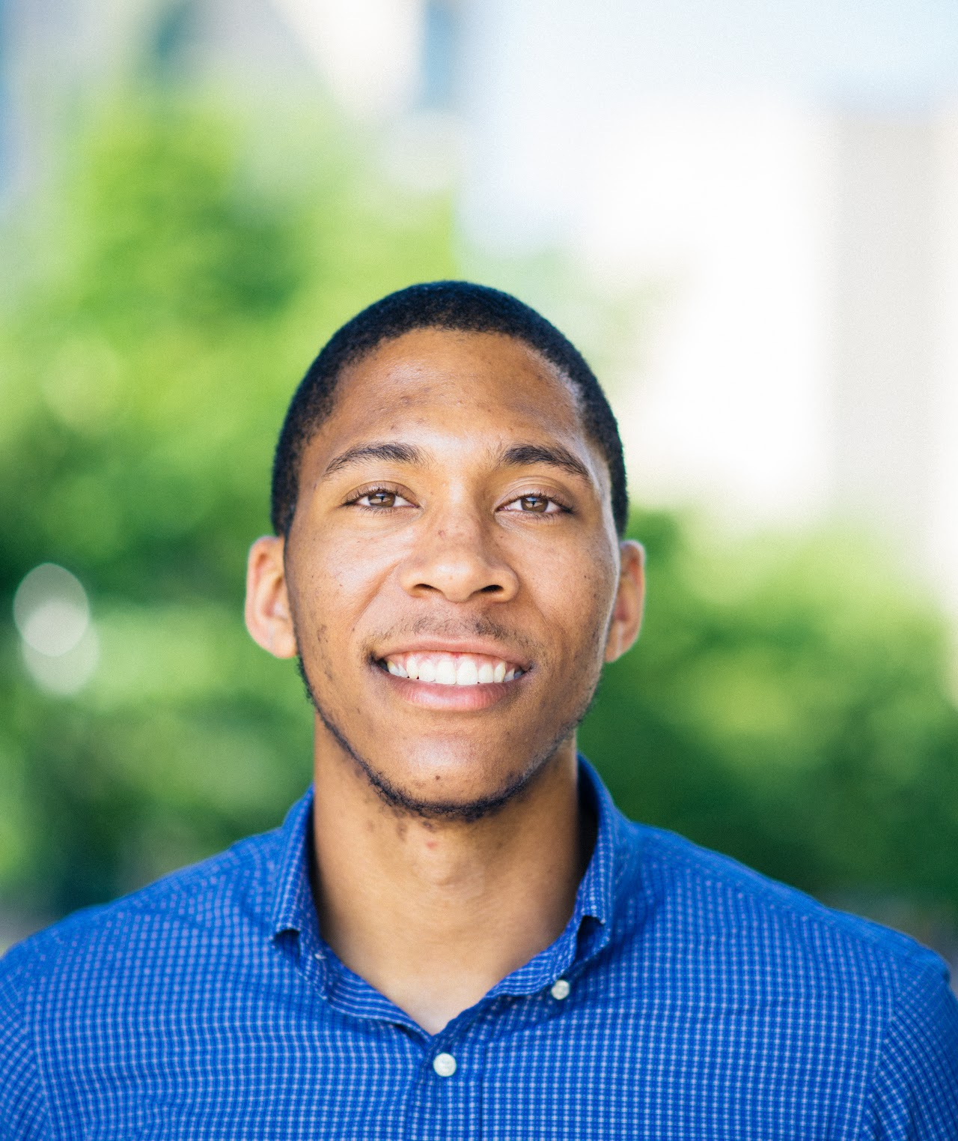
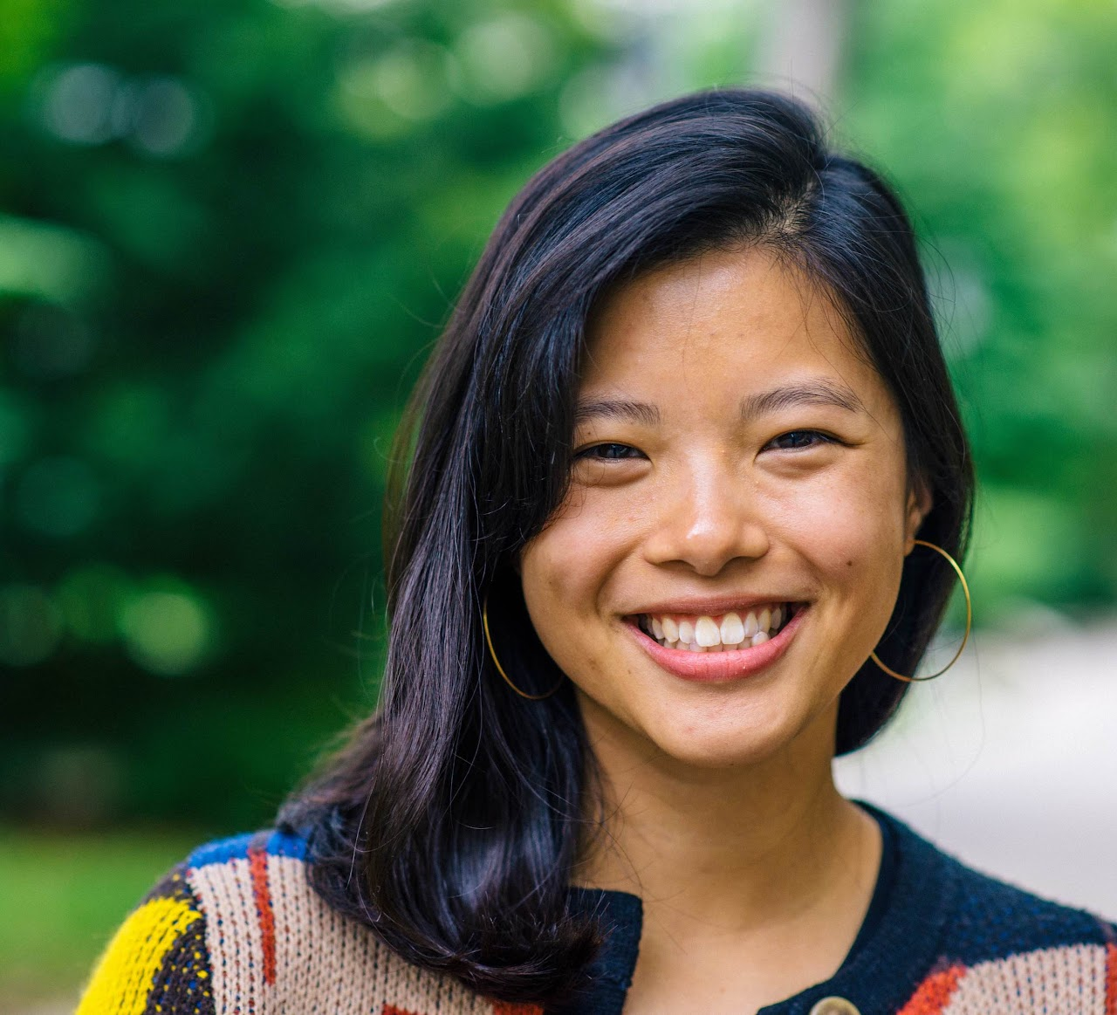
Epidemics of Injustice Spring 2023 Guest Speakers

Slide 40
Attendance throughout the years
2018 | 2022 | 2023
7 lectures | 14 lectures | 14 lectures
300 registrants total | 648 registrants | 692 registrants
150 attendees total | 449 attendees | Evaluation in process

Slide 41
Thank You!

Slide 42
Up Next: Q&A

Slide 43
Thank you to our presenters!
Stephanie Miles-Richardson, DVM, PhD Department of Public Health Education Morehouse School of Medicine smiles-richardson@msm.edu
Brenikki Floyd, PhD, MPH School of Public Health University of Illinois, Chicago brfloyd@uic.edu

