Slide 1
Thank you for joining us
The webinar will begin soon!

Slide 2
Successful Interim Reports: Specific & Responsive
May 3, 2023

Slide 3
Logistics
Up to 1.0 CPH recertification credit
Slides & recording on website within 24 hours
FAQs and Webinars page

Slide 4
Access this and past presentations

Slide 5
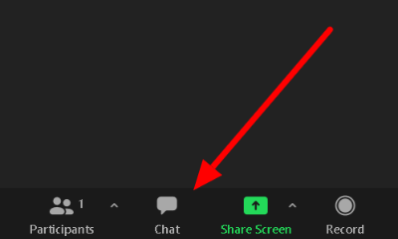

Slide 6
What is an interim report?
Evidence of compliance with one or more criteria as a result of the Council finding non-compliance
* Only applicable to accredited units (not applicants)

Slide 7
Where do interim reports come from?
Full reviews
Annual reports
Previous interim reports
Substantive change notices
Additional information requested by the Council
Other (e.g., complaint, credible media report, info from another agency, etc.)

Slide 8
What’s in an interim report request?
Council provides rationale for determination of non-compliance
Council always defines a specific scope and due date
Each issue aligns with a specific criterion
May address one or more criteria
Let’s look at some examples…

Slide 15
What can the Council do?
Accept interim report as evidence of compliance – issue is resolved
Accept interim report as evidence of compliance – require new interim report to monitor further progress
Reject interim report – explain outstanding issue(s) & require another interim report

Slide 16
What are the consequences of continued non-compliance?
Council can
Require call and/or consultation visit with staff
Require focused or full accreditation review
Confer probationary accreditation
Revoke accreditation

Slide 17
How many are reviewed?
In 2022, the Council reviewed 80+ interim reports
One or more issues of non-compliance in each
43% required another interim report, a new interim report, and/or more explanatory language in the letter
Leads to lots of work for everyone!
43%

Slide 18
How does my school/program respond?
Use CEPH-provided template!
Focus on specific facts and actions taken
Who took specific actions?
When was a decision made or action implemented?
Provide specific supporting info to help Council verify compliance
X

Slide 20
What should I avoid?
Re-writing a section of the self-study
Summarizing past activities already deemed non-compliant
Extraneous or lengthy appendices
Topics beyond the scope of the Council’s request

Slide 21
Example 1

Slide 22
Example 2

Slide 23
Example 3

Slide 24
Example 4

Slide 25
Example 5

Slide 26
Consult CEPH resources
FAQs
Graduation rates
Post-graduation outcomes
Presentations & webinars
Evaluation strategies
Stakeholder data
Writing & assessing concentration competencies
Cumulative, integrative & practice-based experiences

Slide 30
Help us help you!
Ask your staff contact to review a draft of your interim report
Set up a short phone call: can provide greater clarity and context than an email for you & staff contact
Seek clarification if you have questions
Think like a reviewer – are your materials clear, direct, and easy to navigate?

