Slide 1
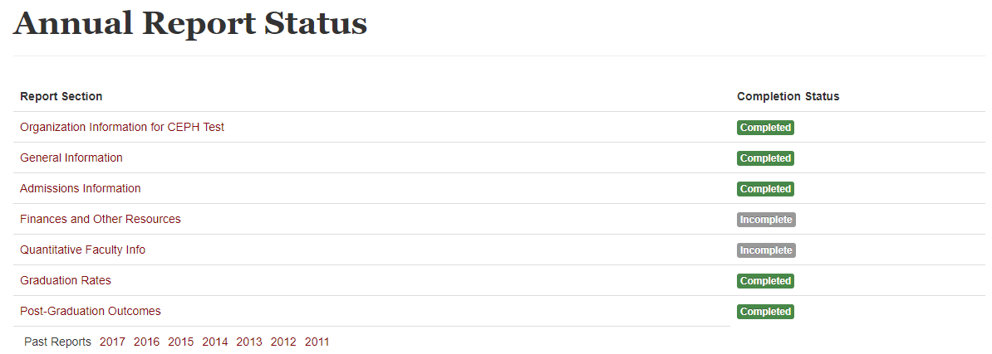
Reporting Home Page
Notes:
This next section is one that many units struggle with each year, so we will take our time filling this out.

Slide 2
Graduation Rates
MTTG: Maximum Time To Graduate
Every accredited program must set this for each degree type or degree level
For East-West State
MPH: 5 years
DrPH: 6 years
This is incredibly important because the MTTG indicates what cohort of students you will report on
Notes:
Every accredited program must set a maximum time to graduation for each degree type or degree level. As you can see here, East-West has designated a 5 year max time to graduate for the MPH program and a 6 year max time to graduate for the DrPH program.
These numbers are important to keep in mind for reporting purposes.

Slide 3
Graduation Rates
Current Reporting Year: AY 2017-2018
What cohort do we report on for MPH?
Let’s Count
2017-2018 – Year 5
2016-2017 – Year 4
2015-2016 – Year 3
2014-2015 – Year 2
2013-2014 – Year 1
Notes:
To figure out what entering cohort we are reporting on, we will need to count backwards.
I know that for my MPH, we have a max time to graduate of 5 years. The easiest way for me to do this is to write it out. I know that the reporting year is year 5, because I need to report on the cohort who reached their max time to graduate during this reporting year.
Then, I can use this information to count backwards.
I know then that 2016-17 was year 4, 2015-16 was year 3, 2014-15 was year 2, and 2013-14 was year 1.
I now know that I need to be reporting on students who entered the program in academic year 2013-2014.
This is a combination of all concentrations in the MPH program.
Now I am going to talk about the students progression as they moved through those five years, so that I can input my data properly. Stick with me here, as I am going to throw a lot of numbers out there.
This data should be easy to pull because we keep track of these students for continuous quality improvement.
I know that in AY 2013-2014 32 students began the program, 0 graduated, and 2 dropped leaving 30 students continuing on.
In AY 2014-2015, 30 students began that year, 23 graduated, and 0 dropped, leaving 7 students continuing on.
In AY 2015-2016, 7 students began that year, 4 graduated, and 1 dropped, leaving 2 students continuing on.
In AY 2016-2017, 2 students began that year and both students graduated, leaving no more students to continue on.
In AY 2017-2018, 0 students continued that year as all had graduated.
All together, we had 29 out of the original 32 students graduate. This equates to a 91% graduation rate. This is above the CEPH required rate, and therefore I will not have any narrative box pop up.
The same counting can be done for the DrPH programs, except the MTTG for that degree is 6 years, so we will need to report on the students that entered in AY 2012-2013.

Slide 4
Graduation Rates
5
32
3
29
0
91%
6
0
0
0
0
0%
Notes:
Now that I have that information, let me populate my report.
For each degree level I am going to populate the maximum time to graduate.
I am then going to populate across the MPH degree. I know that 32 students began the MPH program in AY 2012-2013. Over the 5 years, 3 students withdrew from the program and 29 graduated. This equates to a 91% graduation rate, which the platform has calculated for me.
If you remember from the beginning, we just added our DrPH degree in AY 2016-2017. That means that no DrPH student has reached his or her maximum time to graduate yet. Regardless, it is still important to capture this information. So, I entered my maximum time to graduation and entered zeroes across the row. You will see that this gives me a red Zero percent graduation rate. This is fine, because the reporting platform will allow me to explain why the rate is at zero. CLICK

Slide 5
Graduation Rates
2021-2022
Notes:
In my explanation section, I am simply going to state that DrPH students in our program have 6 years within which to complete their degree. Our first cohort entered in AY 2016-2017, so we will not be able to undertake counting until 2021-2022.
This is an appropriate response in situations like this.
You may ask “If I have graduates from my program, but the program has not reached their maximum time to graduation, should I still enter zeroes?” The answer is yes. Those students who graduated will be captured at some point in the future, just not right now.
It is important to note, that if more than one degree levels has a red percentage, you MUST provide an explanation for each degree level that has a red percentage.

