Slide 1
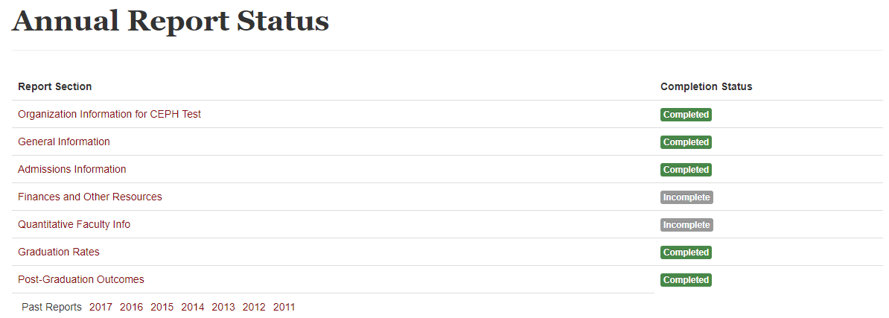
Reporting Home Page
Notes:
This section will focus on quantitative faculty info for the standalone baccalaureate programs

Slide 2
Quantitative Faculty Information for Standalone Baccalaureate Programs
Notes:
As the SBP criteria differs slightly in terms of quantitative faculty information, this is what the reporting platform will look like.
Once you click on “Quantitative Faculty Info” you will see this screen. You will simply input the FTE to the unit of accreditation for your designated leader, and do the same for the total of the rest of your faculty.
Again, if you do not meet the minimum threshold for quantitative faculty information, you will get this explanation box. (CLICK)

Slide 3
Notes:
Again, be as specific as possible here.

