Slide 1
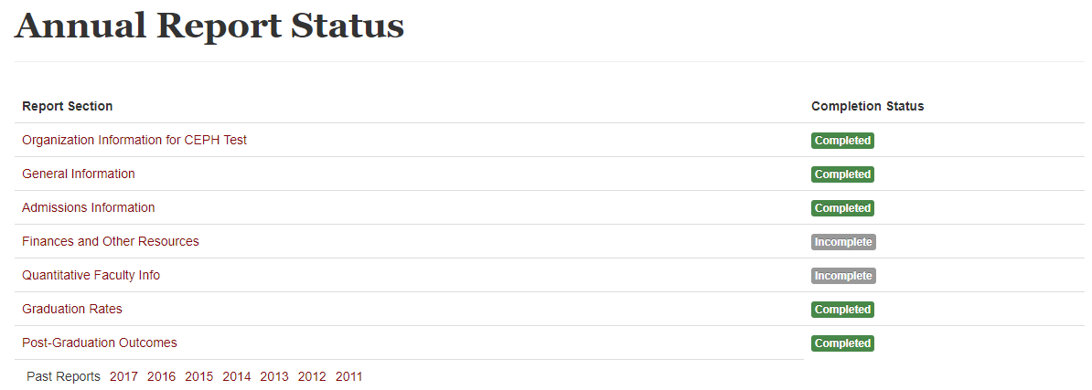
Reporting Home Page
Notes:
This section will focus on finances and other resources.

Slide 2
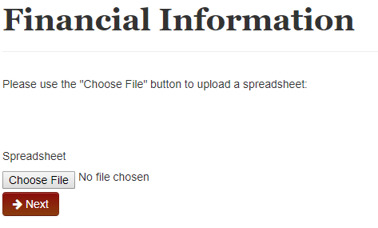
Finances and Other Resources
Notes:
In this section, I will report on the resources I have for my unit of accreditation.
If you remember from the beginning, units reporting through ASPPH do not have to complete certain sections within the CEPH platform. This section is a bit different. Those reporting through ASPPH will not have to provide CEPH their budget table, however they will need to fill out the remainder of this section.
The first step is to click Choose File, CLICK, to attach my budget table.

Slide 3
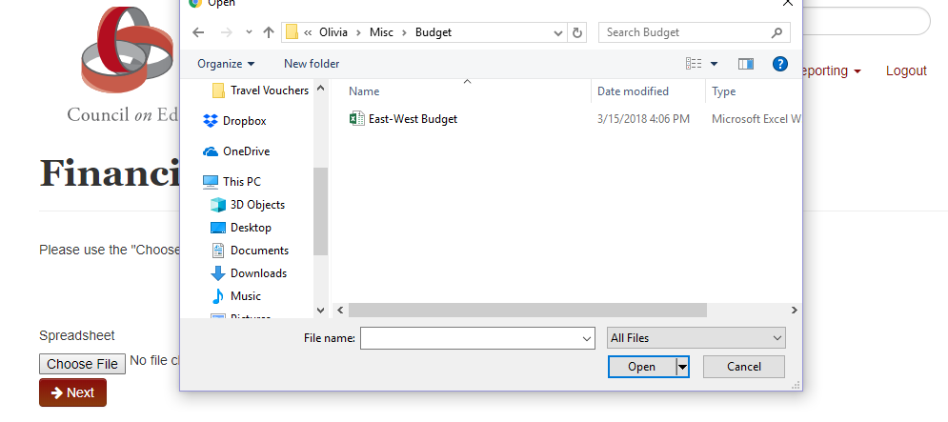
Finances and Other Resources
Notes:
If your unit does not have a dedicated budget, it is appropriate to make an educated estimation for your unit.

Slide 4
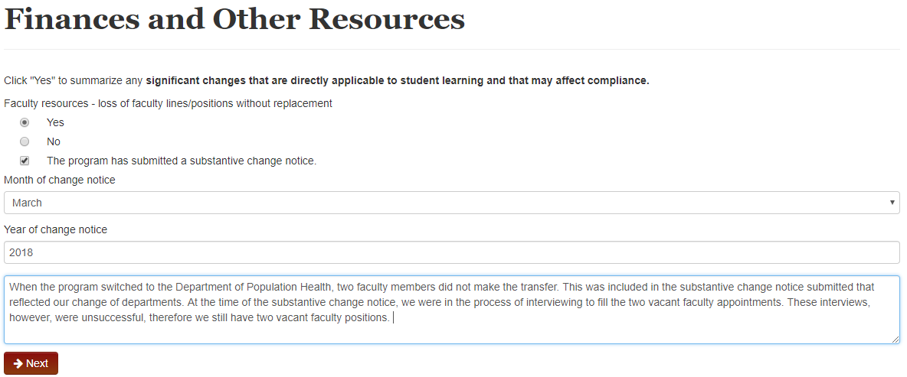
Finances and Other Resources
Notes:
After I upload my budget, the platform asks if any other significant changes have occurred in terms of resources. Again, the platform defaults to the “no” radio button. If I choose “yes”, the platform will give me the opportunity to record if and when my program submitted a substantive change notice and also to explain the change.
Here I am going to choose “Yes”. CLICK
I am going to record that the program submitted a substantive change and that it was submitted in March 2018. Then I am going to explain that (read the box).

Slide 5
Finances and Other Resources
Notes:
The next several questions are all defaulted to the “no” option.
We have not had any significant institutional support that will affect compliance or student learning. CLICK
We have not had any funds allocated to the program in any amount that will affect student learning or compliance. CLICK
We have not gained any significant facilities or physical space that will affect student learning or compliance. CLICK
There have been no changes to staff support. CLICK
There have been no changes to library holdings or library access. CLICK
While we did receive four new computers during the move to the new department, this change does not affect compliance nor does it affect student learning, so I’m going to stay with the default answer of “no”. CLICK
Laboratories are not applicable to our department, so I’m staying with the answer “no”. CLICK
We have not had any other changes that a directly applicable to student learning or that may affect compliance. CLICK

