Slide 1
Overview of proposed criteria revisions for PHP & SPH

Slide 2
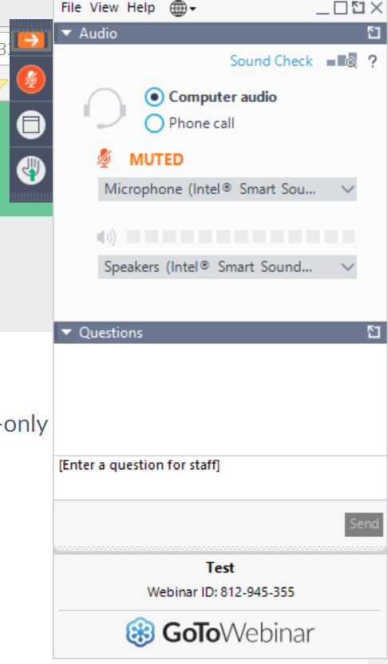
All participants muted. Enter questions here!

Slide 3
Access this and past presentations

Slide 4
Scope of revisions

Slide 5
Timeline
June 30 | Comment period closes
Aug 26 | Council adopts criteria & plan
Sept 23 | Notice to accredited & applicant units

Slide 6
Implementation principles*
As soon as practical
No extra reporting
Units with confirmed SV can keep working with current criteria
* Unlikely to change, but technically subject to change based on emerging circumstances.

Slide 7
This presentation
Help understand proposed revisions
Opportunity for clarifying questions
Help solicit more useful comments
Not a substitute for written comments

Slide 8
Only one substantive (-ish) change

Slide 9
Foundational competency 21
Perform effectively on interprofessional teams

Slide 10
Proposed revised competency
Integrate perspectives from other sectors and/or professions to promote and advance population health

Slide 11
Notes on proposed revision
Requires direct engagement (in-person or online) between student & individual(s) outside PH
Combine external sector/profession’s perspective with PH training to complete a task, solve a problem, etc.
Role-playing, where PH students pretend to assume the external sector/profession role, NOT sufficient
All activies currently deemed compliant will continue to be acceptable!

Slide 12
Clarity for other foundational comps
Condensed without affecting meaning
Added footnotes clarifying commonly misunderstood areas
MPH 5, 6, 8, 10, 12, 14, 16, 17, 19, 22
DrPH 7, 13

Slide 13
Evaluation & Planning B Criteria

Slide 14
Evaluation philosophy

Slide 15
Putting the feedback loop back together
B5 & B6 combined
Criterion tells you what data must be collected!
All data required for specific criteria AND
What other data do you need to measure YOUR specific mission & goals?
Examples of changes with indication of which data point(s) led to changes

Slide 16
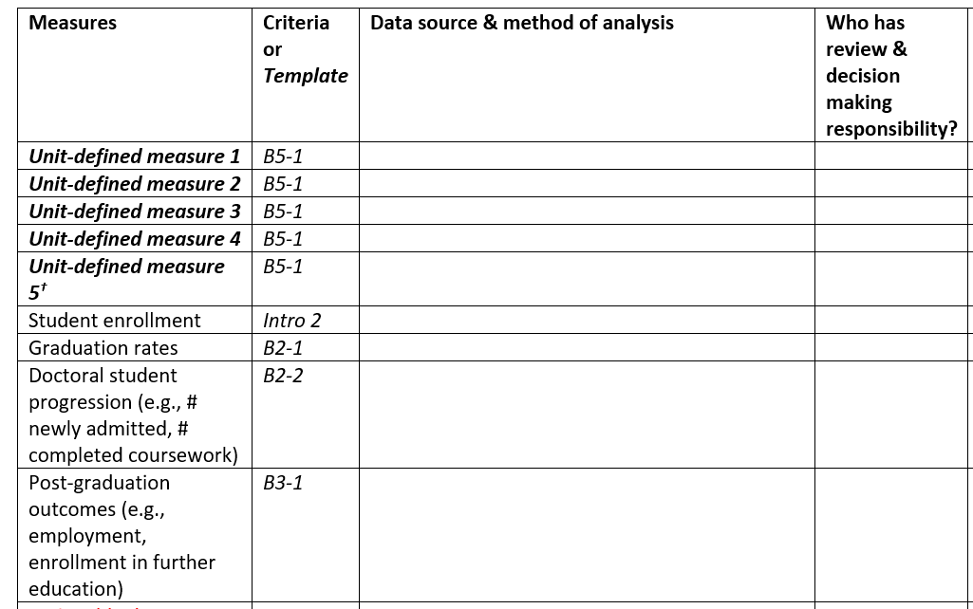
Continued focus on HOW and WHO?
HOW?
WHO?

Slide 17
Alumni data (B4) streamlined & refocused
Perceptions of preparation for workforce or further education
what skills are most useful and applicable?
areas in which they feel well prepared
areas in which they would have benefitted from more preparation
Emphasis on useful data

Slide 18
F Criteria Streamlining

Slide 19
Combined F3 & F4
Emphasis on provision of continuing ed, rather than mechanics of data collection
List events, # of workforce attendees & explain how events are designed for professional community’s needs

Slide 20
Streamlined F1 areas for stakeholder feedback
content of public health curricula, relevance to current practice & future directions
development of guiding statements & eval plan & development of self-study
employers’ assessments of program graduates’ preparation for post-graduation destinations

Slide 21
Bachelor’s Curriculum Streamlining

Slide 22
Combined & condensed D9 & D10
Folded in with PH domains | Removed
Basic statistics | Social & behavioral sciences*
Biological & life sciences | Humanities
Key “general education” domains folded in with PH domains
*already encompassed in existing PH domains

Slide 23
Making implicit expectations explicit

Slide 24
Concentration competencies
“Concentration” denotes appropriate depth of coursework & distinguishes degree offering from others in unit
Generally requires at least 9 didactic credits in 42-credit curriculum (~20% of total credits)
When units offer more than one concentration, comps taught / assessed in conc-specific courses (not core/foundational courses)

Slide 25
All competencies
Must assess individuals within group assignments
Must be assessed prior to MPH ILE & not primarily through individual internships
Expectations on documentation in ERF (i.e., may need more than the syllabus)

Slide 26
MPH APE & ILE
APE assessment based on 2 practical work products produced for practice site as end user
Products for academic audience don’t count toward 2-product requirement
Clearer examples of appropriate APE products
Poster presentation (alone) not acceptable for ILE

Slide 27
Q&A

Slide 28
This presentation
Help understand proposed revisions
Opportunity for clarifying questions
Help solicit more useful comments
Not a substitute for written comments

