Slide 1
Evaluation Strategies, Insights, and Tips
March 16, 2021
Webinar

Slide 2
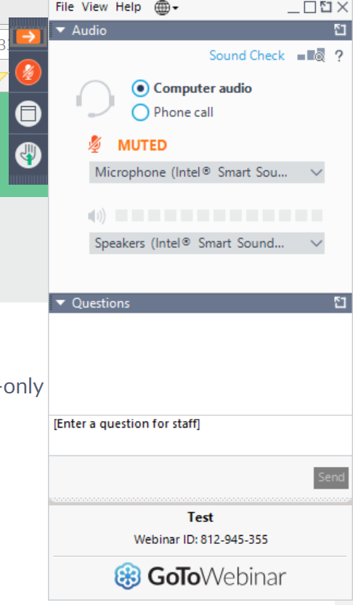
All participants will be muted. So if you have a question, enter it here!
CEPH staff will see it and will read and answer questions live at the end of the presentation!

Slide 3




Access this and past presentations

Slide 4


Slide 5
Evaluation and the Feedback Loop

Slide 6
Evaluation plan must be
Ongoing
Systematic
Well-documented

Slide 7
Criterion B5: Defining Evaluation Practices
  Methods and measures allow for determining effectiveness in advancing unit’s
  mission and goals

Slide 8
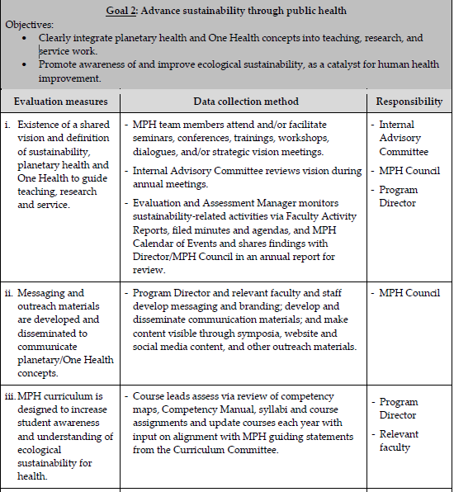
WHAT?
HOW?
WHO?

Slide 9
Evaluation of Program Effectiveness (SBP)
C1. Summary Data on Student Competency Attainment
C2. Graduation Rates
C3. Post-Graduation Outcomes
C4. Stakeholder Feedback

Slide 10

Regular, substantive review of evaluation findings
Examples of specific changes based on evaluation results

Slide 11

Common Issues and Pitfalls
Plan creation
Measures don’t give useful information on progress
Systematic, ongoing, well-documented
Implementation problems (plan doesn’t result in useful information)
Sporadic eval activities
Substantive discussion & action
Changes not data-based

Slide 12


Slide 13
WVU School of Public Health
Strategic Compass & Evaluation
Erik L. Carlton, DrPH, MS
Associate Dean | Director of Graduate Studies

Slide 14
School Information
Unit of Accreditation (2020, 7 yrs) | Primary Instructional Faculty
School (2012); Program (1997) | 40
Degrees Offered | Students (as of Spring 2021)
Bachelors: PUBH (3), HSML Masters: MPH (5), MHA (2), MS* Doctoral (PhD): EPID, OEHS, SBHS | Bachelors: 171 Masters: 96 Doctoral: 36
MPH Concentrations
Biostatistics, Epidemiology, Health Policy, Social & Behavioral Sciences, and Occupational & Environmental Health Sciences
* Two (2) new MS programs planned to launch Fall 2021

Slide 15
Competitive Landscape
CEPH Schools in Adjoining States: 10
CEPH Schools in Broader Region: 29 (43% of CEPH)
Johns Hopkins | George Washington
Harvard; UNC | Pittsburgh
Columbia | Ohio State
Michigan | Rutgers
Boston | Kentucky

Slide 16
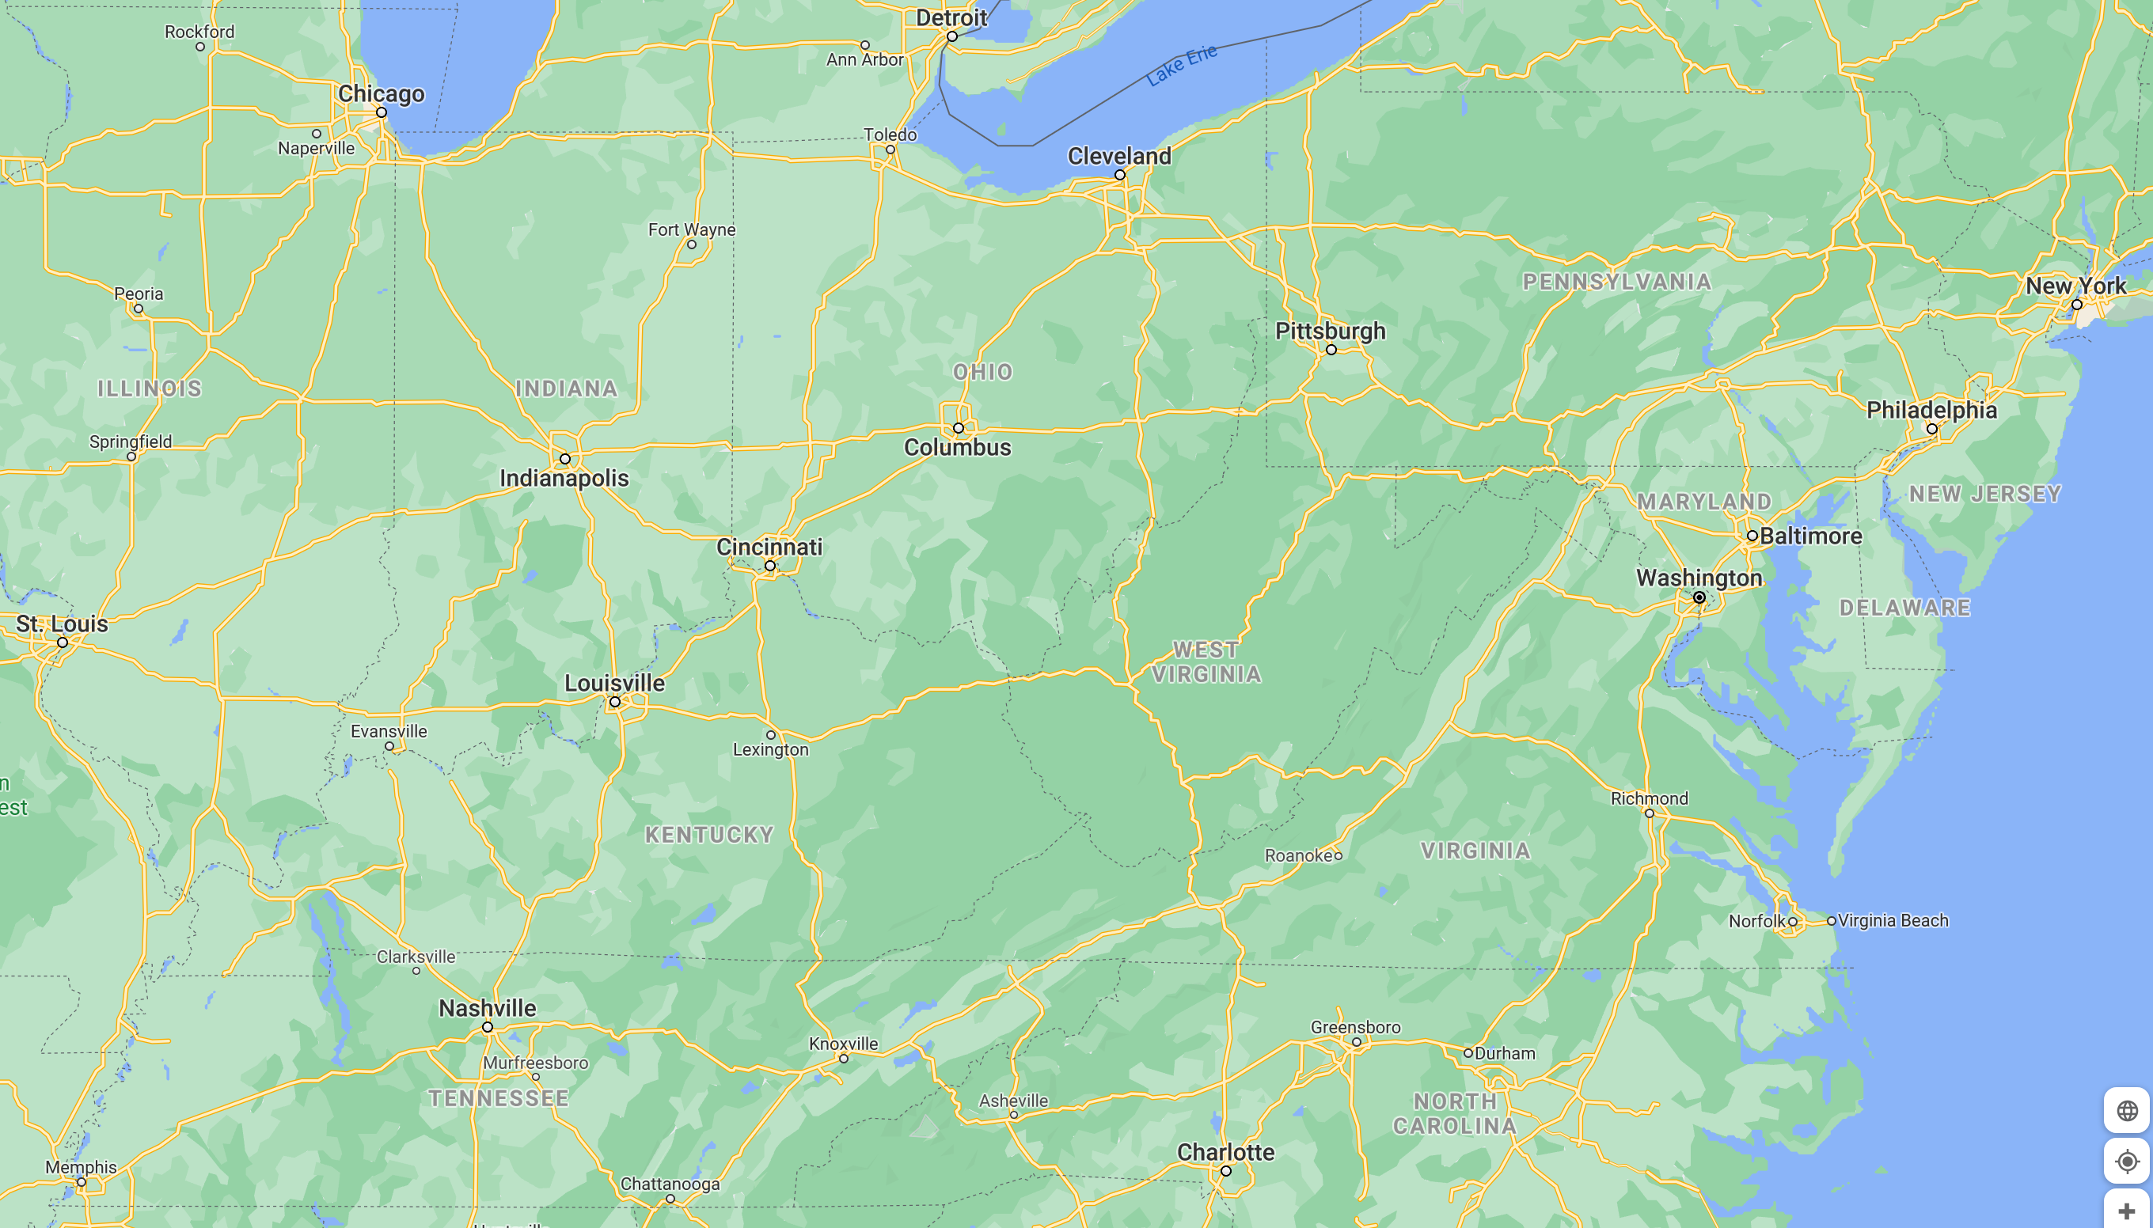































Slide 17
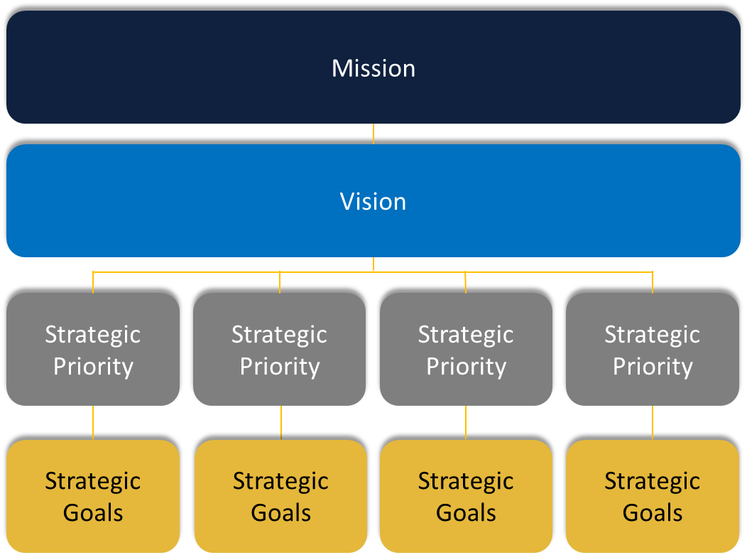
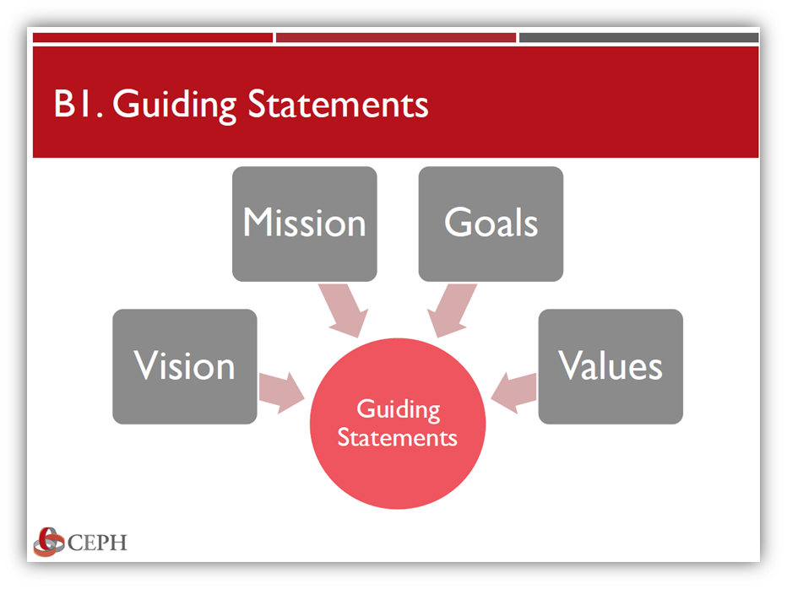
Strategic Compass Framework

Slide 18
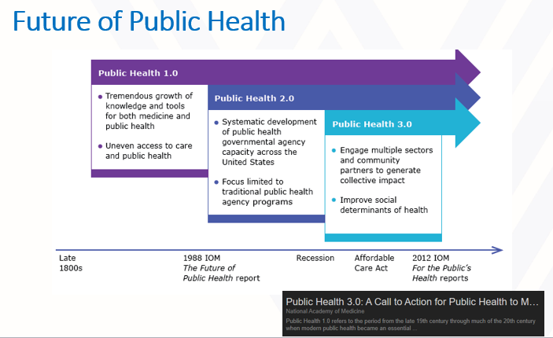
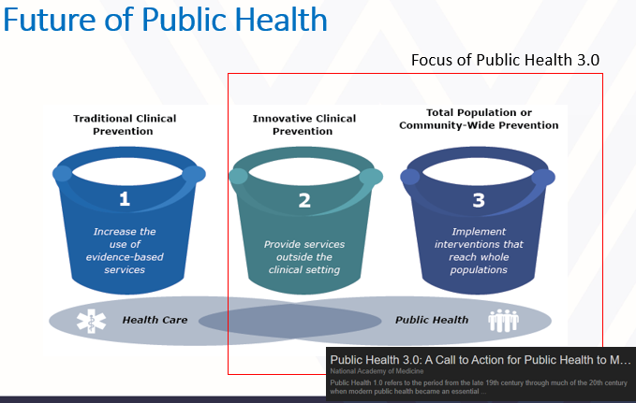







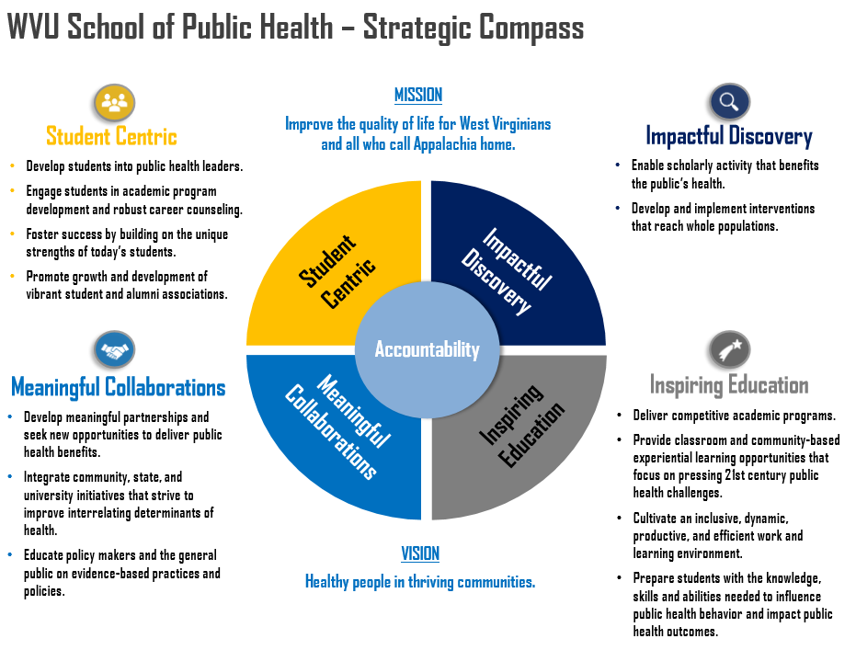
The Process
Environmental
Scan
All Hands Meeting
Executive Leadership Council
Alumni
Core Writing Team
We Listened
We Discussed
We Drafted
We Shared
Feedback

Slide 19
External Stakeholders
Executive Leadership Council
Alumni
Current public health and healthcare leaders (state/local)
State/local civic leaders
Community leaders
Current public health leaders (state/local)
Professional practitioners in a variety of fields
* In 2020, a new state public health caucus was formed through the work of the Executive Leadership Council.

Slide 20
We Listened…
Element | Survey Versions | Post Survey Revision
Mission | Improve the quality of life for all West Virginians. Improve the quality of life for all of Appalachia. | Improve the quality of life for West Virginians and all who call Appalachia home.
Survey Comments
I am most comfortable focusing resources on West Virginia first. However, I realize that state boundaries are artificial and expanding our reach to Appalachia makes some sense. Our resources are limited and the needs in West Virginia are very real.
I like the idea of reaching beyond WV to Appalachia, but maybe "healthy Appalachia.“
…the dreamer in me appreciates making statements that imply/represent our love for people beyond our state borders.

Slide 21
We Listened…
Element | Survey Version | Post Survey Revision
Vision | Eliminate health disparities in Appalachia | Healthy people in thriving communities.
Survey Comments
For the vision statement - Suggestion: something like, "healthy people in thriving communities." Mission suggestion - enhance/strengthen the health and well being of people and communities in WV and beyond.

Slide 22
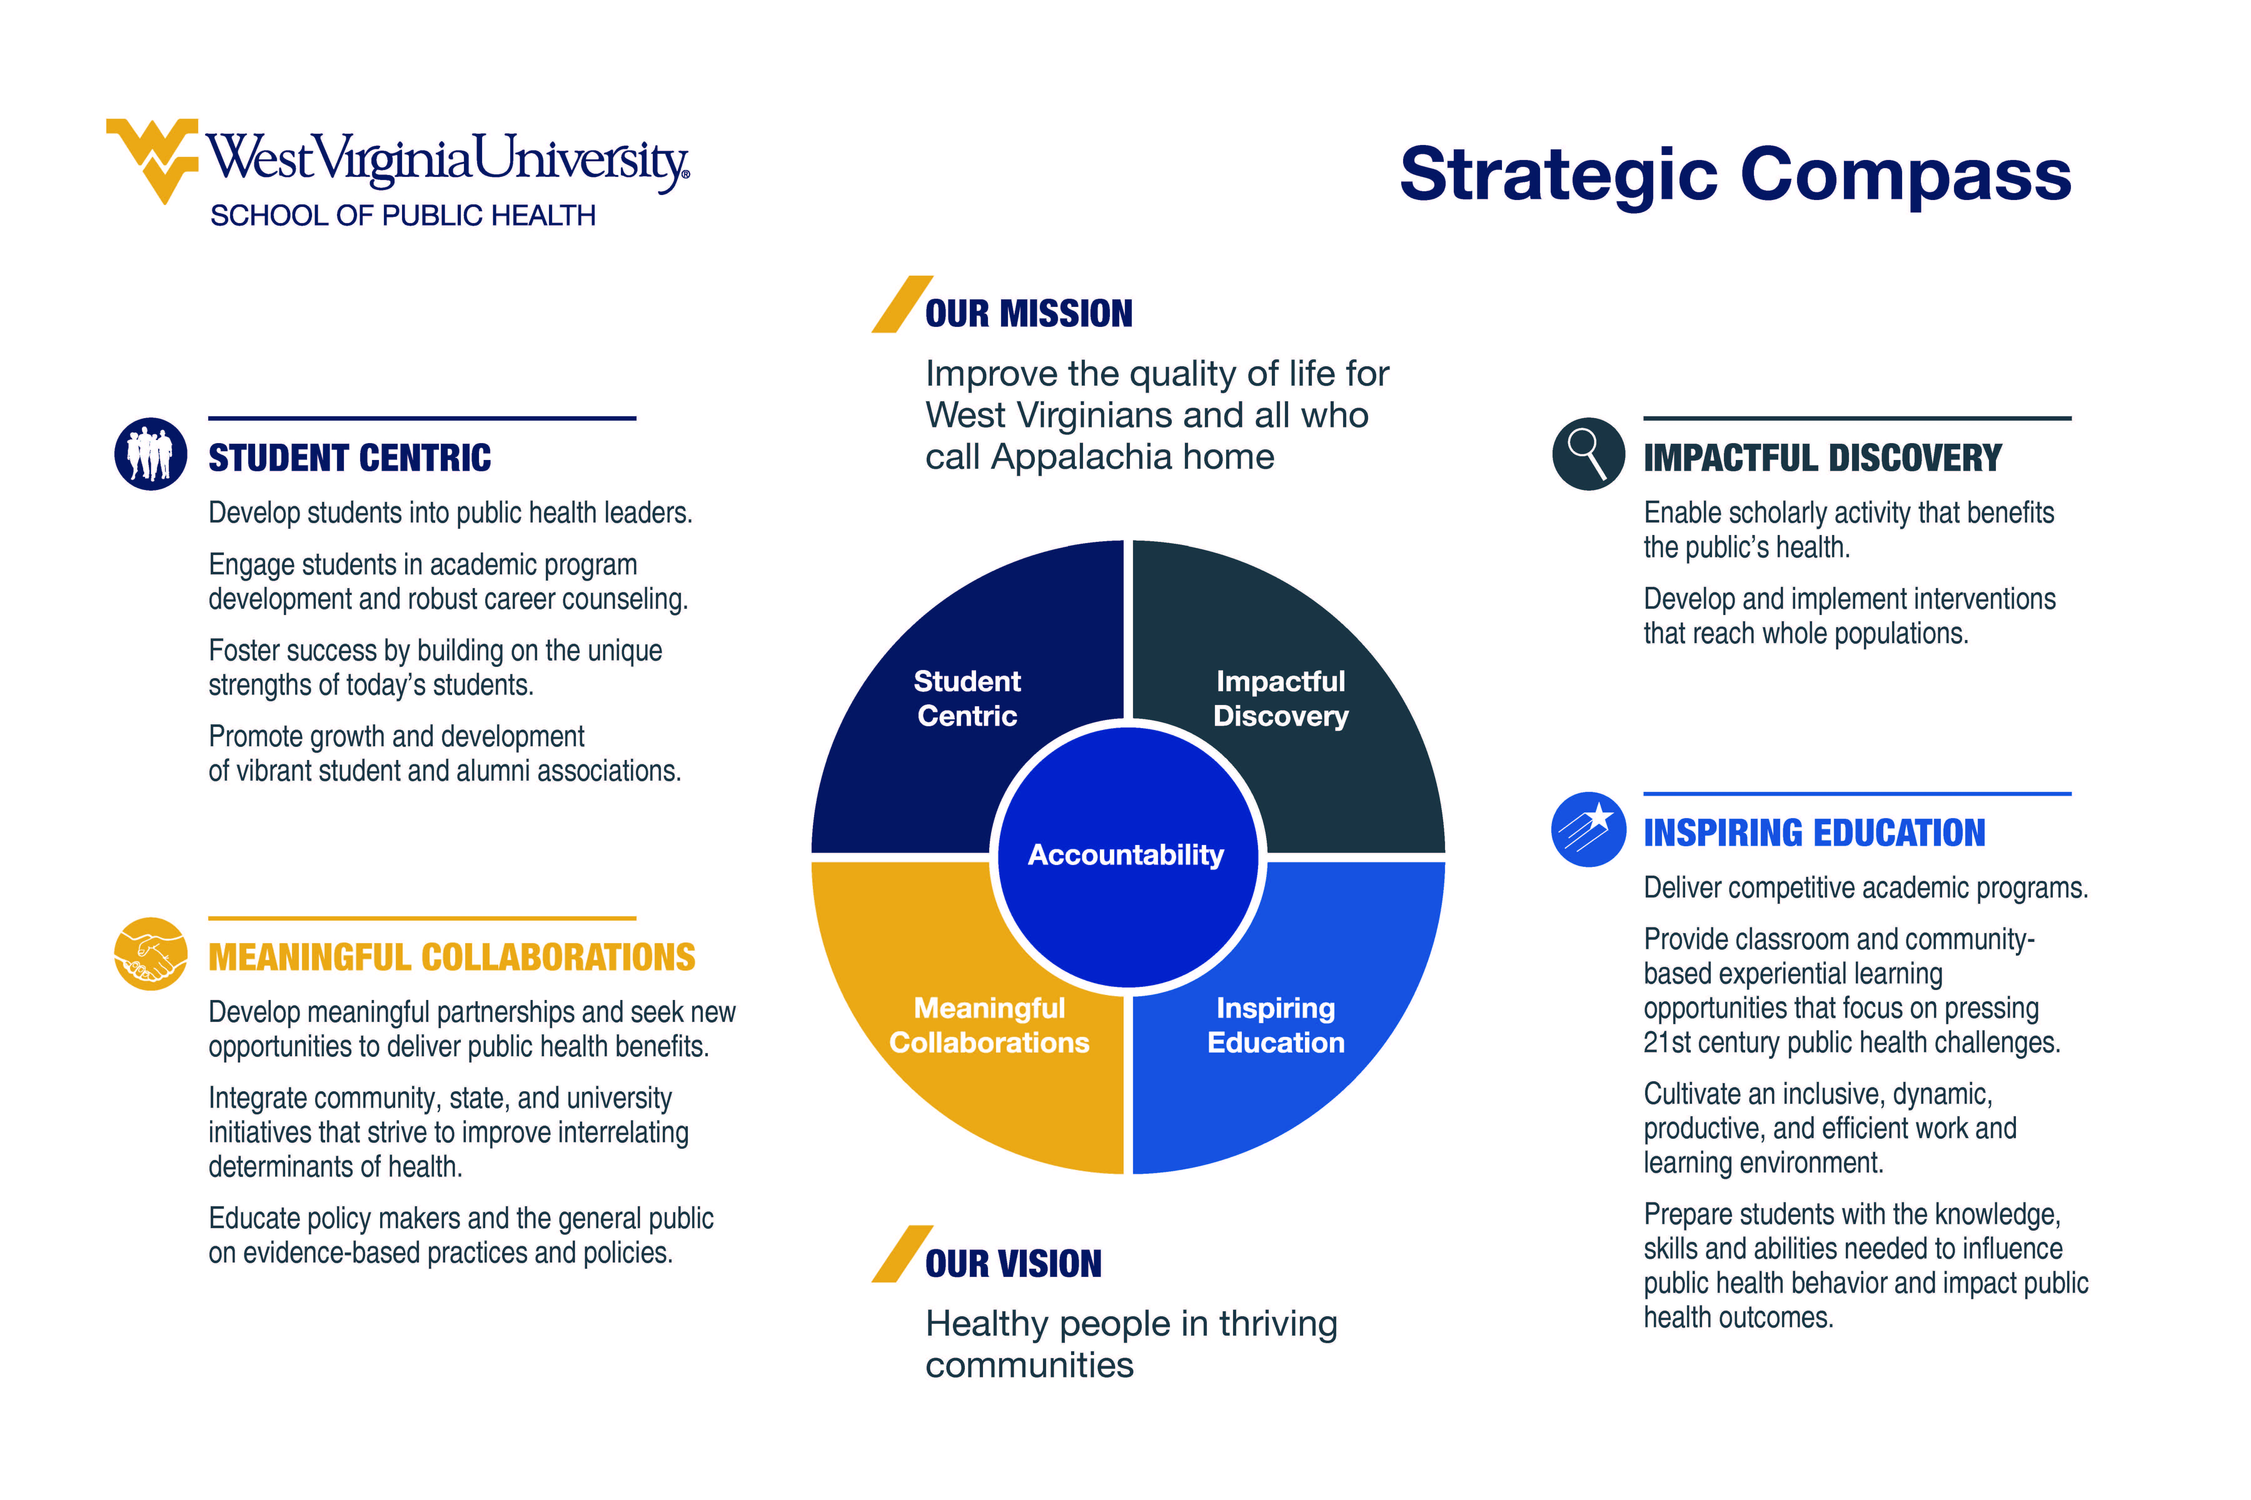
Strategic Priorities
Strategic Goals

Slide 23
Evaluation
4 Strategic Priorities with working groups (Priority Action Teams/PATs) for each
2-5 Strategic Goals (Goal Statements) tied to each Strategic Priority
2-3 measurable Goals tied to each Goal Statement
Goals & Measures developed by PATs
Identified data sources (existing & new) & responsible parties

Slide 24
Next Steps
Integration of competency assessment in WVU’s LMS (SOLE)
Annual review of priorities & goals
  Executive Leadership Council
  Senior Leadership Team/Strategic Steering Committee
  Director of Assessment

Slide 25
Lessons Learned
Involve a broad array of stakeholders EARLY & OFTEN
Multiple feedback cycles creates accountability, validation, and ENGAGEMENT
Develop MOMENTUM with smaller, more achievable (and measurable) goals
Tie EVERYTHING back to the compass (Mission, Vision, Priorities)
CELEBRATE victories & accomplishments!

Slide 26

Overview
Program established 2015
DenYelle Baete Kenyon, PhD – Program Director MPH, Assoc Dean for Diversity and Inclusion, SSOM
Chelsea Wesner, MPH, MSW – Research Instructor, USD, School of Health Sciences
Public Health Program
Generalist Concentration
3 Primary Faculty
87 Students

Slide 27
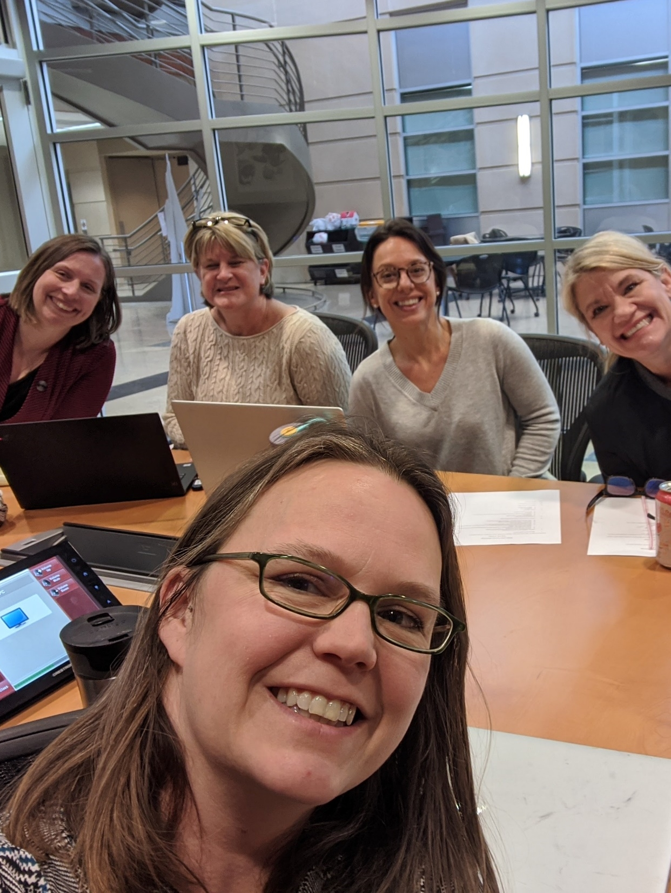
Developing Eval Plan
Identifying community and programmatic priorities
Defining indicators
Finding data sources
Process for review, reflection, and discussion

Slide 28

Program Goals
Goal 1: Academic Excellence. Promote and achieve excellence in public health teaching and learning.
Goal 2: Public Health Research & Practice. Faculty and students will engage in research and practice in collaboration with rural and underserved communities.
Goal 3: Diversity & Inclusion. Recruit and retain diverse faculty and students who embody cultural inclusiveness.
Goal 4: Service. Enhance the program’s involvement in public health service to rural and underserved communities in South Dakota.

Slide 29
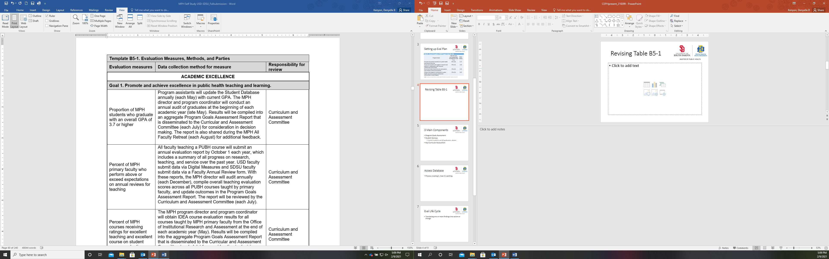
Revising Table B5-1

Slide 30
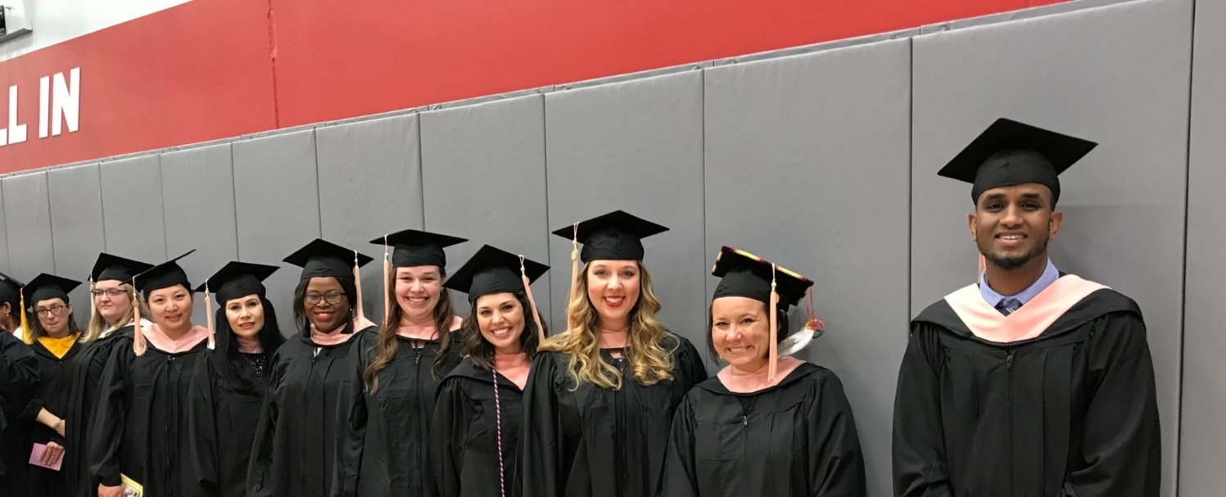
Primary Components of Evaluation
Program Goals Assessment
Student Surveys (Current, Exit/Graduate, Alumni)
Key Curricular Assessment

Slide 31
Program Goals Assessment
Academic Excellence
Goal 1: Promote and achieve excellence in public health teaching and learning.
Responsible parties: Curriculum and Assessment Committee; All Faculty Committee
Metric | Objective | Data Source | Target | 2016/17 | 2017/18 | 2018/19 | 2019/20
1.1 | At least 50% of MPH students will graduate with an overall GPA of 3.7 or higher. | Student database | 50% | 50% | 75% | 41% | 81%
1.2 | All MPH primary faculty will perform above or exceed expectations on annual reviews for teaching. | Annual Performance Evaluation | 100% | 100% | 100% | 100% | 100%
1.3 | Each academic year, 80% of MPH courses will receive ≥4 on a 5-point scale [1=lowest 10%, 5=highest 10%] for the average of excellent teaching and excellent course on student course evaluations. | Course IDEA Evaluations | 80% | 75% | 55% | 82% | 71%
1.4 | Each academic year, 75% graduates will earn ≥90% across key assessments for all MPH foundational and concentration competencies. | Key Curricular Assessment | 75% | Implemented fall 2019
1.5 | At least 75% of students will be satisfied or very satisfied with academic advising. | Student Survey | 75% | Implemented summer 2019 |  |  | 87%
 |  | Exit Survey | 75% | Implemented fall 2019 |  |  | 100%
 |  | Alumni Survey | 75% | Implemented summer 2019 |  |  | 75%
1.6 | At least 50% of Applied Practice Experience (APE) preceptors will assess students’ knowledge of public health principles and application to practice as exceeds expectations. | APE Preceptor Evaluation (Dec) | 50% | Not offered |  | 90% | 47%

Slide 32
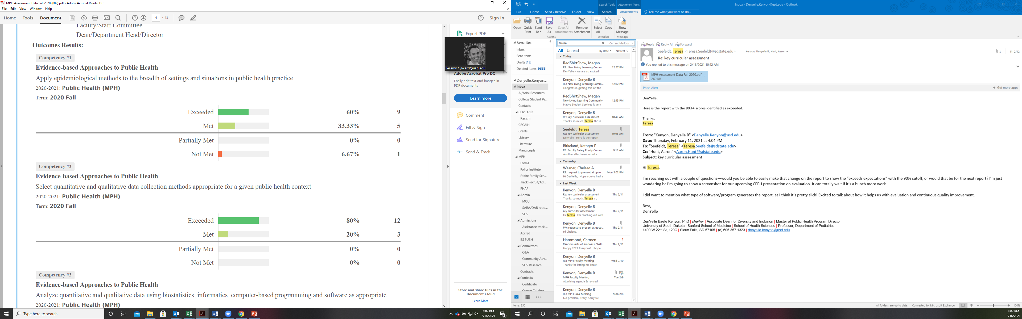
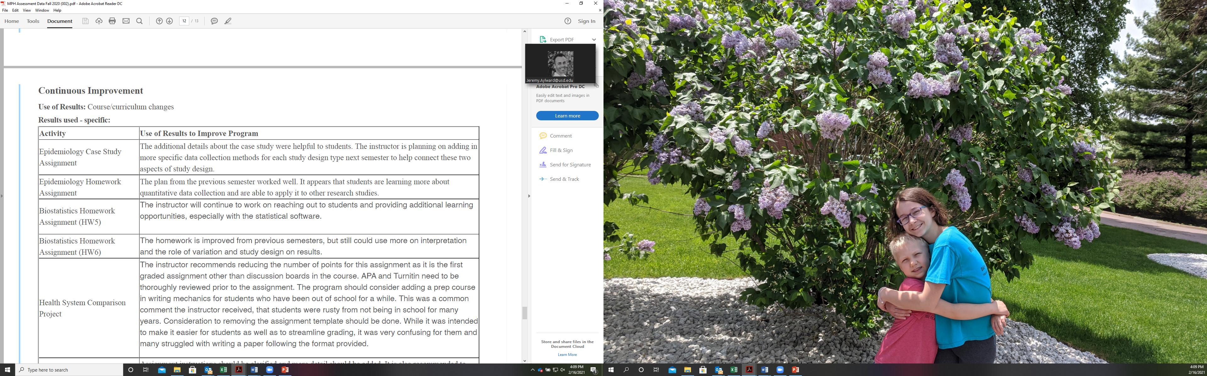
Key Curricular Assessment

Slide 33
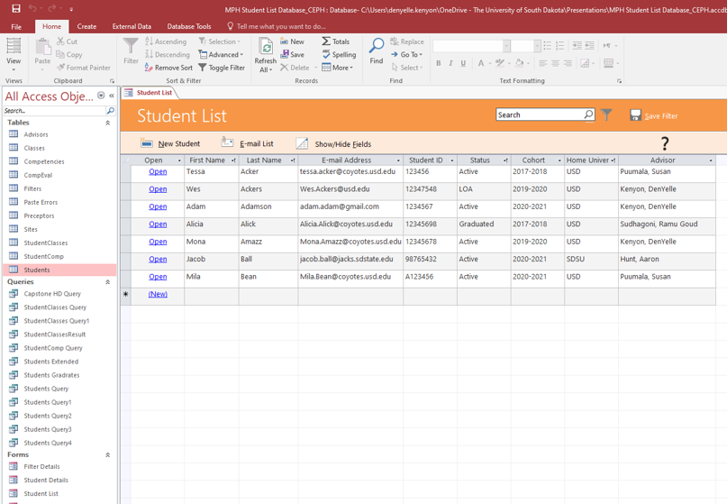
Managing Data

Slide 34
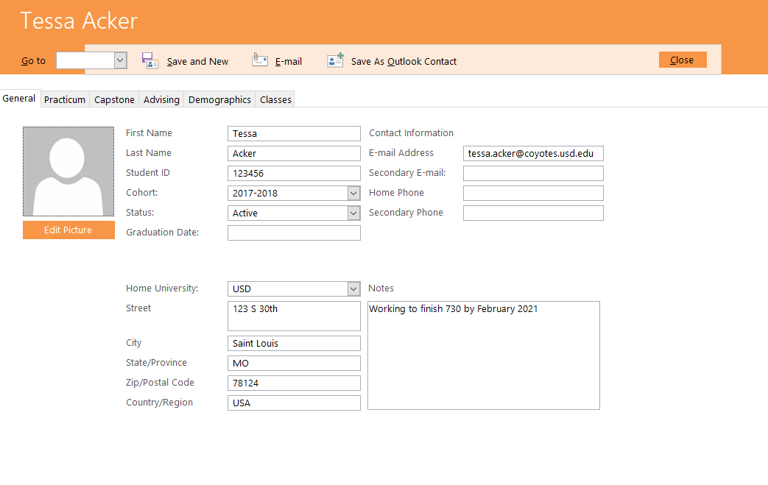

Slide 35
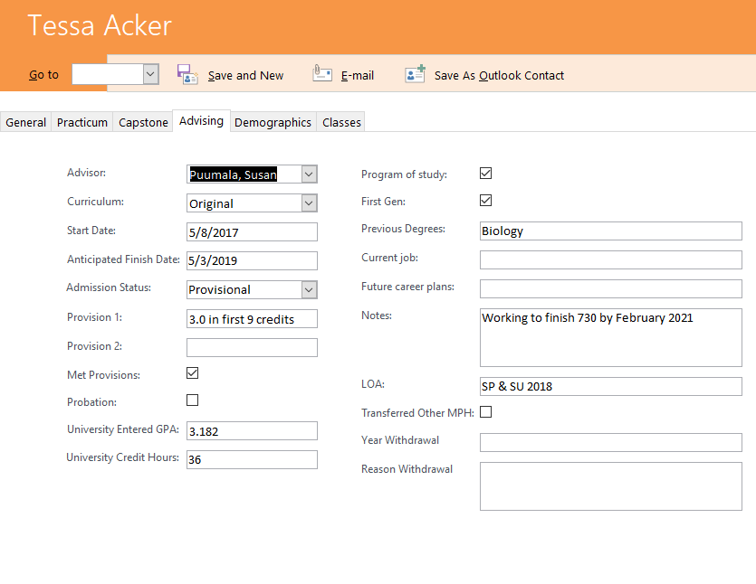

Slide 36
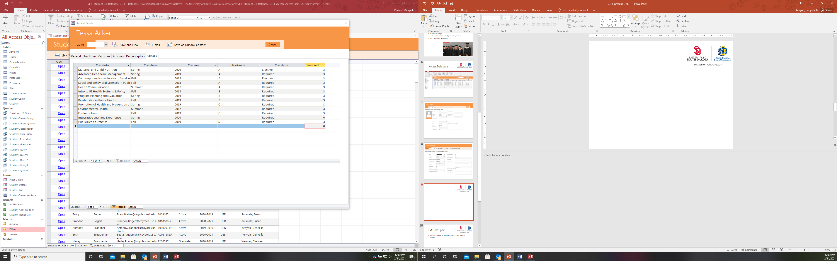

Slide 37

Evaluation Life Cycle
Translating findings into action
Curricular changes
APE & ILE projects
Professional development activities

Slide 38

Key Takeaways
Collaborative, iterative process
  Stakeholder input
Focus on mission & key components
Setting up systems
  Lead, committee
  Data collection, reporting, review, changes
Positive culture of evaluation & continuous quality improvement
  Listen, Learn, Refine
denyelle.kenyon@usd.edu | Chelsea.Wesner@usd.edu

Slide 39
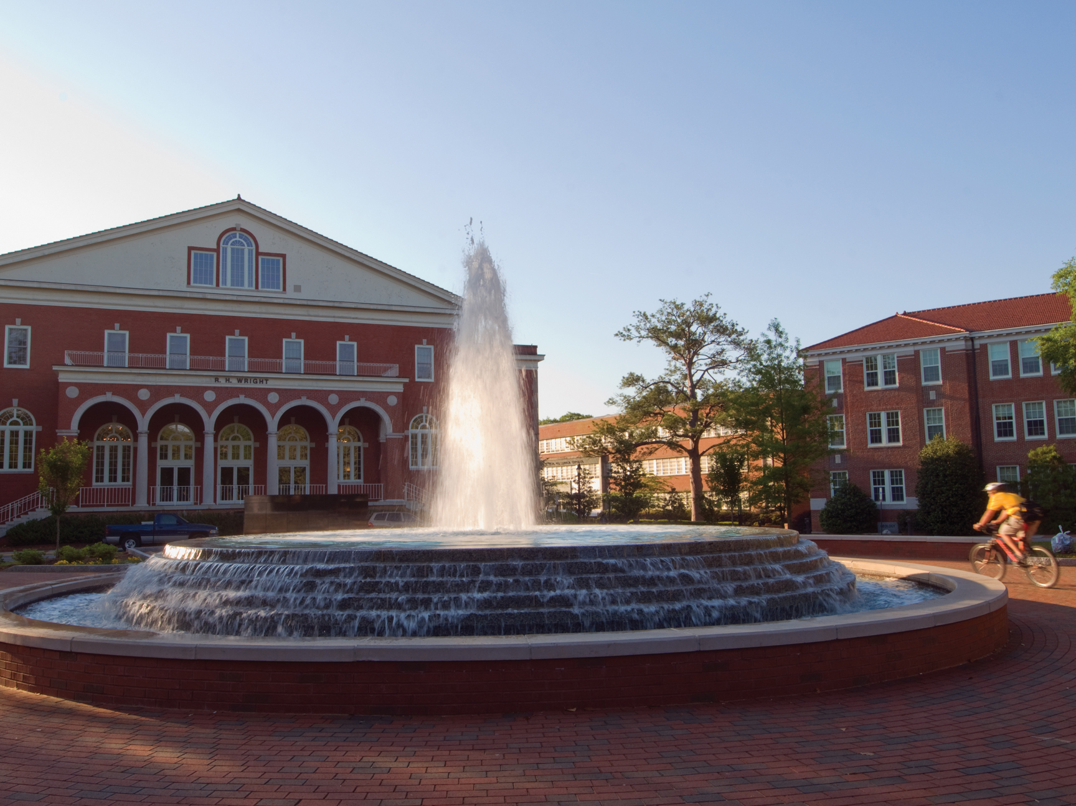
Establishing & Implementing an Evaluation Plan

Slide 40
About Our Program
BS in Public Health – SBP
Concentrations
  Prehealth Professions
  Community Health
  Worksite Health Promotion
Enrollment: 820
# of Faculty: 26.365

Slide 41
Outcomes Assessment
Outcome (2 overarching and 3 for each concentration) | Assessments
Communicate public health information, in both oral and written forms, and through a variety of media to diverse audiences. | Course level assessment (required for SACS) Program level assessment conducted with Exit Survey and 1 Year Follow-up Survey
Locate, use, evaluate, and synthesize public health information.
Determine needs of specific health population.
Develop a health education and promotion plan of delivering appropriate strategies and interventions.
Develop a health education and promotion evaluation plan.
Develop health education material utilizing mass communication strategies in a corporate setting.
Assess population needs mased on health risk appraisal data.
Create effective interventions for behavior change in worksite health promotion/employee wellness programs.
Determine individual health needs for a patient population.
Develop effective patient education materials with appropriate intervention strategies.
Apply effective methods for improving health literacy among patients populations.

Slide 42
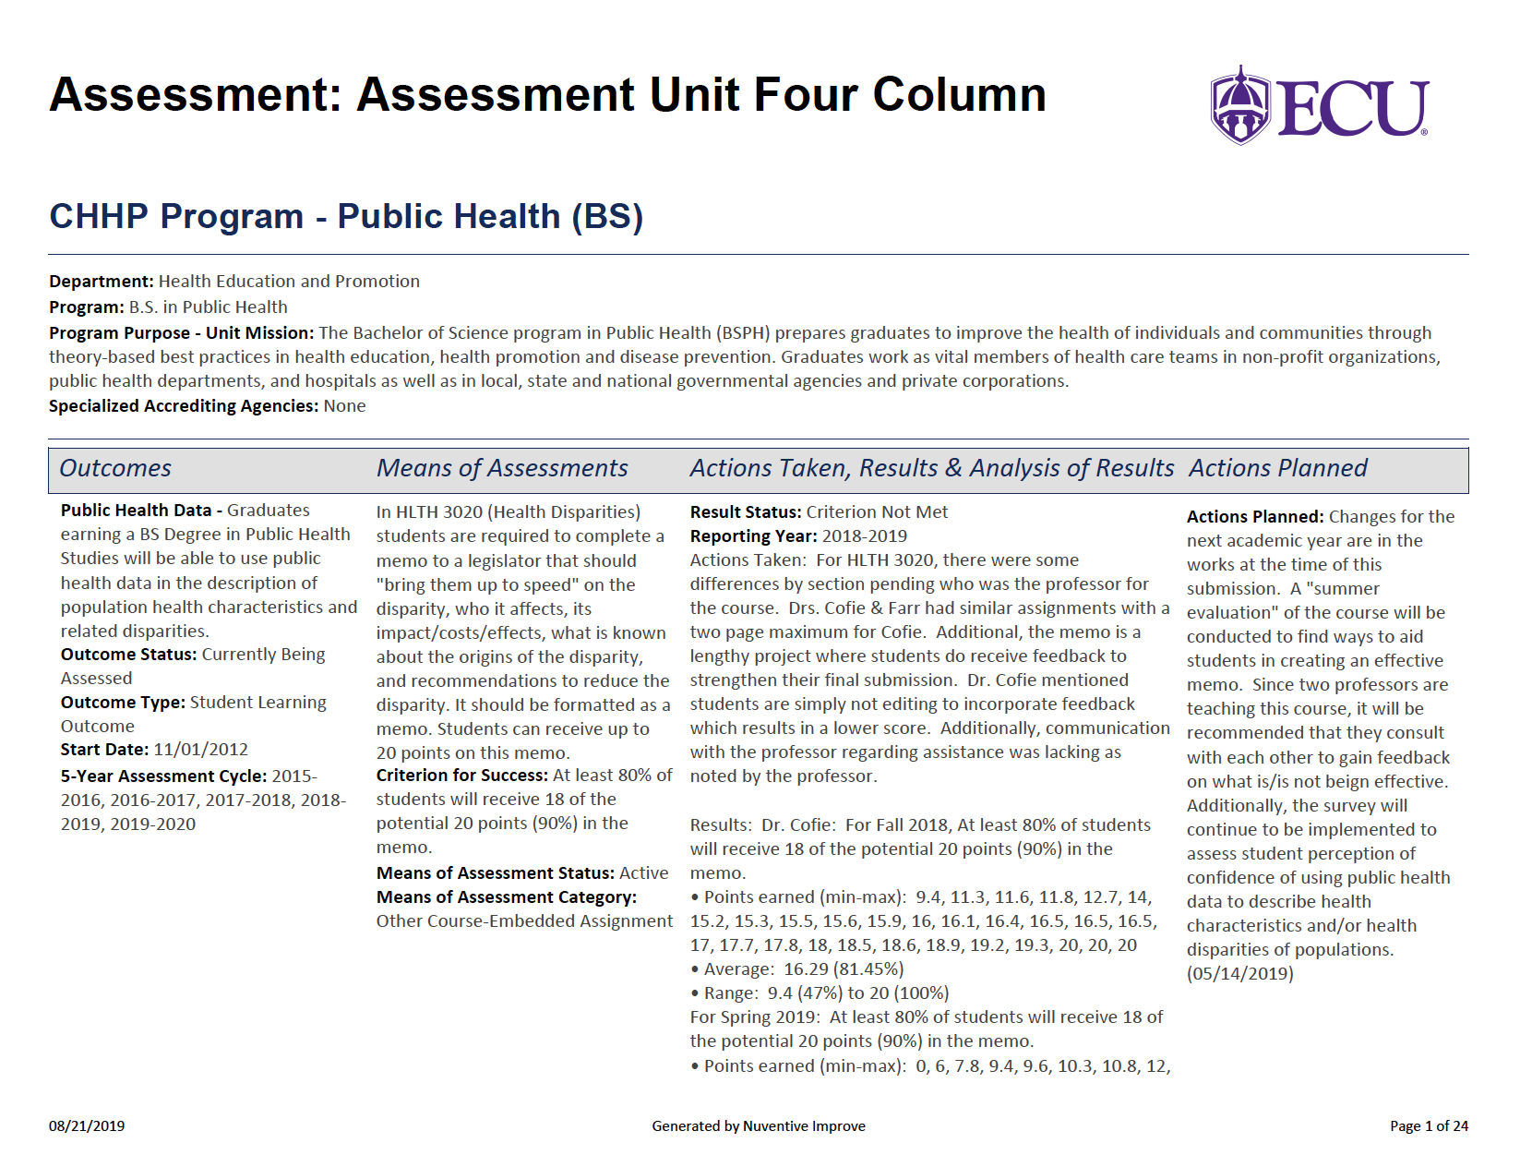

Slide 43
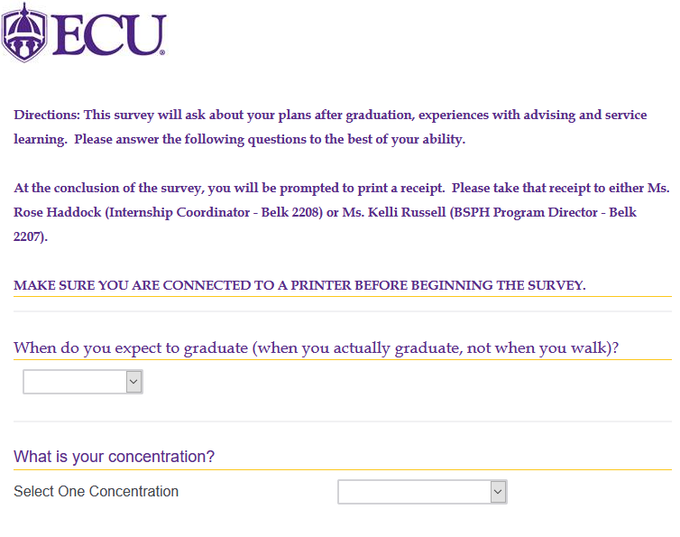
Establishing & Implementing an Evaluation Plan
Part I:
Exit Survey

Slide 44
Exit Survey Questions
Do you plan to attend graduate or professional school after graduation?
Continue Education at ECU? Program?
Accepted to a graduate program? Which Program?
Plan to work in the field of Public Health after graduation?
Offered or Accepted a job in PH and where?
Plan to take CHES?

Slide 45
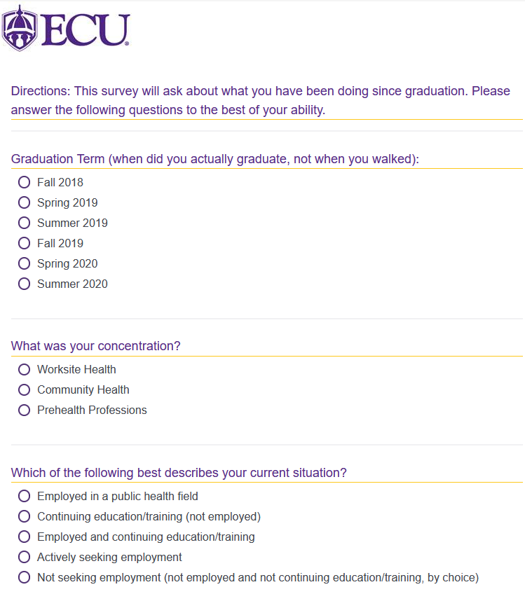
Establishing & Implementing an Evaluation Plan
Part 2:
One Year Follow-Up Survey

Slide 46
One Year Follow-up Survey Questions
Current Situation of Employment or Continuing Ed.
Location of Employment or Degree Pursuing & location
CHES Certification status
Two Strengths & Weaknesses of BSPH Program
Comments
Willingness to Stay Involved as an Alumni

Slide 47
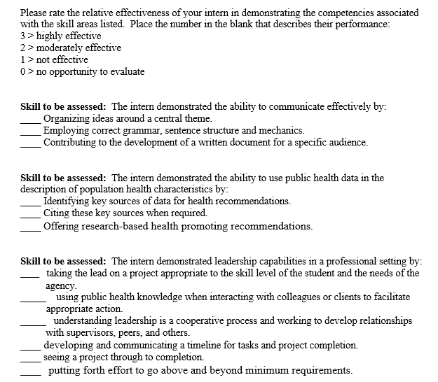
Establishing & Implementing an Evaluation Plan
Part 3:
Preceptor Survey

Slide 48
Tying It All Together
Data
Exit Surveys
Changes to courses and curriculum
HLTH 4605 – Community Health Strategies
Outcomes Assessment
Follow-Up Survey
Stakeholders
Informal information from students
HLTH 3020 – Health Disparities
Public Health Seminar Series

Slide 49
Thank You
Dr. Jennifer Matthews
creemensj@ecu.edu
Ms. Kelli Russell
russellk14@ecu.edu

Slide 50
Dr. Clint Pinion,
MPH Director
&
Dr. Michelyn Bhandari,
HPA Dept. Chair

Slide 51
Public Health Program
Environmental/Occ. Health & Sustainability (MPH) (n=24)
Health Promotion (MPH) (n=32)
Pre-Professional (BSPH) (n=10)
Health Promotion (BSPH) (n=60)
Number of Primary Faculty: 12

Slide 52
Define Your Measures
Evaluation measures | Identify data source(s) and describe how raw data are analyzed and presented for decision making* | Responsibility for review
Instructional Goal Statement: The program prepares competent public health professionals through high-impact pedagogy.
E3.1 Percentage of faculty completing annual or other regular reviews of faculty productivity, relation of scholarship to instruction | Assessment committee produces summary report based on self-report from faculty Evidence: ERF B5-1 through ERF B5-8 | Department Chairs, MPH Program Director, Undergraduate Coordinator; Assessment Committee, Program Committee and Advisory Board during Annual Advisory Board Meeting.
E3.2 Student satisfaction with instructional quality | MPH Director and Undergraduate Coordinator generate reports based on exit surveys. Evidence: ERF B5-1 through ERF B5-8 | Department Chairs, MPH Program Director, Undergraduate Coordinator; Assessment Committee, Curriculum Committee, Program Committee and Advisory Board during Annual Advisory Board Meeting.
E3.3 Number of courses that include a service learning, community-based, or collaborative project | Assessment Committee produces summary report based on self-report from faculty Evidence: ERF B5-1 through ERF B5-8 | Department Chairs, MPH Program Director, Undergraduate Coordinator; Assessment Committee, MPH Curriculum Committee, Program Committee and Advisory Board during Annual Advisory Board Meeting.

Slide 53
Define Your Instrument
 | Criteria | Instrument
Actionable data (quantitative and/or qualitative) from recent alumni on their perceptions of competency attainment | B4 | Alumni Survey/Focus Groups
Actionable data (quantitative and/or qualitative) from recent alumni on their self-assessed abilities to apply competencies in their post-graduation destinations | B4 | Alumni Survey/Focus Groups
Feedback from employers on graduates’ abilities to perform competencies in a practice setting | F1 | Advisory Board Focus Groups
Feedback from external stakeholders on changing practice & research needs that might impact unit priorities and/or curricula | F1 | Advisory Board Focus Groups
Feedback from stakeholders on guiding statements and ongoing self-evaluation data | F1 | Advisory Board Focus Groups
Current educational and professional development needs of self-defined communities of public health workers (individuals not currently enrolled in unit’s degree programs) | F3 | Advisory Board Focus Groups/Prof. Dev. Needs Survey
Student AND faculty (staff, if applicable) perceptions of unit’s climate regarding diversity & cultural competence | G1 | Alumni Survey/ Faculty/Staff Diversity & Inclusion Survey

Slide 54
Create an Assessment Timeline
To Manage…
Summer
June
July
August
Argos Graduation Report
E6.4
Course Syllabi
D1-1, D2-2, D4-1
Post-Graduation Outcomes
E6.5
APEx Matrices/Graded APEx ILE Work Products
D5-1
Collection Instruments
Prof. Dev. Offerings
F3
Argos Report/Grad School Report
H4-1
Faculty Curriculum Vitas
E1
Argos Reports/Grad School Report
Post-Graduation Outcomes
Data Analysis
Student Success Faculty Survey
Advisory Board Focus Groups
Prof. Dev. Offerings
PH Program Comm. Mtg.
B4, E6.1-E6.5, F1, F3

Slide 55
Identify Meaningful Changes
Example One
Advisory Board Meeting
(BSPH)
Preparing students for workforce
Added course & reduced internship hours

Slide 56
Identify Meaningful Changes
Example Two
Alumni Exit Survey
(MPH)
More concentration courses & removal of second stats course
Removed MPH 835 from core courses & added concentration elective

Slide 57
Key Takeaways
Identify measures based on goals
Create user-friendly assessment tools
Create an assessment timeline

Slide 58
www.mph.eku.edu

Slide 59

An Overview of MEZCOPH Evaluation
John E. Ehiri, PhD, MPH
Associate Dean for Academic Affairs
Promote - Prevent - Protect

Slide 60

GRADUATE DEGREES
  Biostatistics (MPH; MSc; PhD)
  Epidemiology (MPH; MSc; PhD)
  Environmental & Occupational Health (MPH)
  Environmental Health Sciences (MSc; PhD)
  Public Health Policy & Management (MPH; DrPH)
  Health Behavior Health Promotion (MPH; MSc; PhD)
  Maternal & Child Health (MPH; DrPH)
  Global Health (MPH)
  Public Health practice (MPH)
  Health Services Administration (MPH)
  Industrial Hygiene (MPH)
  One Health (MPH)
  Clinical Leadership (MPH/MD)

Slide 61
ONLINE MPH PROGAMS
Health Behavior Health Promotion
Applied Epidemiology
Health Services Administration

Slide 62
UNDERGRADUATE PROGAM
BS in Public Health

Slide 63
MEZCOPH STUDENTS
On-Campus MPH | 249
On-Line MPH | 250
MS | 24
PhD | 74
BS in Public Health (On-Campus) | 295
BS in Public Health (Online) | 41
DrPH Maternal and Child Health | 20
DrPH Public Health Policy and Management | 12

Slide 64
MEZCOPH Faculty
Primary Instructional Faculty: 69
Secondary Instruction Faculty: 43

Slide 65
MEZCOPH EVALUATION GUIDING PRINCIPLES
The following types of data are collected annually to facilitate evaluation:
  Instruction: diversity of applied, admitted, and matriculated applicants and students to determine their ethnic/racial/underserved backgrounds, socioeconomic status, and geographic origins.
  Service: community engagement activities, outreach, practice and service by faculty, and community-based student internships.
  Research: Faculty funding, publications, and engagement of students in research.

Slide 66
OUR MISSION
Dedicated to promoting the health and wellness of individuals and communities in the southwest and globally with an emphasis on achieving health equity through excellence in education, research & service.

Slide 67
VISION
LOCAL IMPACT
NATIONAL INFLUENCE
GLOBAL REACH

Slide 68
Evaluation Committee
  Established in 2002 and meets regularly twice a year and supported by a full-time Data Analyst
  Coordinates evaluation activities, provides formal feedback to all MEZCOPH committees, ensures that data are used to inform decision-making and planning, encourages faculty, staff, student, alumni and community-partner involvement in evaluation activities, ensures that data are collected systematically, and ensures that systems are in place to collect necessary data.
  Membership: Associate Dean for Research (Chair), Associate Dean for Academic Affairs, Associate Dean of Community Programs and Dean, Phoenix Campus, Assistant Dean Students and Alumni Affairs, Assistant Dean of Finance, Director, Information Technology, Special Assistant to the Dean.
  Based on established metrics, data analyst produces tables and reports for the Evaluation Committee’s review and dissemination.

Slide 69
MEZCOPH Evaluation Objectives
Instruction | Research | Service/Community Engagement | Diversity
Recruit and Matriculate an Ethnically, Geographically, Socioeconomically and Academically Diverse and Qualified Student Body | Expenditures on externally funded grants & contracts (with MEZCOPH PI) will average at least $250,000 annually per TE/T faculty member. | Have faculty and academic professionals are involved in community engagement, outreach, practice and service activities | Develop and Sustain a Diverse and Robust Academic Community
Educate individuals for successful public health professional, research and academic careers. | Primary faculty (at least half-time) will, on average, be externally funded for at least 30% time for research, training and/or other scholarly activity | Have undergraduate public health and MPH student internships that are community-based. | Actively maintain a stable, fair and equitable organization that supports the programs, practice and policies of MEZCOPH.
Foster the Success of Our Students | Tenured and tenure-track faculty will publish on average at least three peer-reviewed articles per year. | Provide workforce development/continuing education activities. | Stand as a model of equity and inclusion by creating a scholarly community that understands values and respects all individuals so students, faculty and staff can achieve their full potential as public health leaders.
Provide well trained and qualified course instructors. | At graduation, at least 40% of our students will have participated in a research project (as part of a class or outside of the classroom), given a scientific presentation or were an author or coauthor of a publication.

Slide 70
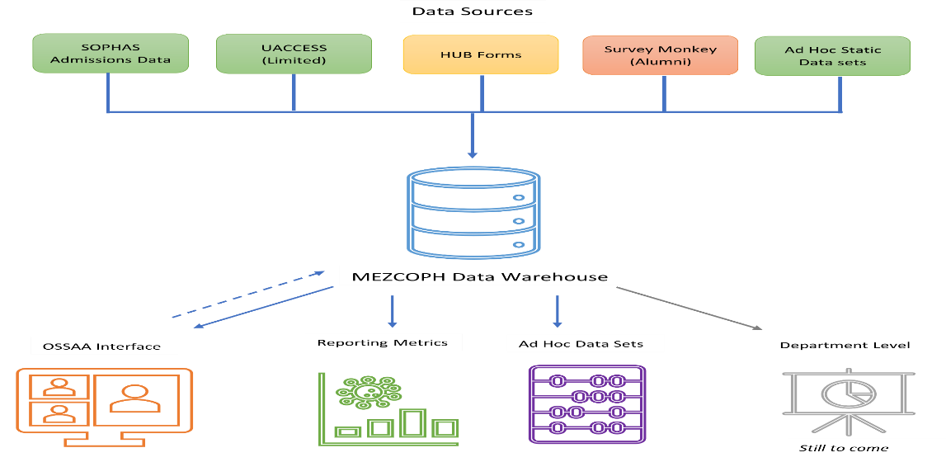
SOURCES OF DATA

Slide 71
DATA PRESENTATION
  In April and October of every year, evaluation data are presented and discussed at the MEZCOPH Executive Council meeting (members includes Chair of the faculty, chair of the staff council, 2 students (chair of the Student Public Health Alliance and representative of the Students’ Affairs Committee); Chair of the Committee on Inclusion Excellence; Community member, Research Center directors, and the administrative leadership of the College).
  Additionally, in May and December of each year, summary of the data are presented at College-wide retreats, followed by discussion, recommendation and action (as needed)

Slide 72
USE OF EVALUAITON
Instruction | Research | Diversity
Expanded the number of available service-learning courses | Made resources available to support engagement of students in faculty research and revised UAVITAE software to better track the related objective. | Created a new position for Associate Dean for inclusion, diversity ad equity
Monitor the number of faculty who are participating in university-level training to improve teaching effectiveness. | Associate Dean for Research and the Research Advisory Committee (RAC) instituted a new process for reviewing specific aims pages for first submissions of grants to increase external funding | Curriculum review to address inclusion, diversity, equity and access (IDEA)
Increased virtual recruitment efforts to attract underrepresented and geographically diverse students. The new activities arose from data collected in the New Students Survey which showed that few students were recruited at in-person graduate fairs. Thus, resources were shifted to build out virtual recruiting activities |  | Inclusion, diversity, equity and access standard agenda item in faculty assembly and departmental meetings

Slide 73

Q&A

Slide 74
Presenter contacts
Erik Carlton: erik.carlton@hsc.wvu.edu
DenYelle Kenyon: Denyelle.Kenyon@usd.edu
Chelsea Wesner: Chelsea.Wesner@usd.edu
Jennifer Matthews: creemensj@ecu.edu
Kelli Russell: russellk14@ecu.edu
Clint Pinion: Clint.Pinion@eku.edu
Michelyn Bhandari: Michelyn.Bhandari@eku.edu
John Ehiri: jehiri@arizona.edu

Slide 75


