Slide 1
Overview of proposed criteria revisions
November 2023

Slide 2
Logistics
Use Q&A box at any time during presentation
Slides & recording on website within 24 hours

Slide 3
Access this and past presentations

Slide 4
Today’s webinar
Revision process
Overview of proposed revisions
Questions
NOT a substitute for written comments

Slide 5
Process: how did we get here?
2020–2021
adopting revised criteria amid racial reckoning—desire to be deliberate & thoughtful
2021–2023
multiple Council workgroups & full group discussions, review of other accreditors’ practices, consultation with legal counsel

Slide 6
Process: what happens next?
Jan 12, 2024: comments due
March 1: Council reviews comments
By April 1: new criteria promulgated OR another draft out for comment
When criteria are adopted: notification to all accredited & applicant units about relation to next s-s (will give units time to incorporate)
No compliance reporting expected, most units will use revised criteria in next full review

Slide 7
Comment period
Submit via web form only
Comments outside scope of revision (on other criteria or non-DEI topics) not accepted
Next substantive criteria revision (all criteria): 2026

Slide 8
Overview of proposed revisions

Slide 9
Acknowledging the challenge…

Slide 10
Changes
New definitions & examples for key terms
Streamlined, clarified Criterion G1
B Criteria
Guiding statements
Grad rates
Alumni perceptions
Language changes in learning objectives & competencies (D)
Minor adjustments to A, E, H
Replaced “stakeholder” throughout doc
F1: Community Involvement

Slide 11
Adjusted examples in “aspects of diversity include…”
Aspects of diversity include ability/disability, age, citizenship or national origin, community affiliation, country of birth, culture, ethnicity, first-generation students, gender, gender identity and expression, health status, historical under-representation, language, political ideology, privilege, race, refugee status, religion/spirituality, sexual orientation, socioeconomic status, tribal sovereign status, and veteran status. This list is not intended to be exhaustive.

Slide 12
Cultural concordance replaces cultural competency
Cultural concordance… refers to bridging the cultural gap between public health professionals and communities to promote culturally sensitive and population-centric strategies.
It involves public health professionals being aware of their own cultural biases, acquiring knowledge about different cultures, and demonstrating respect and sensitivity to diverse cultural perspectives.
By doing so, public health professionals can build trust, establish effective communication, and engage communities in a manner that is respectful of cultural beliefs and values.

Slide 13
Replaced “stakeholders”
Partners
Relevant communities & individuals
Audiences
Etc.

Slide 14
Criterion G1: 3 changes
Removed one example of possible actions (“recruitment & retention of diverse faculty, staff, and students”) to avoid implicit expectation
Added clear direction on collection of climate data within criterion itself
Adjusted documentation requests

Slide 15
Climate data
The school or program monitors its progress and efforts in diversity and cultural concordance using evidence, including, at a minimum, student, faculty, and staff (if appropriate) perceptions of the unit’s climate. The unit regularly collects, monitors, and responds to perceptions of its climate relating to diversity and cultural concordance.
The unit defines qualitative and/or quantitative methods designed to provide useful information on climate. Units may draw on university climate data if the data are sufficiently specific to provide useful information. “Useful information” refers to information that provides the unit with a reasonable basis for making curricular and related improvements. Qualitative methods may include focus groups, key informant interviews, etc.
The school or program documents and regularly examines its methodology for collecting climate perceptions, making revisions as necessary, to ensure useful data.

Slide 16
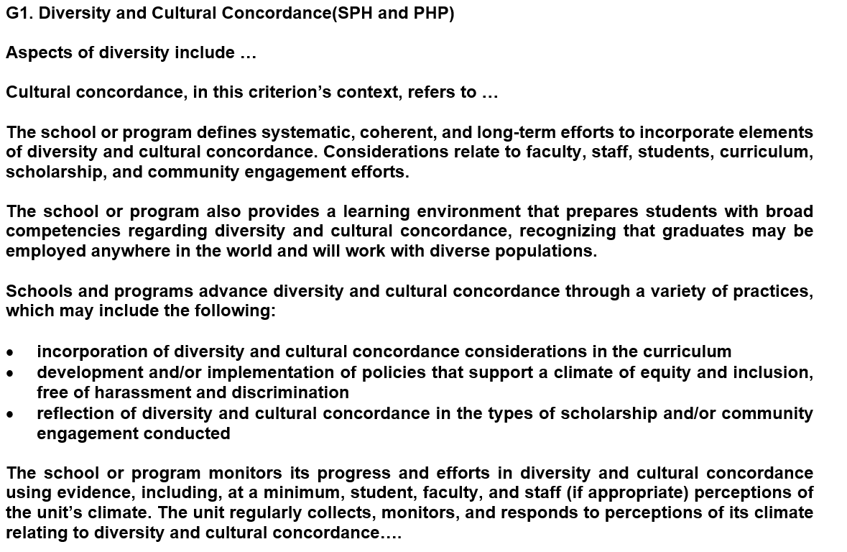

Slide 17
Doc requests
Removed requirement for explicit definition of “priority populations”
Removed duplicative request for “actions and strategies…that create… a culturally competent environment”
Replaced request for “quantitative & qualitative data” with request for “evidence”

Slide 18
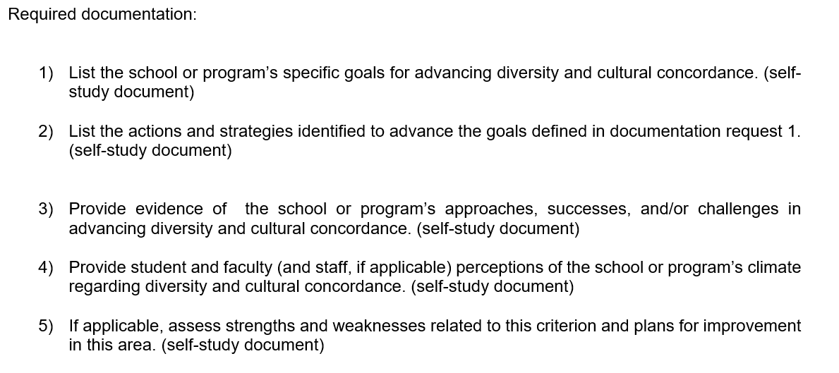

Slide 19
B1: Guiding Statements (mission, vision, goals)
Together, the school or program’s guiding statements must address the unit's approaches and aspirations for each of the following:
advancing the field of public health through instruction, scholarship, and service
promoting student success through instruction, scholarship, and service
preparing students to work with diverse populations and communities

Slide 20
B2: Evaluation & Quality Improvement
No change to criterion or doc request text, but…
Eval plan flows from guiding statements, so incorporating DEI into guiding statements may necessitate adjustments to your eval plan…

Slide 21
B3: Graduation rates
Current criterion & approach remains: 70% graduation within max allowable time for master’s & bachelor’s, 60% graduation for doctoral
For units who do not meet threshold, added 2 new options (Option 2 & Option 3) to demonstrate compliance

Slide 22
Option 2
Three-year average meets threshold (70% or 60%)
Allows for units that have an anomalous year but are otherwise on track

Slide 23
Option 3
Grad rates match or exceed graduation rates of at least two comparable degree programs within the same institution
Intends to recognize units’ unique missions and purpose, particularly for units that intend to serve populations underrepresented in higher education

Slide 24
Option 3: additional requirements
public disclosure of rates within one click of unit’s homepage
recruitment and admissions processes accurately present time, effort, and other commitments necessary for success
proactive student advising and support
detailed analysis of factors that depress graduation rates
interventions designed to address non-completion
analysis of the effectiveness of interventions

Slide 25
B5: Alumni Perceptions
Information on alumni perceptions of their preparation for the workforce:
what skills are most useful and applicable in post-graduation destinations
areas in which graduates feel well prepared
areas in which graduates would have benefitted from more training or preparation
perceptions of their preparation to work in diverse environments and/or with diverse populations

Slide 26
F1: Community Involvement
For seeking input:
Partners should align with university and school or program missions and relate to the types of degrees offered and to relevant student and community demographics.
They may also provide regular feedback about efforts to prepare students to work with diverse populations and communities.

Slide 27
Wording changes to learning objectives (D1, D16, D17, D18)
4. List major causes and trends of morbidity and mortality in the U.S. or other community relevant to the school or program, with attention to differences in populations within the community, e.g., economic, ethnic, gender, racial, etc.
10. Explain the cultural, social, political, and economic determinants of health and how the determinants relate to population health and health inequities

Slide 28
Wording changes to foundational competencies (D2, D3, D9)
MPH FCs 6, 13, 19, 20
DrPH FCs 4, 5, 10, 15, 16
Bachelor’s FC 1

Slide 29
A Criteria: committees & decision making
A1: Organization & Administration
A3: Student Engagement
“… makes efforts to include diverse voices and perspectives from a range of individuals/students…”

Slide 30
E Criteria: Faculty
Faculty Qualifications (E1) added “Faculty education, experience, demographics, and/or lived experience supports the instructional areas with which they are associated.”
Instructional Effectiveness (E3) added “The school or program supports professional development and advancement in instructional effectiveness, including support for working with diverse students and communities.”
Minor additions & adjustments in E4 & E5

Slide 31
H1 (Academic Advising) & H2 (Career Advising):
Advisors “…understand the needs of a diverse student body and are qualified to … support their success.”

Slide 32
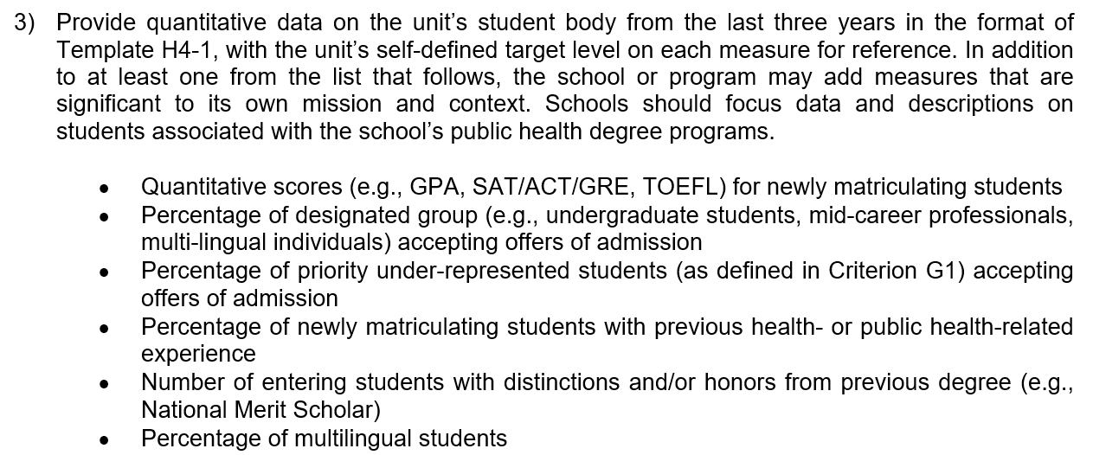
NOT A REVISION—but lots of questions coming in on Criterion H4
Choose the indicator that works best for you—we do not require reporting on % of URM enrollments!
BUT federal guidance says that tracking quant information on URM enrollment is permissible & can be useful as long as it is not used to influence admissions decisions

Slide 33
Questions?

