Slide 1
Webinar: Collecting Alumni & Stakeholder Data
April 2023

Slide 2
Logistics
Up to 1.0 CPH recertification credit
Slides & recording on website within 24 hours

Slide 3
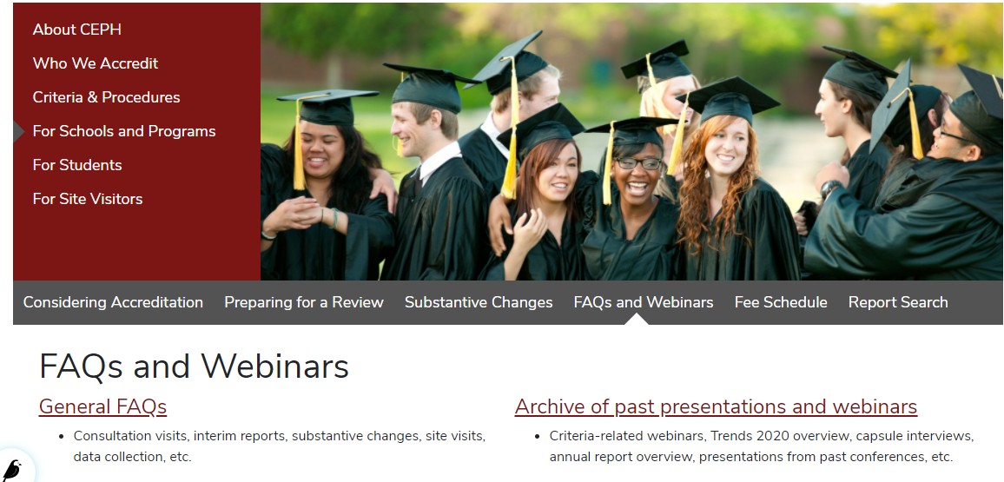
Access this and past presentations

Slide 4
What’s on the agenda?
Outline of relevant CEPH criteria and common challenges
Panelists
Q&A session

Slide 5
Relevant CEPH Criteria
SPH/PHP
Criterion B4: Post-Graduation Outcomes
Criterion B5: Perceptions of Curricular Effectiveness
Criterion F1: Community Involvement in Eval/Assessment
SBP:
Criterion C3: Post-Graduation Outcomes
Criterion C4: Stakeholder Feedback

Slide 6
Post-Graduation Outcomes
Criteria asks school/program to:
collect and analyze data on graduates’ employment or enrollment in further education post-graduation
choose methods that are explicitly designed to minimize the number of students with unknown outcomes
achieve rates of 80% or greater employment or enrollment in further education
Most common challenge:
High unknowns / methods not designed to reduce unknowns

Slide 7
Alumni Perceptions of Curricular Effectiveness (SPH and PHP)
Criteria asks school/program to:
Collect information on alumni perceptions of their preparation for the workforce.
Data collection must elicit information on:
Define qualitative and/or quantitative methods designed to provide useful information
Documents and regularly examine methodology, making revisions as necessary, to ensure useful data.
what skills are most useful and applicable in post-graduation destinations;
areas in which graduates feel well prepared;
and areas in which they would have benefitted from more training or preparation
Most common challenge:
Doesn’t generate useful information
Relies on survey with low response rate
Asks the wrong questions
Overly reliant on one method

Slide 8
Community Involvement in School or Program Evaluation & Assessment (SPH and PHP)
Criteria asks school/program to:
stakeholders not adequately engaged, or not engaged consistently (e.g., Advisory Board lapses)
Most common challenges:
engage community stakeholders, alumni, employers, and other relevant community partners.
ensure that stakeholders provide regular feedback on its student outcomes, curriculum, and overall planning processes
define qualitative and/or quantitative methods designed to provide useful information
gather useful information from employers of graduates to assess student outcomes and the curriculum
no useful data from employers

Slide 9
Stakeholder Feedback (SBP))
Criteria asks programs to collect information on:
alignment of the curriculum with workforce needs
preparation of graduates for the workforce
alumni perceptions of readiness and preparation for the workforce and/or further education
Data collected from both alumni and relevant community stakeholders
Schedule for reviewing data
Most common challenges:
Lack of data from employer perspective
Alumni data aren’t useful or informative

Slide 10
Up Next: Panelists

Slide 11
Collecting Data from Alumni, Employers and Other stakeholders Amy Abruzzi Amana Kaskazi Rutgers University, EJ Bloustein School
Thursday, April 20, 2023
2-3 PM eastern time

Slide 12
Standalone Baccalaureate Program: Undergraduate Public Health Program
Enrollments: As of January 2023, we have 530 declared public health majors and 175 declared public health minors. During any given semester, approximately 1800 students are in our public health courses.
Faculty: More than 20 full-time faculty and about 40 part-time faculty support our Public Health program.
More than a dozen faculty/staff support stakeholder data collection:
Public Health Program Leader
Assistant Director of Assessment and Accreditation
Bloustein’s Office of Academic and Student Services staff
Faculty teaching Leadership Seminar and Professional Practice Internship
Rutgers Career Exploration and Success staff

Slide 13
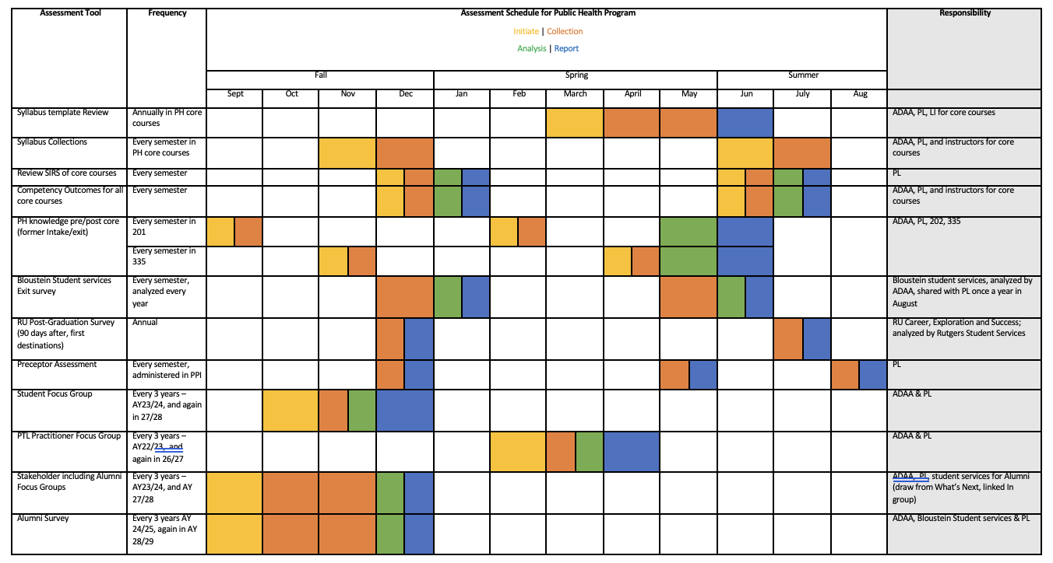
Part of our Larger Assessment plan for maintaining accreditation
GANTT chart illustrating regularly occurring activities that comprise our main assessments
Key components:
Assessment tool (e.g.: syllabus templates, exit survey, post-graduation survey, stakeholder focus groups)
Frequency (e.g.: every semester, annual, every 3 years)
Specifies phase by month:
Initiated, Collection, Analysis, Report

Slide 14
Identifying and engaging Stakeholders
 | Alumni | Employers/Preceptors | Practitioners
Identification process | Faculty/student advising office recommendations, LinkedIn | Internship coordinator, Networking events, RU 90-day out survey | Various directories, Part-time lecture lists, LinkedIn
Informal conversations | One-on-one meetings, What’s Next programs, DIL interviews | One-on-one meetings, What’s Next programs, DIL interviews | One-on-one meetings, What’s Next programs, DIL interviews
Formal data gathering | Alumni survey, First destination survey, Focus groups | Preceptor survey, First destination survey, Focus groups | Evaluations, Observations, Focus groups

Slide 15
Overlapping realms
Alumni often work in health departments, hospitals, health related organizations; often serve as internship preceptors
Employers/preceptors include health departments, hospitals, organizations
Practitioners are often part-time lecturers, may also be alumni, preceptors

Slide 16
Use of LinkedIn
Individual networks
Alumni network

Slide 17
Building Our LinkedIn Network
All public health majors required to take Leadership Seminar (450) (prior to capstone experience)
One of the components is to help them build a LinkedIn profile.
Current students are encouraged by their Academic Advisors to join our PH Alumni Network on LinkedIn as they near graduation
Que up for it during Professional Practice Internship (499) (6-credit capstone course)
Faculty also encourage our students to join their individual profiles as well as our network on LinkedIn
Program Leader also encourages alumni, practionners, employers to join LinkedIn

Slide 18
What’s Next series and DIL interviews
Driven by challenges of large major at large university, where student declare in junior year
What’s Next site on Canvas – self enroll course
Career pathways approach
Updated and revised with student assistants
Recordings of programs and interviews, lots of other info
What’s Next Program Series
Panel discussions feature alumni
Benefits of Zoom
Recent programs include “Navigating your first year out”, “Inside your local health department”, and “Focus on Epidemiology”
Day in the Life (DIL) interview series
One-on-one career pathway interviews. Zoom!
uses “menu” approach for asking career questions
conducted by student assistants

Slide 19
Three Different Focus groups
Students
Invite students at various levels of matriculation
Stakeholders
Invite alumni, employers, recruiters, and hiring managers
Practitioners
Invite part-time lectures & practitioners
Questions focus on curriculum and development experiences, program structure and support, and challenges/opportunities for improvement
Questions focus on degree impact on career journey, program improvement, alumni engagement, and emerging field competencies
Questions focus on teaching and workload, program structure and support, professional development, suggestions for improvement

Slide 20
Sample of Focus Group Protocol

Slide 21
Three different Surveys
First Destination Survey
Given to alumni within six months of graduation
Alumni Survey
Given to alumni every 3 years
Preceptor Survey
Given to part-time lectures & practitioners
Questions focus on employment status, including job title, industry, salary, and location, and further education plans
Questions focus on employment status, further education plans, skills and experiences gained, and alumni engagement
Questions focus on experiences with the program and our students

Slide 22
Results of first destination survey

Slide 23
Sample of Preceptor survey (Qualtrics)

Slide 24
Closing the Loop
Engage: Solicit in continuous feedback
Analyze: Identify patterns and actionable items
Plan: Collaborate on recommendations for improvement
Execute: Implementing recommendations based on community feedback

Slide 25
Take home messages
PLAN!
Think about how gathering stakeholder data fits into your larger plan for program evaluation and assessment
Schedule in tentative dates for focus groups and surveys well in advance
Establish routines for obtaining data gathered outside of your program
NETWORK!
Foster regular, informal contact with stakeholders
Student-focused programming helps forge better relationships across all types of stakeholders
LinkedIn can be very helpful for locating individuals, especially for alumni
SHARE!
Discuss findings with faculty, student advisors at program meetings, get feedback, new ideas
Let stakeholders know about their impact whenever possible
Let upper-level administrators know what you are doing

Slide 26
Contact information
Amy Abruzzi, PhD, MPH, MLS, MCHES, CPH
Associate Teaching Professor and Public Health Program Leader, Undergraduate Programs
E.J. Bloustein School of Planning and Public Policy
Rutgers, The State University of New Jersey
email: amy.abruzzi@rutgers.edu
Amana Kaskazi, PhD
Assistant Director for Assessment & Accreditation
E. J. Bloustein School of Planning & Public Policy Rutgers, The State University of New Jersey
email: amana.kaskazi@ejb.rutgers.edu

Slide 27
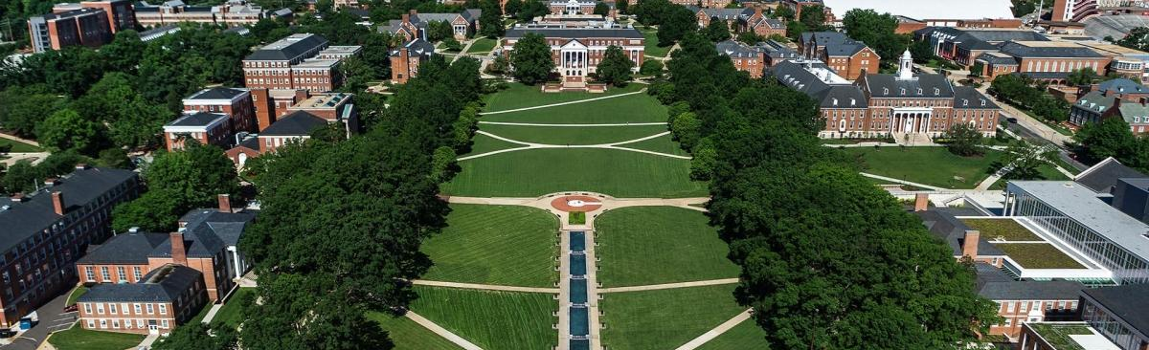
Reaching Alumni for Actionable Data
Brittany Bugbee, MPH
bbugbee@umd.edu
Office of Planning and Evaluation
University of Maryland School of Public Health
April 20, 2023

Slide 28
University of Maryland School of Public Health
School formed in 2007, accredited in 2008
90 primary faculty
Data efforts overseen by the Office of Planning and Evaluation
Undergraduate
Masters
Doctoral
Total Enrollment
2,227
322
164
# Graduating in FY22
776
125
24
Programs
Community Health
Family Science
Kinesiology
Public Health Science
Behavioral and Community Health
Biostatistics
Couple and Family Therapy
Epidemiology
Environmental Health Sciences
Health Administration
Health Equity
Health Care Management
Health Policy Analysis and Evaluation
Kinesiology
Physical Activity
Public Health Practice and Policy
Behavioral and Community Health
Environmental Health Sciences
Epidemiology
Family Science
Health Services Research
Kinesiology
Maternal and Child Health

Slide 29
Data Sources
Surveys (commencement, alumni)
Commencement cards
Alumni update form
Internet/LinkedIn searches
Updates from faculty/staff
Preceptor and employer surveys
Notes:
.

Slide 30
Surveys
Graduate commencement survey overseen by OPE (twice per year)
Undergraduate commencement survey overseen by University Career Center (twice per year)
Alumni survey (once per year)
Assess:
Post-graduation destination
Competencies
Meaningfulness of education for employment
Experiences outside of the classroom
Overall program satisfaction

Slide 31
Meaningfulness of Education
The skills I learned from my SPH courses will be meaningful for my future employment.
My SPH education has prepared me broadly and intellectually to address my job requirements.
My SPH education provided me with the specific skills I need for my current job.

Slide 32
Open-ended Survey Items
Commencement Survey
What skills or competencies were lacking in your education at the SPH?
What do you consider to have been the positive aspects of your academic program?
What do you consider to have been the negative aspects of your academic program?
Please use this space for any general comments you have about your experience at the SPH that was not covered in this survey.
Quantitative and qualitative items on availability of faculty and class size

Slide 33
Open-ended Survey Items
Alumni Survey
What coursework (specific classes, topic areas, or skills) has been the most valuable to your career so far?
What skills have been important for your career but were not part of your education?
What one thing would you change about {Program Name}?
Please use this space for any general comments you have about your experience at the SPH that was not covered in this survey.

Slide 34
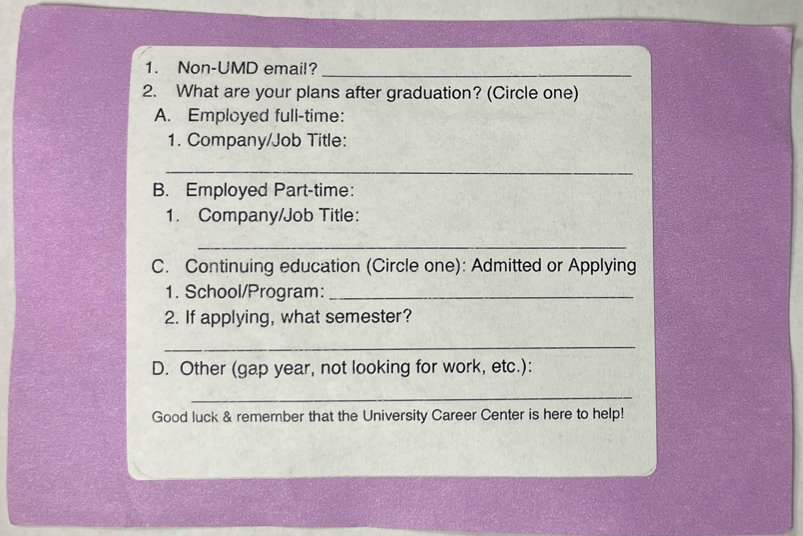
Commencement Cards

Slide 35
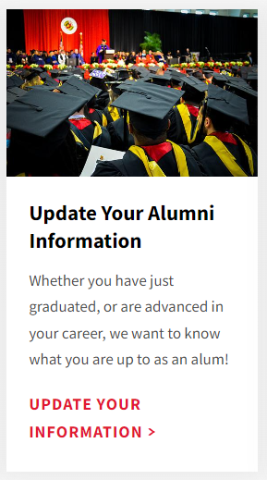
Alumni Update Form
Programmed in Qualtrics to collect information about what alumni are up to
Can be filled out by alumni or faculty/staff
Shared primarily on social media
Received ~500 responses in past five years
https://go.umd.edu/UMDSPH-Alumni-Form

Slide 36
Last Stages
LinkedIn/Internet Searches
Creating LinkedIn pages is part of professional development curricula
Students/alumni invited to join LinkedIn groups for specific programs
Time-intensive but valuable
Faculty/Staff Updates
Most effective for graduate program alumni

Slide 37
Example of a Lesson Learned
Among undergraduates, there was stronger agreement that they had been prepared “broadly and intellectually” relative to preparation with specific skills.
From examining post-graduation outcomes and open-ended responses, learned that this was mostly coming from students pursuing medical professions

Slide 38
Preceptor and Employer Surveys
Each done biennially (surveys alternate)
Employer contact information shared by students at the time of commencement and alumni surveys (but remains a challenge)
Opportunity to ask about expected changes to the field, workforce development needs

Slide 39
Key Lessons
Diversity of data sources and timepoints
Building relationships across campus
Sharing results widely, in meetings, to gain insight
Continuous improvement to data collection tools

Slide 40
Collecting Data from Alumni, Employers, and Other Stakeholders
Christopher Seplaki, PhD
Christopher_Seplaki@URMC.Rochester.edu
Associate Professor, Department of Public Health Sciences (Primary), Psychiatry (Secondary)
Director, Master’s in Public Health (MPH) Program
University of Rochester, School of Medicine and Dentistry
Rochester, NY

Slide 41
About the UR MPH Program
Unit of accreditation: Program
Degrees/concentrations offered: MPH with one generalist concentration [presently] and two formats (hybrid and online only)
Number of students: approximately 50 +/- total (part-time + full-time)
Number of primary faculty: Named PIF=3, Total PIF=7, Non-PIF=4
Number of administrators/staff who support alumni/stakeholder data collection: approx. 2-3

Slide 42
How We Obtain Stakeholder Input
Three groups of stakeholders
Alumni
Employers
Other stakeholders
Three modes collection:
Informal professional interactions
Formal, quantitative survey (quantitative data)
Formal, structured interviews (qualitative data)

Slide 43
Informal Professional Interactions
Professional interactions between our faculty and our alumni, potential MPH employers, public health partners and other related organizations or program stakeholders
Can be powerful because they happen often and tend to be focused on a particular topic
Must have a mechanism to solicit / receive information (feed to relevant committee, use regular solicitation reminders)

Slide 44
Formal Quantitative Survey of Alumni
Online survey invitations sent out in fall to list of recent alumni
Survey covers a range of content related to multiple sections of the self-study
Requires updated contact information
Completion rates are always a challenge, so (a) resend invitations and … (b) ...

Slide 45
Formal Qualitative Structured Interviews with Alumni
Program Director follow-up in January / February with a subset of names and invites for live, structured interview
Use a script…

Slide 46
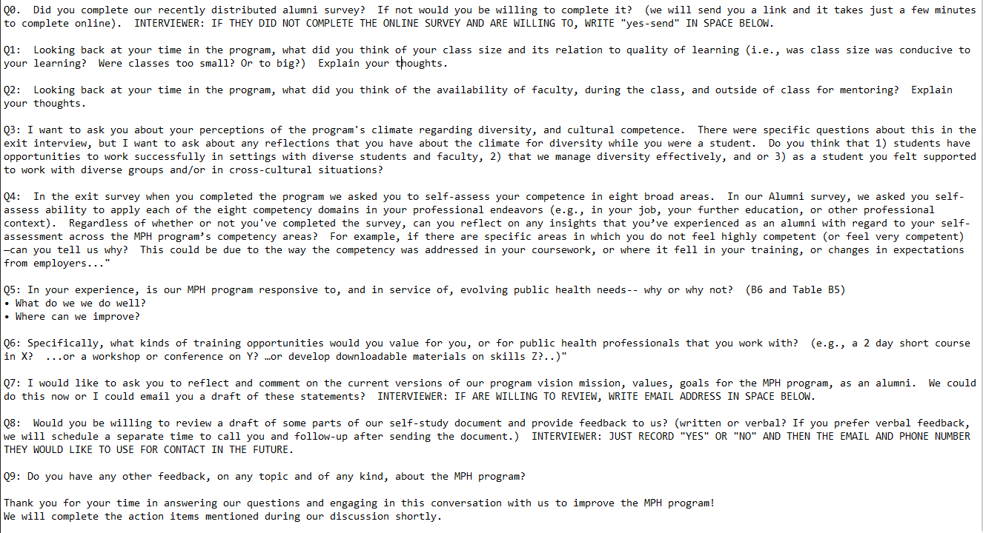
Formal Qualitative Structured Interviews with Alumni

Slide 47
Formal Qualitative Structured Interviews with Potential Employers and Partners
In January PD solicits from faculty recent informal stakeholder interactions
PD conducts interview with a selection of potential MPH employers or related public health professionals
Local public health service providers
Regional planners
National organization representatives
Interviews focus on perceptions of MPH training effectiveness and trends for the field

Slide 48
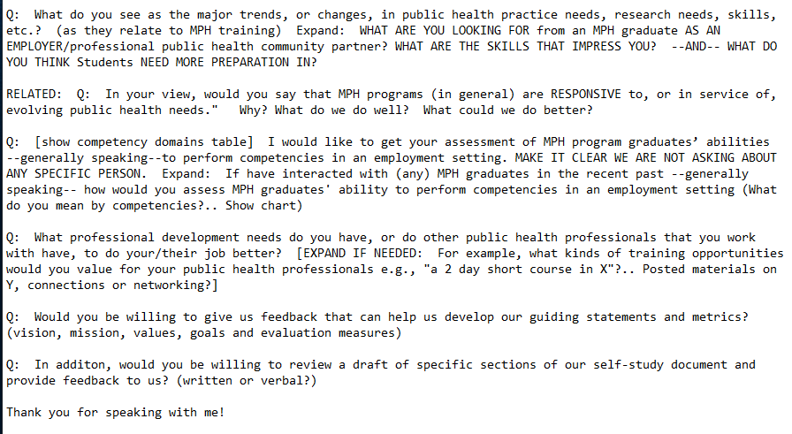
Formal Qualitative Structured Interviews with Potential Employers and Partners

Slide 49
Final Thoughts
Build on strengths relative to size of program
Build your process within an explicit feedback loop
Have a clear process and a schedule of events
Fix what did not work
Review your process
Incorporate feedback and new ideas
Questions?

