Slide 1
Pre-Application Orientation Webinar: Part A
Standalone Baccalaureate Programs
Notes:
Welcome to Part A of the pre application orientation workshop for standalone baccalaureate programs. My name is Olivia Luzzi, I am an accreditation specialist here at CEPH and I will be walking you through this portion of the P-AOW.

Slide 2
Pre-Application Orientation Workshop Elements
P-AOW Part A
This recorded webinar
Provide an overview of filling out the IAS
Expectations and timeline
P-AOW Part B
Good and bad examples
Review common questions
Need to register to receive slides
Notes:
The P-AOW now has two important elements, Part A, which is this recording where we will provide an overview of filling out the IAS step-by-step and go over expectations and timelines. Part B is also a recorded webinar that reviews strong and weak examples related to specific sections of the IAS.

Slide 3
If you haven’t already…
Watch the CEPH Overview
Brief PowerPoint presentation explaining CEPH and accreditation
https://ceph.org/about/dates-to-remember/paow/
Notes:
If you haven’t already, I encourage you to go back and watch the recorded CEPH Overview presentation. It explains who we are at the Council on Education for Public Health, known as CEPH, as well as the basics of accreditation generally.

Slide 4
Overview of the webinar
Minimum Qualifications
Resources
Application Timeline
Eligibility
Cost
Unit of Accreditation
Initial Application Submission Walk-through
Notes:
Topics that will be covered in this recording are: available resources for you as you begin your journey to accreditation, minimum qualifications, the application timeline, important notes about eligibility, cost, the unit of accreditation, and finally, the bulk of our time will be spent walking through filling out the IAS.

Slide 5
Resources: Prospective Applicant Checklist
1
2
3
Notes:
Two important resources that I want to make you aware of are our Prospective Applicant Checklist and the strength of our website’s search function. We will use the search function to find the checklist. Simply type checklist into the search bar, and you will get two results. Click on the second result, considering accreditation, and a list of resources will pop up. If you navigate to the third option, it will provide you a link to download the checklist.
A note about our search function—it is very sophisticated and a great place to begin if you are in need of some guidance. Simply type a key word into the search bar and you should get where you need to go!

Slide 6
Notes:
This is the first page of the checklist—it includes a custom timeline to help you determine the best time to submit your IAS to CEPH. You will be working closely with the Director of Accreditation Services (and that’s me - Kristen Varol). You should view me as a resource for any questions you may have.

Slide 7
Minimum qualifications
Institutional Accreditation
Bachelor’s degree in a discipline of public health
Notes:
Next, before we get too far, I want to talk about the minimum qualifications to apply with CEPH: you must be housed in an institutionally accredited institution, and you must offer a bachelor’s degree in a discipline of public health.

Slide 8
Application timeline
Review Checklist
Download and prepare IAS
Mail check to CEPH ($1,000)
Email IAS to CEPH
Begin draft and review process with CEPH
(~2-3 rounds)
IAS submitted to Council meeting
Council decision
Notes:
Here is a very boiled down timeline of the steps from now until you receive a decision on your application from the Council. First, we ask that you carefully review the checklist and download the IAS template. You will then prepare your IAS, and once you feel it is in a good place, you will mail a check, of one thousand dollars to the CEPH offices. You will then email your electronic IAS to CEPH staff and an iterative process begins.
In the next few slides, we will talk more in depth about these stages

Slide 9
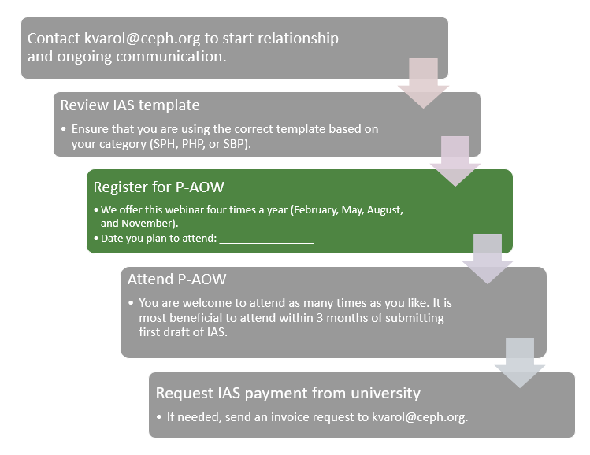
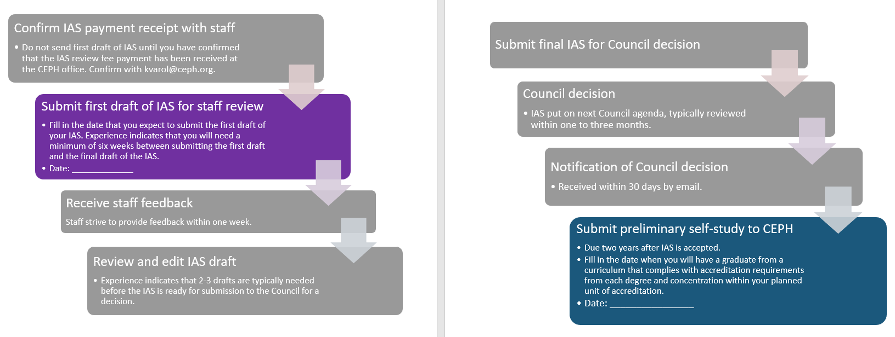
Notes:
This is the timeline from the last page of the of the checklist I mentioned earlier. This is a customizable timeline to help you in your planning process. The colored boxes are places where you will need to insert dates to determine your specific timing. The checklist has detailed information to help you figure out these dates and we recommend contacting our Director of Accreditation Services, Kristen Varol, to help work through your individual timeline.

Slide 10
Eligibility
Graduation Rates
Must have at least one graduate from each concentration in the unit of accreditation by the time of the preliminary self-study
Notes:
A quick note about a key eligibility requirement-you must have at least one graduate from each concentration in the unit of accreditation by the time of your preliminary self-study. If you are a long-established program, this may not be an issue for you, however, if you are a new program, you will need to pay close attention to this requirement, as it may mean setbacks for you if you are not careful in your planning. The checklist’s customizable timeline will help you with this careful planning. It is important to be realistic with your timeline in order to not face any unwanted setbacks in the process.

Slide 11
Unit of accreditation (1 of 2)
SBP only include baccalaureate public health degree programs, with no graduate public health degree programs included
Eligible majors and degree programs:
Bachelor of Public Health
Bachelor of Arts or Bachelor of science with a major in public health
Bachelor of Arts or Bachelor of Science with a major in a discipline of PH, such as epi or health promotion
Bachelor of Arts or Bachelor of Science with a major in a closely related field, such as global health, international health, or health sciences/studies
CEPH does not accredit minors, certificates, or associate's degrees
Notes:
The unit of accreditation for an SBP only includes baccalaureate public health degree programs with no graduate public health degree programs included. If you have a graduate public health degree program in the unit you would like to seek accreditation for, you will need to navigate to the PHP P-AOW Part A recording, as this is not for you.
Additionally, if you are an SBP program hoping to begin a graduate public health program in the next few years, please reach out to CEPH staff directly to discuss.
Back to the slide—any of these degree programs are eligible for CEPH accreditation. Please note, CEPH does not accredit minors, certificates, or associate’s degrees.

Slide 12
Unit of accreditation (2 of 2)
Must include all BPH, BSPH, BAPH, BA/BS in public health degrees that operate within the same governance and leadership structure.
Notes:
One final notes, the unit of accreditation must include all public health baccalaureate degrees that operate within the same governance and leadership structure.

Slide 13
Initial Application Submission (IAS)
Twelve Sections
Statement of Regional Accreditation
Instructional Matrix
Organizational Structure
Foundational and Concentration Competencies
Curriculum Overview
Institutional Commitment and Fiscal Support
Recruitment and Selection
Policies and Plans for Recruitment and Selection of Students
Documentation of Qualified Designated Leader
Documentation of Required Faculty Resources
Graduation Data
Evaluation of Program Effectiveness
Notes:
This next portion will take the bulk of our time today. We are going to walk through the IAS step-by-step. The IAS has 12 sections, some of which will be quick and easy for you to fill out, and some of which will take a bit more time. The sections bolded in red here are ones that are most problematic and take the most time to fill out.

Slide 14
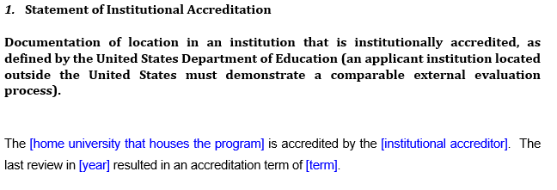
1. Statement of institutional accreditation
Notes:
The first section is an easy fill in the blank exercise. You will replace the blue text with text that describes your institution.

Slide 15
2. Instructional Matrix
Notes:
The instructional matrix tells us what degrees and concentrations are contained in your unit of accreditation. As you can see, we list the concentration, the degree, and then the delivery format. (interpret the chart)

Slide 16
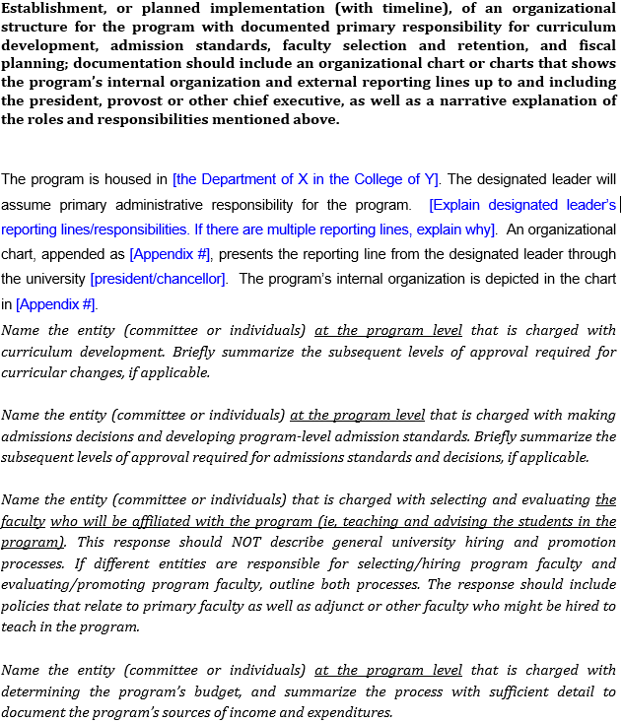
3. Organizational structure
You fill in the blue parts
You write narrative in response to this
Notes:
Section three also has a fill in the blank portion, but also requires a bit more narrative from you. The italicized text describes to you what you need to respond to in narrative format. As you can see here, you will need to name the entity at the program level that is charged with curriculum development and briefly summarize the subsequent levels of approval for curricular changes.
Please note that all items in this IAS, will be requesting information about the specific program or unit of accreditation. All responses should be tailored to the prospective unit of accreditation, and not processes at the overall institution unless otherwise noted.

Slide 17
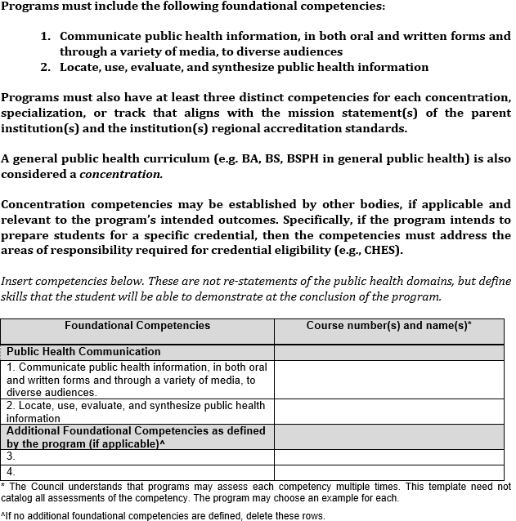
4. Foundational and concentration competencies: foundational
Map the competencies to course numbers and names
Leave these here
Do you have more foundational competencies? Put them here
Notes:
Section four is a bit more in depth than the previous sections. Here you will map specific competencies to course names and numbers at your university. CEPH has developed two foundational competencies that we require every program to meet. You will leave these competencies in the table. If your program wishes to define additional foundational competencies, you may do so and add them to this table. Please note that foundational competencies are competencies that every student, regardless of concentration or focus area, must meet. Additionally, it is important that you put the course name AND number in this table.

Slide 18
4. Foundational and concentration competencies: concentration
Map the competencies to course numbers and names
You must fill out
These courses, along with those mapped in the foundational table, must be included as an appendix to this document
Notes:
The second part of section four is concentration competencies. This is where you develop and define competencies specific to each concentration that your program offers. Even if your program offers a generalist concentration only, you still must develop and define at least three concentration competencies.
Each concentration must have at least three distinct competencies that are mapped to concentration courses.

Slide 19
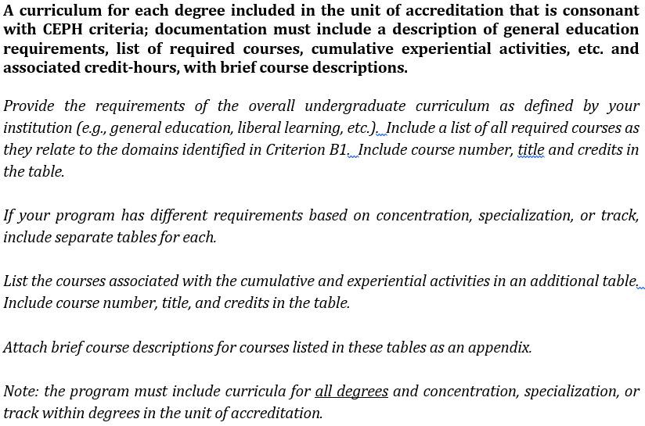
5. Curriculum overview (1 of 4)
Notes:
Section five is related to the overall public health curriculum. we ask that you provide the requirements of the overall undergraduate curriculum, which includes a list of all required courses as they relates to domains in SBP criterion B1.

Slide 20
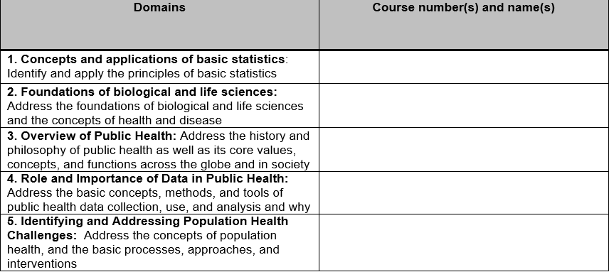
5. Curriculum overview (2 of 4)
STAT 101: Introduction to Basic Statistics
Notes:
This section also has a table that you will need to fill out. These are the domains in criterion B1, and here we ask that you provide a list of all required course names and numbers that relate to the domains on the pre-populated left side of the table. For example, you can see that for domain one, we have listed STAT 101. There may be more than one course that relates to the domains.

Slide 21
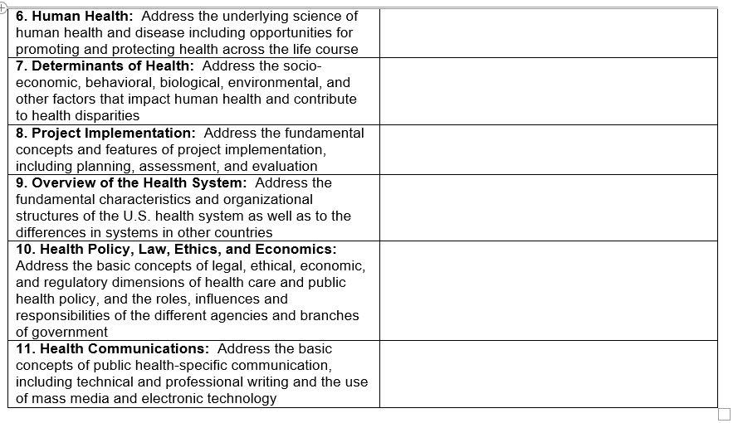
5. Curriculum overview (3 of 4)
HSMP 205: Health Systems
Notes:
This is the second half of the table with the remaining domains.

Slide 22
5. Curriculum overview (4 of 4)
300hr practicum at a practice partner site
PH 490: Public Health Practicum
Notes:
Section five also covers the cumulative and experiential activities. This could be the traditional internship, or service-learning projects or a research paper. You will provide a list of all activities in the left-hand column and provide the course name and number in the right-hand column.

Slide 23
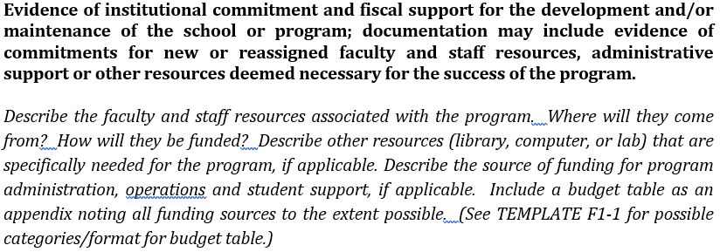
6. Institutional commitment and support
You provide narrative response
Notes:
Section six is another place that we ask you to respond to the italicized text with narrative about the specific unit.

Slide 24
7. Recruitment and selection
You provide narrative response
Notes:
Section seven is the same narrative response format.

Slide 25
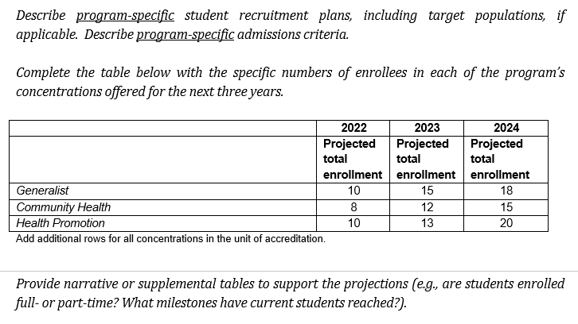
8. Policies and plans for recruitment and selection of students
= narrative response
Notes:
Section eight requires you to both provide narrative response to italicized text as well as fill out a table with program specific information. In this table, you will enter the next three years across the top of the table, and along the left-hand side, you will enter every concentration that you offer. If you only offer one concentration, you may delete all other rows. You will then work your way across the table entering the projected new enrollment in that year as well as the projected graduates in that year.

Slide 26
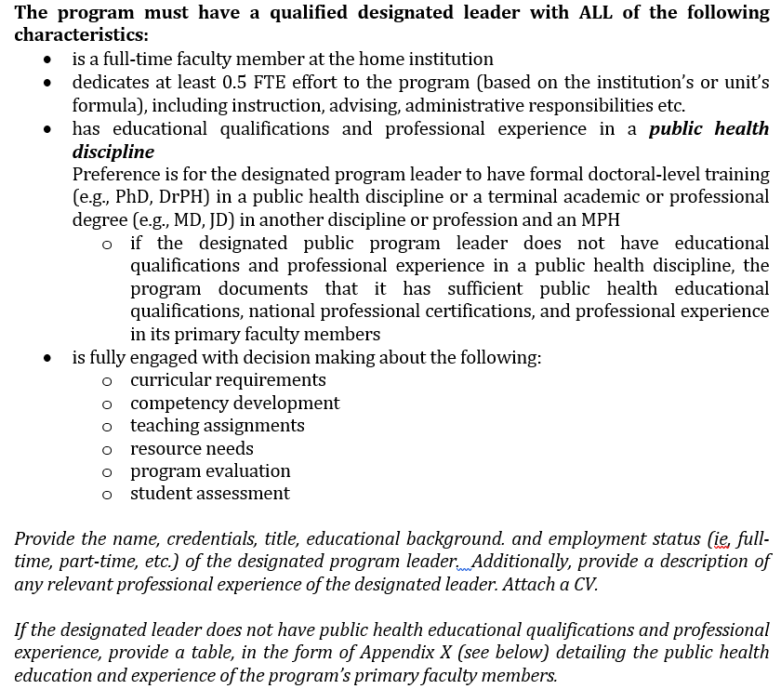
9. Documentation of a qualified designated leader
Narrative response
Notes:
Section 9 is a section that may hold programs back. Programs must have a qualified designated leader that meets all of the characteristics listed on the screen, Most importantly, the designated leader must be a full-time faculty member, that dedicates at least 0.5FTE to the program and has educational and professional experience in public health. We ask that you provide information about the qualified designated leader, including his or her CV and additional information if needed.

Slide 27
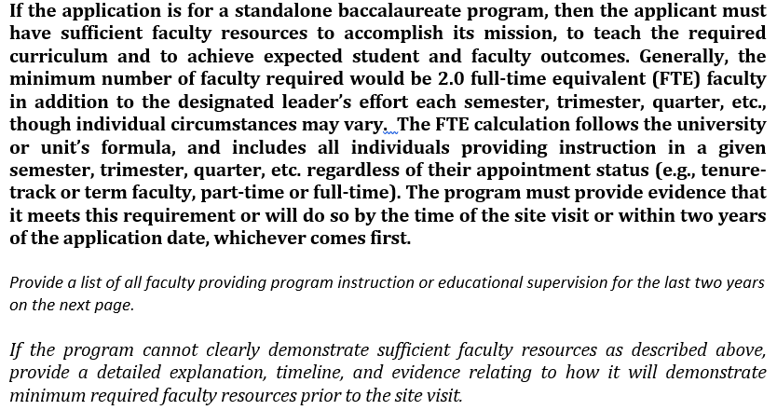
10. Documentation of required faculty resources (1 of 2)
You provide narrative response
Notes:
Section ten also holds programs back on occasion. The program must have at least 2.0 FTE faculty in addition to the designated leader. This does not need to be two individual people that equal 2.0FTE, it could be four individuals who each offer 0.5FTE to the program.

Slide 28
10. Documentation of required faculty resources (2 of 2)
Fill out and add/delete rows as necessary for your program
Notes:
This table provides information about each of the faculty members listed. This includes rank and title, FTE allocation, educational qualifications and courses taught in your program.

Slide 29
11. Graduation data
BS – Health Science | Maximum Time to Graduate: 5 years
Cohort of Students | 2015-16 | 2016-17 | 2017-18 | 2018-19 | 2019-20
# Students starting | 11 | 37 | 26 | 30 | 32
# Students withdrew, dropped, transferred out of unit of accreditation etc. | 0 | 5 | 2 | 1 | 2
# Students graduated | 9 | 32 | 12 | 5 | 0
# Students continuing | 2 | 0 | 12 | 24 | 30
Graduation rate (# graduated/ # starting | 82% | 86% | 46% | 17% | 0%
Notes:
Section 11 is the section that causes the most amount of grief for many places. I am going to walk you through this graduation rate table and help you determine what cohorts to report on.
For the purposes of this demonstration, we are going to go back in time and assume that the year is 2020.
Let’s begin with our maximum time to graduation. My program has determined that my maximum time to graduation is five years. That means that for this table, I am going to look at the cohort that has most recently reached their max time to graduate. That means that I will need to look at the cohort of students that entered my program and have had five years to graduate. If you look on the screen, the cohort of students that I am interested in entered my program in 2015-16. this means that they had 2015-16, 2016-17, 2017-18, 2018-19, 2019-20, to graduate out of my program.
These students represent students who reached 75 credit hours and declared their major as public health. I then fill out the information regarding those students as I move down the table. I will do that for the remainder of cohorts, giving CEPH important information about attrition and retention rates.

Slide 30
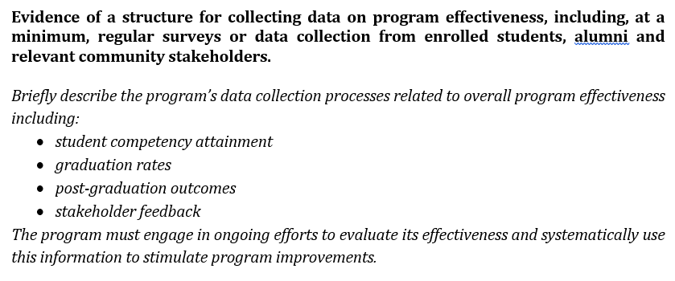
12. Evaluation of program effectiveness
You provide narrative response
Notes:
Section eleven is also a portion of the IAS that holds programs back. This section is about the overall feedback loop to measure your program’s effectiveness. You will again provide narrative in response to the italicized text. It is important to note here, that we are not necessarily interested in student data, we are interested in looking at the overall process of quality improvement at the program. You must address all four bulletpoints on the screen and it is important that we see evidence of the program closing the loop on feedback.

Slide 31
Submission
First send the $1,000 check to CEPH
Email the draft IAS to submissions@ceph.org
CEPH reviews draft and provides feedback
You make changes/updates
Repeat as many times as needed
CEPH places IAS on Council agenda
Council decision is made
If accepted, your two-year application period begins!
Notes:
That is the end of the IAS, so I just want to remind you of what the submission process will look like. You will send your one thousand dollar check to the CEPH offices and email your IAS to CEPH. You will begin the iterative process of refining the submission, and once ready, CEPH will place the IAS on the next available council agenda. The council will then make a decision based on your submission, and you will hear of that decision within 30 days. Once that decision is made, your two year applicant period begins!

Slide 32
CEPH.org
FAQs
Webinar recordings
Upcoming events
Email kvarol@ceph.org
Notes:
The resources available on our website include multiple FAQ documents, access to previous webinar recordings as well as advertisements of any upcoming events. My email address is also provided because I am the staff contact for all units pursuing initial accreditation.

Slide 33
Reminder!
Download the checklist
Download the template
Notes:
As a reminder, please download both the checklist and the IAS template!

Slide 34
Next step: register for Part B
https://ceph.org/about/dates-to-remember/paow/
Notes:
You have now completed P-AOW Part A, and your next step is to register for Part B at the website shown on the slide. After you register for the webinar, we will send you a link to access the slides. During this recorded presentation, we walk through more specific examples related to the IAS and common questions that we receive during the IAS preparation process. You can find registration information on our dates to remember page. Thank you for listening to this webinar, and we look forward to supporting you through all your accreditation efforts.

