Slide 1
Pre-Application Orientation Webinar: Part A
Public Health Programs (PHP)
Notes:
Welcome to the Pre-Application Orientation Webinar: Part A for Public Health Programs

Slide 2
Pre-Application Orientation Webinar Elements
P-AOW Part A
This recorded webinar
An overview of filling out the IAS
Expectations and timeline
P-AOW Part B
Good and bad examples
Review common questions
Need to register to receive slides
Notes:
The elements that we’ll be covering in Part A include filling out the IAS (that stands for initial application submission – and sometimes we simply call it the “application”) as well as expectations and timelines. Part B is also a recorded webinar that reviews strong and weak examples related to specific sections of the IAS.

Slide 3
If you haven’t already…
Watch the CEPH Overview
Brief PowerPoint presentation explaining CEPH and accreditation
https://ceph.org/about/dates-to-remember/paow/
Notes:
If you haven’t already, I encourage you to go back and watch the recorded CEPH Overview presentation. It explains who we are at the Council on Education for Public Health, known as CEPH, as well as the basics of accreditation generally.

Slide 4
Overview of the webinar
Minimum Qualifications
Resources
Application Timeline
Eligibility
Cost
Unit of Accreditation
Initial Application Submission Walk-through
Notes:
This is an overview of the topics we will cover today. We’ll briefly discuss personnel resources, the timeline for the application, minimum eligibility, cost, and then walk through the initial application submission. This webinar really is intended to be a very high-level introduction; more specific content will be provided in Part B and we’ve found that one-on-one discussions can be most helpful to clarify questions at this stage of your preparation.

Slide 5
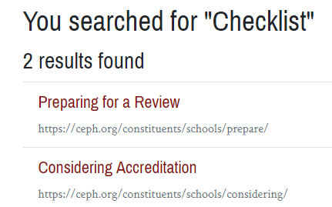
Resources: Prospective Applicant Checklist
1
2
3
Notes:
Two important resources that I want to make you aware of are our Prospective Applicant Checklist and the strength of our website’s search function. We will use the search function to find the checklist. Simply type checklist into the search bar, and you will get two results. Click on the second result, considering accreditation, and a list of resources will pop up. If you navigate to the third option, it will provide you with a link to download the checklist.
A note about our search function—it is very sophisticated and a great place to begin if you need help finding what you are looking for. Simply type a keyword into the search bar and you should get where you need to go!

Slide 6
Notes:
This is the first page of the checklist—it includes a custom timeline to help you determine the best time to submit your IAS to CEPH. You will be working closely with the Director of Accreditation Services ( Kristen Varol). You should view her as a resource for any questions you may have.

Slide 7
Minimum qualifications
Institutional Accreditation
MPH (or equivalent)
Schools of Public Health should contact CEPH for individualized guidance
Notes:
Minimum qualifications include institutional accreditation and
Offering an MPH or equivalent professional public health master’s degree. You may offer additional public health degrees such as those at the bachelor’s and/or doctoral levels
International institutions: please contact staff for additional information on minimum qualifications
Schools have additional minimum qualifications that we won’t cover here. Contact CEPH individually for one-on-one consultation

Slide 8
Application timeline
Review Checklist
Download and prepare IAS
Mail check to CEPH ($1,000)
Email IAS to CEPH
Begin draft and review process with CEPH
(~2-3 rounds)
IAS submitted to Council meeting
Council decision
Notes:
Here is a very boiled down timeline of the steps from now until you receive a decision on your application from the Council. First, we ask that you carefully review the checklist and download the IAS template. You will then prepare your IAS, and when you determine that it is in good shape, you will mail a check for $1,000 to the CEPH office. You will then email the first draft of your IAS to CEPH staff and an iterative process begins.
In the next few slides, we will talk more in depth about these stages.

Slide 9
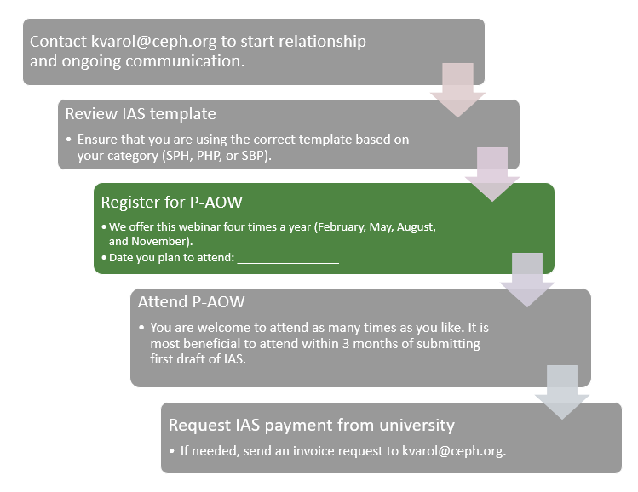
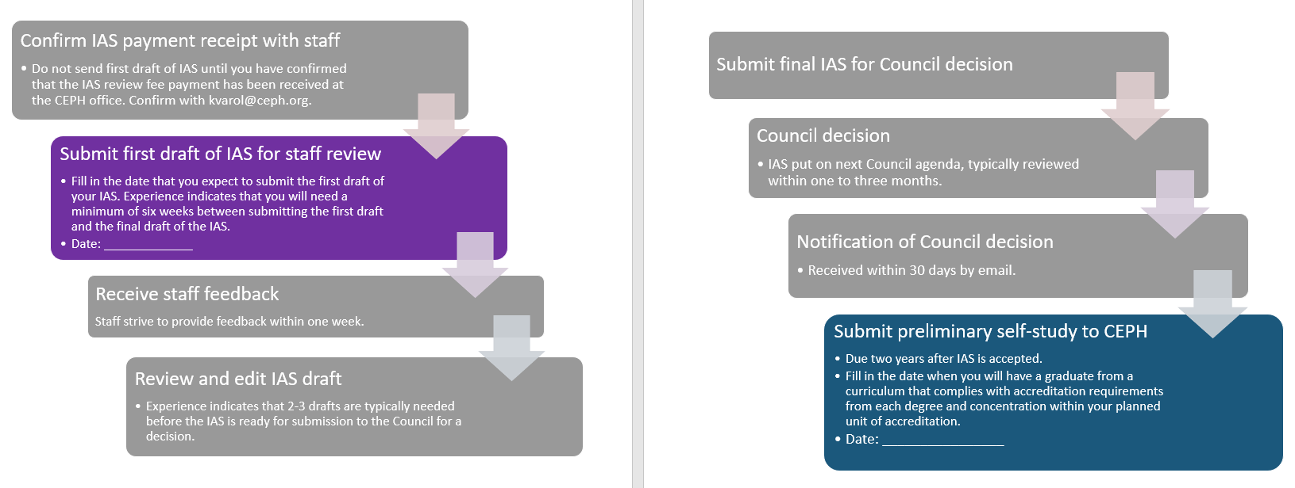
Notes:
This is the timeline from the last page of the of the checklist. The colored boxes are places where you will need to insert dates to determine your specific timing. The checklist has detailed information to help you figure out these dates and we recommend contacting Kristen, to help work through your individual timeline.

Slide 10
Eligibility requirements
Must offer an accreditable curriculum
Degree length
Applied practice experience (APE)
Integrative learning experience (ILE)
Competencies
Must have at least one graduate from each concentration by time prelim self-study is due
Notes:
In addition to meeting the minimum qualifications that we covered earlier, submission of an IAS also requires planning for some basic eligibility requirements.
A program must offer an accreditable curriculum, meaning that MPH degrees must be at least 42 credits and DrPH degrees must be at least 36 post-master’s credits. All MPH and DrPH curricula must offer an applied practice experience and an integrative learning experience. Lastly, the curriculum must be based on foundational and concentration competencies.
A second important eligibility requirement is that there must be at least one graduate from each concentration within two years of Council acceptance of the IAS. This may impact the timing of an IAS submission and often does. It is important to keep this requirement in mind and contact CEPH staff if you have any questions.

Slide 11
Cost expectations
Initial review fee is $1,000
To be submitted before the 1st draft of your IAS
As accreditation process unfolds, expect invoices at the beginning of each calendar year
Fee schedule available online
Notes:
Before you submit your IAS, you must pay the initial review fee of $1,000 and confirm receipt with CEPH staff. Please note that this process often takes longer than you anticipate, so please plan ahead to ensure that CEPH has received the payment by the time you want to send your first draft for review.
CEPH only accepts checks for the IAS review fee and annual invoices (such as for the applicant fee).
We are happy to answer any specific financial questions one-on-one.

Slide 12
Walk through the Initial Application Submission (IAS)
Notes:
Now it’s time to walk through the Initial Application Submission, otherwise known as the IAS

Slide 13
1. Instructional matrix
Notes:
Item 1 is the instructional matrix. This is where you will list all of the degrees that you are seeking accreditation for, and it is how we establish the unit of accreditation. If you have any questions about what should be included, please feel free to reach out and we’ll be happy to walk you through how to fill out the table.

Slide 14
2. Statement of institutional accreditation
Notes:
The second requirement is the statement of institutional accreditation. For those programs based in the United States, this is a very straightforward request where you will populate the information noted in blue. If you are located outside of the United States, you’ll work with staff to identify the necessary information.

Slide 15
3. Guiding Statements and Evaluation Practices
Notes:
Item 3 addresses the guiding statements and evaluation practices. For the guiding statement, you must provide the program’s vision, mission, and goals. Remember that the vision should be outwardly-focused while the mission defines what you plan to accomplish internally.

Slide 16
3. Guiding statements & evaluation practices
Notes:
This table is intended to provide your program with information that allows you to determine your effectiveness in advancing your mission and goals. For the IAS, you’ll be completing a simplified version of the full template. We’ll talk through a few more specifics about how to populate the cells in an upcoming slide.

Slide 17
General principles of guiding statements
Mission and goals must address research, service, and instruction
Goals must relate to program’s mission
Evaluation measures allow the program to determine effectiveness in advancing goals
Evaluation measures do not need a target (or a verb)
Define areas of interest, strength within the program
Notes:
Guiding statements are an important component of the IAS, and ideally there should be a common thread that connects your guiding statements from the vision to the mission to the goals and ultimately to the evaluation measures. For the measures that you need to write on your own, keep in mind that we are not looking for a target or a SMART objective and these program-defined measures should address the program’s unique context that isn’t already captured by the CEPH-defined measures.

Slide 18
Example
Measures | Data source & method of analysis | Who has review & decision-making responsibility? | Does it measure Goal 1? | Does it measure Goal 2? | Does it measure Goal 3?
Use of media platforms in course assignments | Syllabi Program director reviews syllabi for course assignments that require students to use some type of media platform. Summarized in a document | Program director reviews with full faculty every year at the faculty retreat | X
Disciplinary perspectives represented by program faculty | Faculty survey Program director collects responses to annual survey (administered in December) and creates a summary that is shared with the Steering Committee at its March meeting | MPH Steering Committee | X | X
Student enrollment | The program director updates a registrar-provided list every October and March to ensure that it reflects the actual activity of each student. The program director and department chair meet in April to review enrollment and make projections for future years. | Program director and department chair
Student AND faculty (staff, if applicable) perceptions of unit’s climate regarding diversity & cultural competence | Annual student & faculty survey Program coordinator administers annual survey of both faculty and students and compiles results by indicator. Responses include both quantitative and qualitative feedback. MPH Program Operations Committee reviews data at its planning meeting for the upcoming academic year. | MPH Program Operations Committee | X | X | X
Notes:
This is an example of how to populate the table we looked at previously. This table needs to tell us how you use evaluation data. For example, Where do the data come from? Who collects it? How is it presented for decision making? Who has final decision-making authority? Which of the goals does each measure support? I previously mentioned that this is a simplified version of the full table. For the IAS, you must present at least six measures total, at least three of the measures must be program-defined (as opposed to CEPH-defined), and each goal must be supported by at least one program-defined measure.

Slide 19
4. Degree requirements
Notes:
For item 4, list the required courses for each degree. If your program includes multiple MPH or DrPH concentrations, there is a version of this template that you will use in place of what you see on the screen.

Slide 20
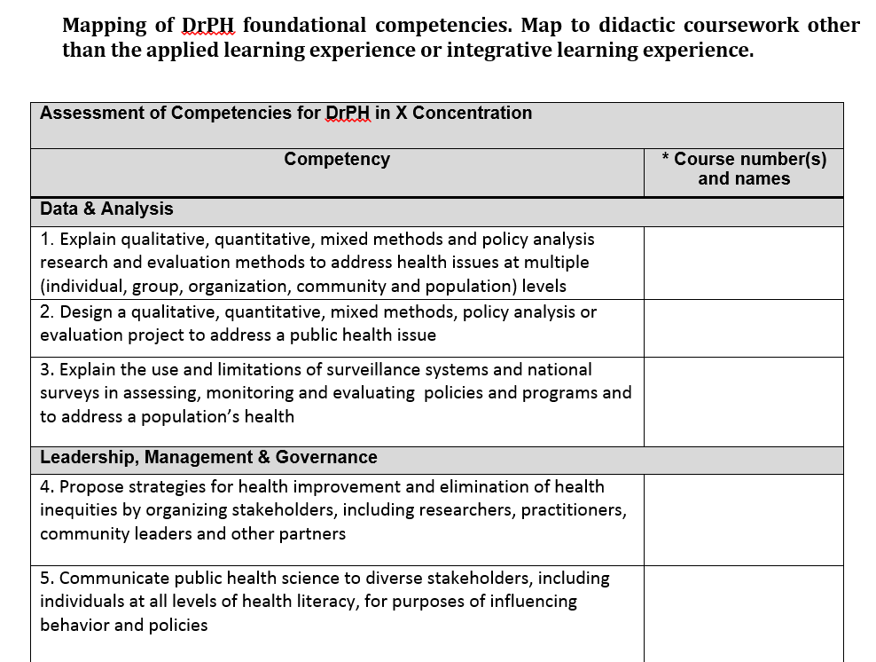
5. Foundational curriculum mapping
Notes:
For MPH degrees, the program must map course names and numbers to the 22 foundational competencies. You are also expected to attach all syllabi mentioned in the table in Appendix A of the IAS. (click)
For programs that offer a DrPH, foundational competency mapping is also required for the DrPH competencies. Again, we are just looking for the course names and numbers along with all relevant syllabi.

Slide 21
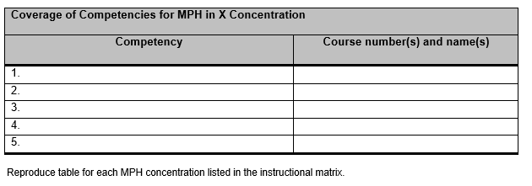
6. Concentration competencies
Required for all public health degrees
MPH, DrPH, MS, PhD, MSPH, etc.
At least 5 distinct competencies for MPH and DrPH
Reflective of degree level
Must not overlap with foundational competencies
Notes:
Concentration competencies are required for all graduate-level public health degrees. If it is a public health degree at the master’s or doctoral level, it must have concentration competencies whether it is an MPH, a DrPH, an MS, or a PhD.

Slide 22
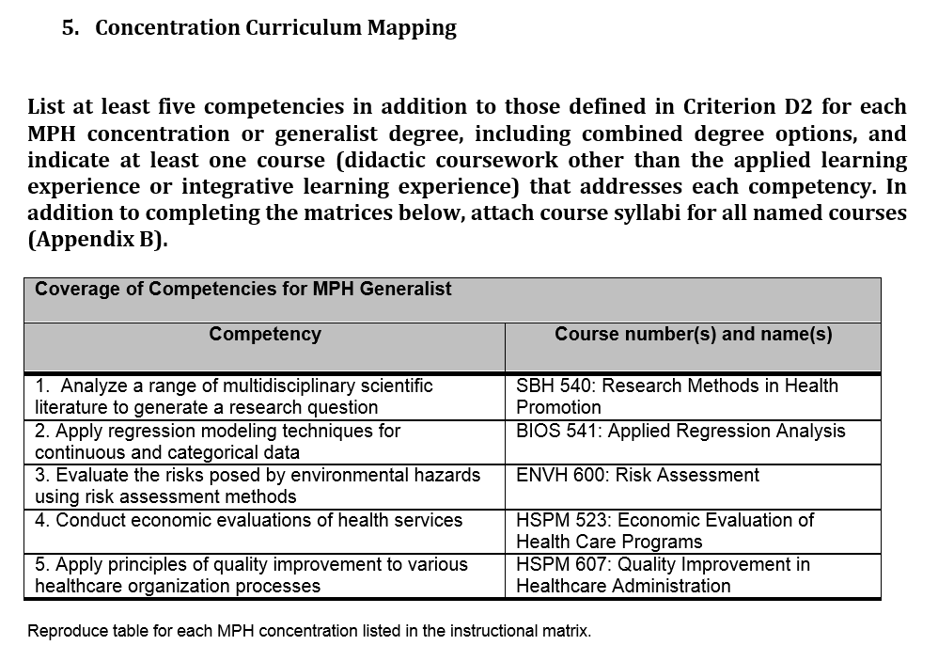
Example: MPH generalist
Notes:
Yes, even generalist degrees need a set of distinct concentration competencies! Here you see an example set of five competencies for an MPH generalist that are either more advanced than or distinct from any of the foundational MPH competencies.

Slide 23
7. Student enrollment
Notes:
Item 7 is student enrollment. Complete the table with the projected student enrollment for each of the next three years by degree and concentration offered. Add additional tables for each degree included in the unit of accreditation. In addition to the numbers, we also ask that you provide additional narrative or supplemental tables to support your enrollment projections.

Slide 24
8. Faculty resources
For programs:
Primary instructional faculty (PIF) must
be employed at the university full-time
dedicate at least 0.5 FTE to the program
provide regular instruction in unit of accreditation
Notes:
Item 8 is faculty resources. Programs must employ, at a minimum, 3 primary instructional faculty members. A primary instructional faculty member, otherwise known as a PIF, must [state 3-part definition]
Additional faculty resources may be required based on the degrees and concentrations included in your unit of accreditation.

Slide 25
Faculty resources table
 | FIRST DEGREE LEVEL |  |  | SECOND DEGREE LEVEL | THIRD DEGREE LEVEL | ADDITIONAL FACULTY
CONCENTRATION | PIF 1 | PIF 2 | PIF 3 | PIF 4 | PIF 5
Health Policy & Mgmt | Luzzi 0.75 | O’Connell 0.50 | Albers 0.50 | N/A | N/A | PIF: 1 Non-PIF: 4
MPH
 | FIRST DEGREE LEVEL |  |  | SECOND DEGREE LEVEL | THIRD DEGREE LEVEL | ADDITIONAL FACULTY
CONCENTRATION | PIF 1 | PIF 2 | FACULTY 3 | PIF 4 | PIF 5
Health Policy & Mgmt | Luzzi 0.75 | O’Connell 1.0 | Williams 0.40 | N/A | N/A | PIF: 0 Non-PIF: 2
MPH
Health Promotion | O’Connell 1.0 | Varol 0.75 | Konner 0.50 | Bazzi 1.0 | N/A | PIF: 1 Non-PIF: 0
MPH, BSPH
PHPs must have at least 3 PIF – and more may be needed based on offerings
Different tables for single concentration vs. multi-concentration units
Notes:
You’ll notice when you complete the faculty resources table that each concentration must have at least 3 named faculty members. This is a table that often creates confusion for programs, so again, we will encourage you to reach out if you have any questions about how to complete this table correctly.
Many programs submit a first draft of the IAS before the minimum faculty are in place – the Council is unlikely to accept an IAS until the faculty are more finalized

Slide 26
9. Graduation rates
Must have a graduate from each public health concentration by time prelim self-study is due
Establish maximum time to graduate (in years)
Record by degree type
Think in cohorts
Institutional research may not give the best/right data
Notes:
Item 9 is graduation rates. First you must establish a maximum time to graduate. How long does a student have to complete the public health degree? This is typically defined by your institution, but if not, you will need to set a maximum allowable time.
Then, you will collect and record data by degree type (MPH vs MS or PhD vs DrPH). Although it may be useful to separate the data by concentration for your internal purposes, you must report it by degree to CEPH.
Think about tracking students in cohorts and follow that cohort from the time of enrollment until the end of the max time to graduate. Note that even if your students do not move through the program as a defined cohort on the same timeline, CEPH considers all students who start in a given year to be part of the same cohort because they have the same maximum allowable time to graduate.
Also note that while data from your institutional research center (or a similar office) may be available, it often does not provide the information needed for CEPH’s graduation rate requirement. In many cases, the programs that we work with have found that they need to manually track their own students to ensure that the data are in the format needed for accreditation.

Slide 27
Reporting graduation rates in the IAS
MPH | Maximum Time to Graduate: 5 years
Cohort of Students | 2015-16 | 2016-17 | 2017-18 | 2018-19 | 2019-20
# Students starting | 9 | 14 | 24 | 36 | 45
# Students withdrew, dropped, transferred out of unit of accreditation etc. | 1 | 3 | 3 | 5 | 3
# Students graduated | 8 | 11 | 21 | 3 | 0
# Students continuing | 0 | 0 | 0 | 28 | 42
Graduation rate (# graduated/ # starting) | 89% | 79% | 88% | 8% | 0%
*MTTG: maximum time to graduate
Provide data based on the MTTG (e.g., if MTTG is 5 years, provide the most recent 5 years of data or provide all data if no student has reached MTTG
Notes:
This table is how you report graduation rates in the IAS. A really important concept is that you must track students down the column of the table, and no individual student should be counted in more than one column. So if you have a maximum allowable time to graduation of 5 years, you will report up to five years of data, which is based on the entering cohorts of students over the last 5 years. If your program has existed for fewer years than your max time to graduate, then you will provide information for each year that your program has been in operation and student progress to date – even if students haven’t graduated or reached the max time yet.

Slide 28
10. Institutional commitment & fiscal support
Notes:
Item 10 is where you show evidence of institutional commitment and fiscal support. You’ll want to briefly describe the resources available to the program. And this really should be brief – just a few paragraphs is sufficient. If you’re exceeding a page, you’re probably writing too much.

Slide 29
CEPH.org
FAQs
Webinar recordings
Upcoming events
Email kvarol@ceph.org
Notes:
The resources available on our website include multiple FAQ documents, access to previous webinar recordings as well as advertisements of any upcoming events. My email address is also provided because I am the staff contact for all units pursuing initial accreditation.

Slide 30
Reminder!
Download the checklist
Download the IAS template & sample
Notes:
Now that we’ve gone through the steps of the IAS process, this is a reminder to 1) download the checklist and 2) download the IAS template and completed sample of the IAS.

Slide 31
Next step: register for Part B
https://ceph.org/about/dates-to-remember/paow/
Notes:
You have now completed P-AOW Part A, and your next step is to register for Part B at the website shown on the slide. After you register for the webinar, we will send you a link to access the slides. During this recorded presentation, we walk through more specific examples related to the IAS and common questions that we receive during the IAS preparation process. You can find registration information on our dates to remember page. Thank you for listening to this webinar, and we look forward to supporting you through all your accreditation efforts.

