Slide 1
CEPH overview

Slide 2
Characteristics of accreditation
Published standards
Self-evaluation against the standards
Peer review (on site)
Accreditation decision
Publication of decision
Ongoing monitoring & re-evaluation
Accreditation serves a public purpose

Slide 3
An overview of credentialing
Credentialing
Institutions
Individuals
Accreditation
Certification
Licensure
Registration
Hospitals
Health Departments
Academic Programs
Health Education Specialists (CHES)
Public Health (CPH)
Nurses
Physicians
Social Workers
Sanitarians/
Environmental Health Specialists
Dietitians

Slide 4
Credentialing in public health
Accreditation
Council on Education for Public Health
Public Health Accreditation Board
Certification
Certified Health Education Specialist
National Board of Public Health Examiners

Slide 5
Organizations you may hear about...

Slide 6
Guiding statements
Mission: CEPH assures quality in public health education and training to achieve excellence in practice, research and service, through collaboration with organizational and community partners.
Objectives:
To promote quality in public health education through a continuing process of self-evaluation by the schools and programs that seek accreditation;
To assure the public that institutions offering graduate instruction in public health have been evaluated and judged to meet standards essential for the conduct of such educational programs; and
To encourage - through periodic review, consultation, research, publications and other means - improvements in the quality of education for public health.

Slide 7
CEPH background
Established in 1974 jointly by APHA & ASPH (now ASPPH)
Private, non-profit corporation
14 member decision-making body (Councilors)
~10 staff members
~100 trained peer reviewers (site visitors)
Recognized by the US Department of Education

Slide 8
CEPH: vital statistics
Accredit 200+ total units
~50 units are currently applicants
Accredit in nearly all US States, DC & PR
Accredit outside US (< 10 units)

Slide 9
CEPH jargon: “unit of accreditation”
SBP = standalone baccalaureate program
PHP = public health program
SPH = school of public health

Slide 10
SBP
Bachelor’s only
PHP
MPH only
SPH
MPH + doctoral
MPH + bach + doctoral
MPH + MS
MPH + doctoral + MS
MPH + doctoral + MS + bach
Any combination above + all non-PH degrees housed in SPH
MPH + MS + doctoral
MPH + MS + bach + doctoral
MPH + doctoral + bach
MPH + bach
MPH + doctoral
MPH + MS + bach

Slide 11
People
Documents
Staff
Criteria
Council
Procedures
Site visitors

Slide 12
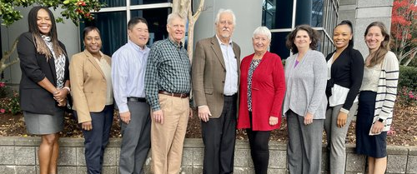
The council

Slide 13
CEPH Staff

Slide 14
Who makes decisions?
Council, acting in official role, has sole authority to make decisions
Staff/site visitors may not make any accreditation decisions!

Slide 15
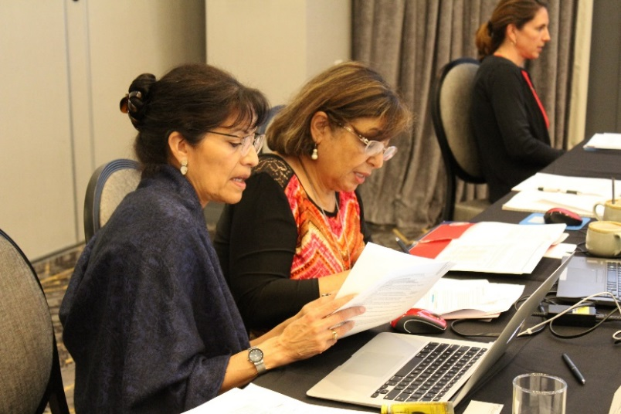
Council activities
4 decision-making meetings per year
Executive Committee meetings/conference calls throughout year

Slide 16
Documents
SBP Criteria
PHP & SPH Criteria
Procedures

Slide 17
Criteria: What do I need to do?
Accreditation Criteria for Schools and Programs of Public Health
Accreditation Criteria for Standalone Baccalaureate Programs

Slide 18
Procedures: How do I do it?

Slide 19
Major steps and milestones
Initial application submission (IAS)
Preliminary self-study document
Final self-study document
Site visit
Report
Response
Accreditation decision
3 years

Slide 20
Resources
CEPH staff are happy to help with questions large & small!
submissions@ceph.org
Sign up for weekly Happenings emails
New resources & announcements regularly at ceph.org

