Slide 1
MPH/DrPH Curriculum Webinar
Update on results, trends, and highlights of best practices
April 2020

Slide 2
All participants will be muted. So if you have a question, enter it here!
CEPH staff will see it and will read and answer questions live at the end of the presentation!

Slide 3
Continuing education
Up to 1.0 CPH recertification credit may be earned at this event

Slide 5
Today’s topics...
Criterion D1/D2 compliance
Criterion D3 compliance
MPH competency examples
DrPH competency examples
Curricular trends
Other parts of the curriculum

Slide 6
Available data on curriculum
43 units have completed full reviews (s-s & sv)
17* were initial accreditation visits
138 units completed compliance reporting
*Includes 3 transitions from program to school

Slide 7
How are units doing on D2 & D3?
After full review
After compliance report
47% with some outstanding issues
57% with some outstanding issues
***On average, only 3 competencies outstanding!***

Slide 8
Criterion D1: Foundational Knowledge
We are at 99% compliance with this criterion
This Photo by Unknown Author is licensed under CC BY-NC-ND

Slide 9
D2: MPH foundational competencies
Remaining 8 that are <97%
3. Analyze quant & qual data using software
10. Explain basic principles and tools of budget and resource mgmt.
12. Discuss multiple dimensions of policy-making process
16. Apply principles of leadership
17. Apply negotiation and mediation skills
19. Communicate audience-appropriate content, both in writing and through oral presentation
21. Interprofessional teams
22. Apply systems thinking

Slide 10
D3: DrPH foundational competencies
Remaining 3 that are <96%
8. Facilitate shared decision making through negotiation and consensus building methods
18. Assess an audience’s knowledge and learning needs
19. Deliver training or education experiences that promote learning in academic, organizational or community settings

Slide 11
Moving from CNV to Yes
Strong examples of assessments and documentation

Slide 12
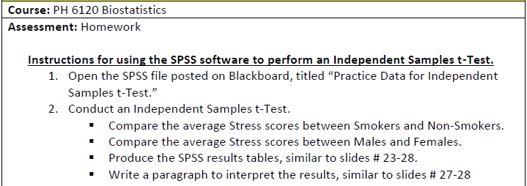
MPH #3: Analyze quant. & qual. data
Hawaii Pacific University

Slide 13
MPH #10: Budget & resource mgmt
Southern Illinois University, Carbondale

Slide 15
MPH #12: Policy-making process
University of Montana

Slide 16
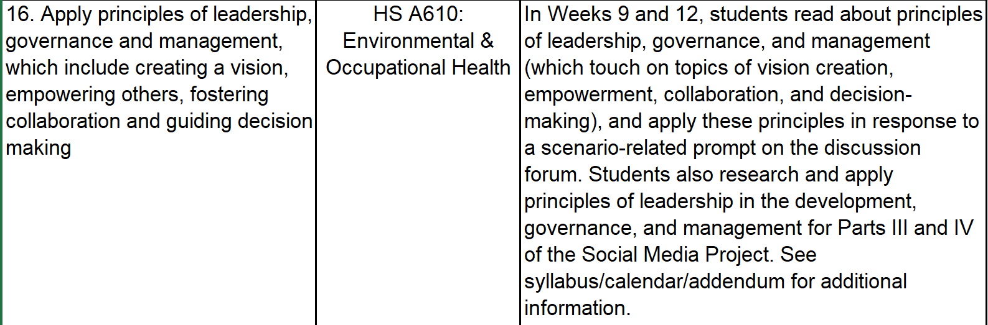
MPH #16: Leadership, governance, management
University of Alaska, Anchorage

Slide 18
MPH #16: Leadership, governance, management
EXCERPT FROM SYLLABUS:
Part III: Putting it Together and Planning for Action
What leadership skills will be necessary to appropriately and effectively manage your social media campaign?
Part IV: Launce and Monitor
Regularly monitor your campaign, and apply your previously researched leadership skills to provide appropriate responses in the role of a public health practitioner and advocate (again, utilizing social media management guidance, which will be provided).
University of Alaska, Anchorage

Slide 19
MPH #17: Negotiation & mediation
SUNY Downstate

Slide 20
MPH #19: Communicate appropriately
National Taiwan University

Slide 21
MPH # 21: Interprofessional practice
Nova Southeastern University

Slide 25
MPH #22: Systems thinking tools
University of Virginia

Slide 26
Class 8 – October 23rd: Systems Thinking
“Systems Thinking” definitions, concepts and methods
Peter Senge’s “Fifth Discipline and the Learning Organization”
Importance for Public Health
Discuss cases and examples
Assignments:
Case Study 2: “Ledina Lushko: Navigating Health Care Delivery,” Harvard Business School, 2010 (Student team leads discussion)
Judge, “Organizational Capacity for Change Dimension 5: Systems Thinking,” Harvard Business Publishing, 2011
Peters, “The application of systems thinking in health: why use systems thinking?” Health Research Policy and Systems, 2014 (In Collab)
Foundational Competency:
This session describes, applies and uses concepts and models of systems thinking, using a class exercise applying to a public health problem (#22).
Excerpt from
7470 Syllabus

Slide 27
7470 Midterm Exam Q2 (University of Virginia)

Slide 28
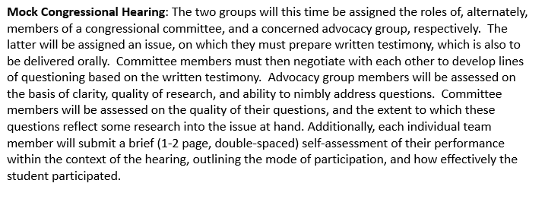
DrPH – 8: Facilitate shared decision making through negotiation and consensus-building methods
SUNY -Downstate

Slide 29
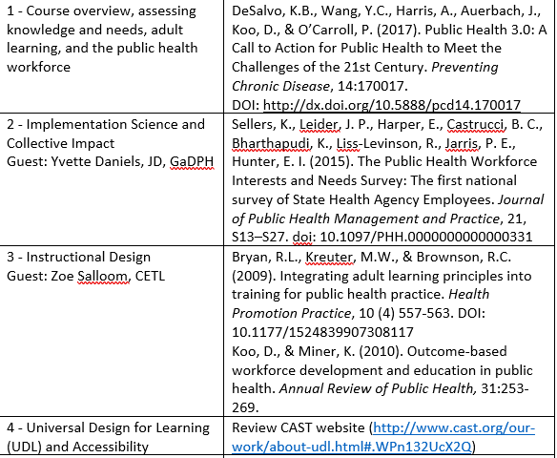
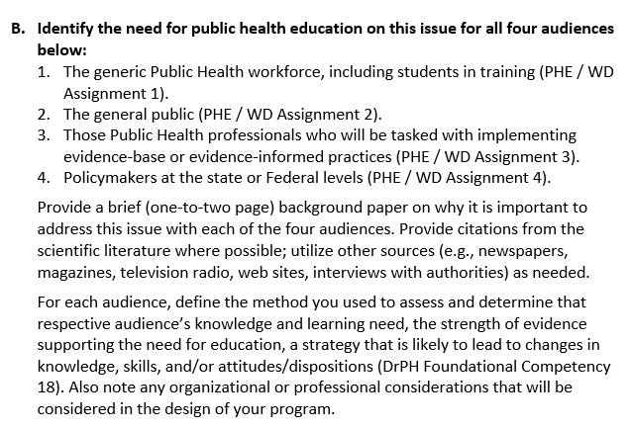
DrPH – 18: Assess an audience’s knowledge and learning needs
Georgia State University

Slide 30
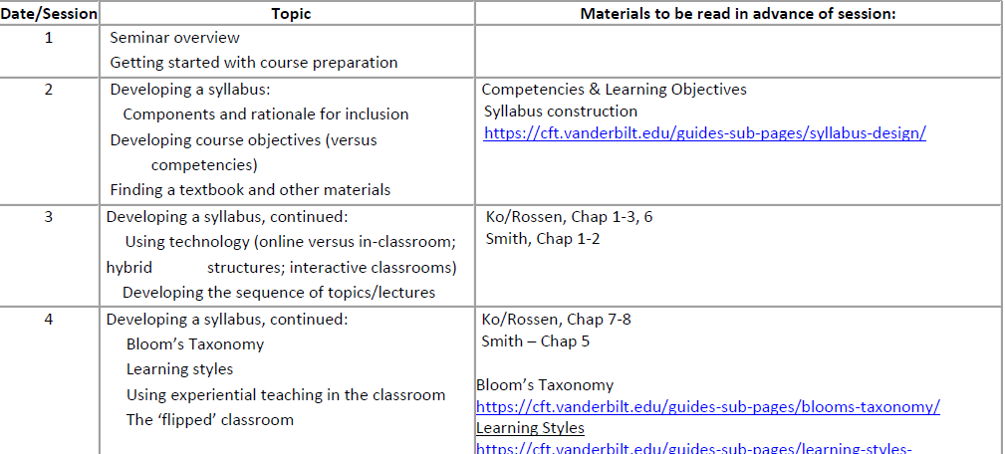
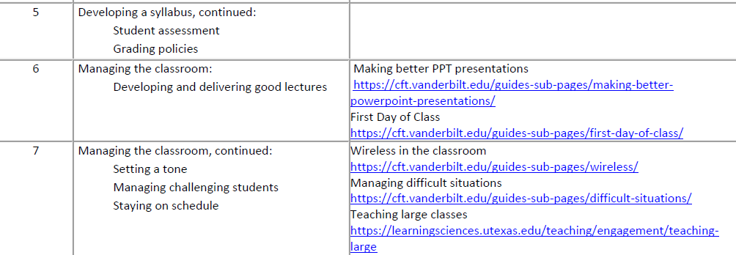
DrPH – 19: Deliver training or education experiences that promote learning in academic, organizational, or community settings
University of Arkansas School of Medical Sciences

Slide 32
Trends in MPH foundational curriculum

Slide 33
Curricular structure: categories
Traditional
Discrete courses in all 5 former core areas
Plus an intro course, if applicable
Add/adjust
At least 3 discrete courses in former core areas
Interdisciplinary/new
2 or fewer discrete courses in former core areas

Slide 34
 | All units N=180 | SPH N=58 | PHP N=122
Traditional | 4% | 3% | 4%
Add/adjust | 84% | 66% | 93%
Interdisciplinary/new | 12% | 31% | 3%

Slide 35
Add/adjust nuance: PHP overrepresentation?
~33% units in overall sample are PHPs offering single concentration
97% of these are add/adjust

Slide 36
What do add/adjust curricula look like?
7-10 courses total to address D1 & D2
3-5 of these in former core disciplines

Slide 37
Added courses in…
Program planning, eval | 48%
Intro to PH | 45%
Research methods | 40%
Health equity, priority populations* | 15%
PH law, ethics | 13%
Communication | 12%
PH biology | 9%
*Rural, urban, border health, etc.

Slide 38
What’s being adjusted?
~65% of units in this group require at least 1 course that combines disciplines
Combine former core areas with one another in single course
Combine former core with “new” disciplines in single course

Slide 39
What’s happening to the former core areas?
Discrete course in…
Social behavioral sci* | 96%
Epidemiology | 95%
Biostatistics | 92%
Environmental health | 77%
Health services admin | 68%
Caution!
* Includes prog planning & eval

Slide 40
Interdisciplinary curriculum

Slide 41
Example 1
Administration, supervision & consultation in PH
Research design
Advanced concepts in health behavior
Seminar: epidemiology

Slide 42
Example 2
Foundations of PH
PH leadership & management
Health equity, communication & advocacy
Designing & evaluating PH interventions
Designs, concepts & methods in PH research
Quantitative & qualitative data analysis methods in PH research

Slide 43
Example 3
Thinking in populations:
the PH mindset
Investigation & control:
acute PH Events
Assessment & intervention:
wicked problems in PH
Framing & persuasion:
PH in the public sphere

Slide 45
What do we know about DrPH?
~10 courses for D3
Common course title themes:
Advanced research methods
Strategic planning
Resource management
Leadership
Pedagogy

Slide 46
What about other parts of the curriculum?

Slide 47
Criterion D4: Concentration Competencies (Full reviews)
Average 4 concentrations
Median 3 concentrations

Slide 48
Concentration competencies: Reasons for non-compliant findings

Slide 49
MPH applied practice experience
70% (n=26) compliance from full reviews
Non-compliance due to:
Competency identification or assessment
Nature or # of work products
Good APE plan defined but not yet implemented
2 work products
5 competencies
Mutually beneficial to organization

Slide 50
DrPH applied practice experience
D6
One project
5 competencies
Advanced-level practice experience
Collaboration with practitioners
50% compliance (n=6)
APE plans not yet implemented

Slide 51
MPH integrative learning experience
Foundational competency synthesis
Concentration competency synthesis
High-quality written product
At or near the end of program of study

Slide 52
DrPH integrative learning experience
Field-based product(s)
High-quality writing
Synthesis: foundational & conc
33% compliant (n=6)

Slide 54
Available resources
Accreditation Orientation Workshop in July
Distance-based and in-person consultation visits
Regularly updated FAQs on CEPH website
Upcoming webinars:
https://ceph.org/about/dates-to-remember/#1
submissions@ceph.org

Slide 55
Attendee questions?
Please complete our survey!

